Slide 1
Beyond the Assessment Threats: Positive Uses of Generative AI in Teaching Learning
Prof. Alan F. Smeaton
Dublin City University
Government of Ireland AI Advisory Council

Slide 2
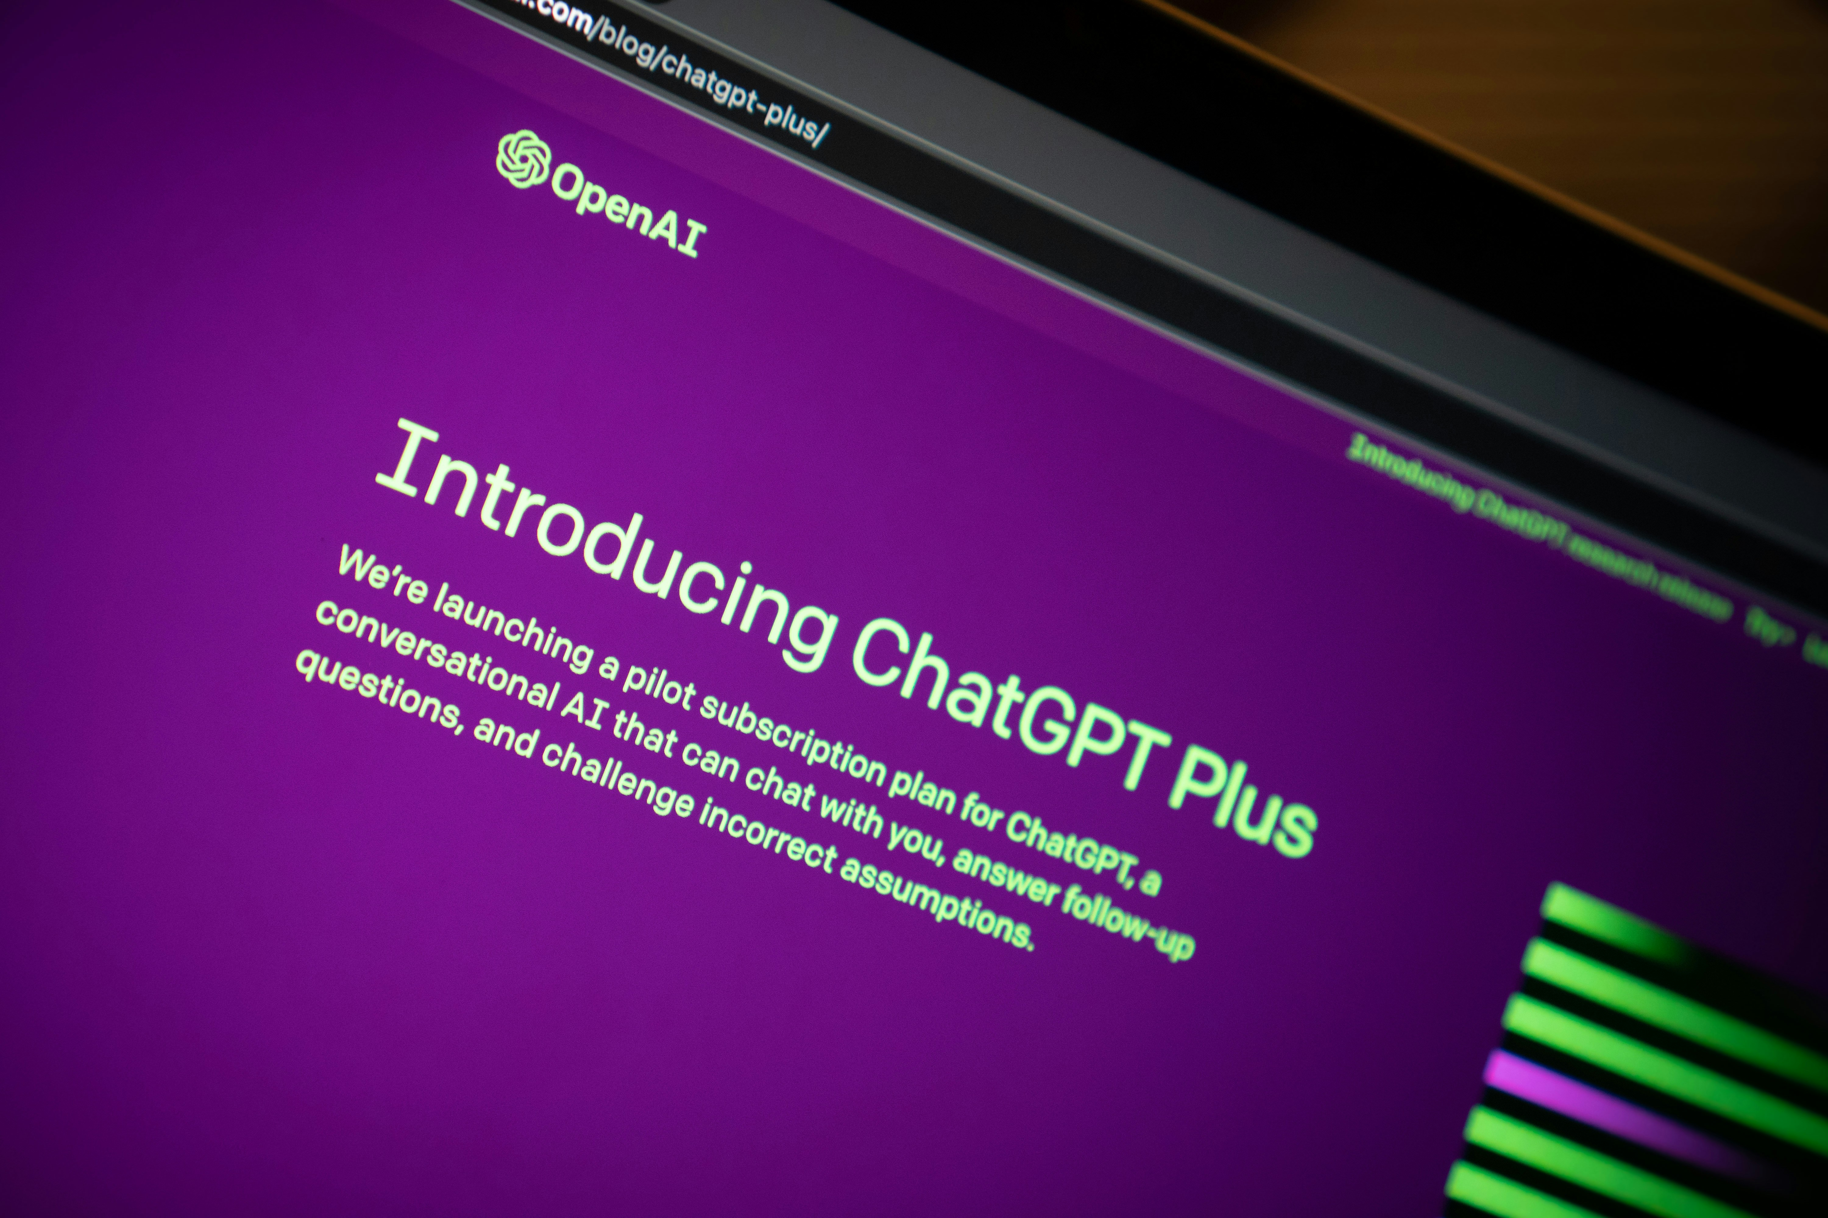
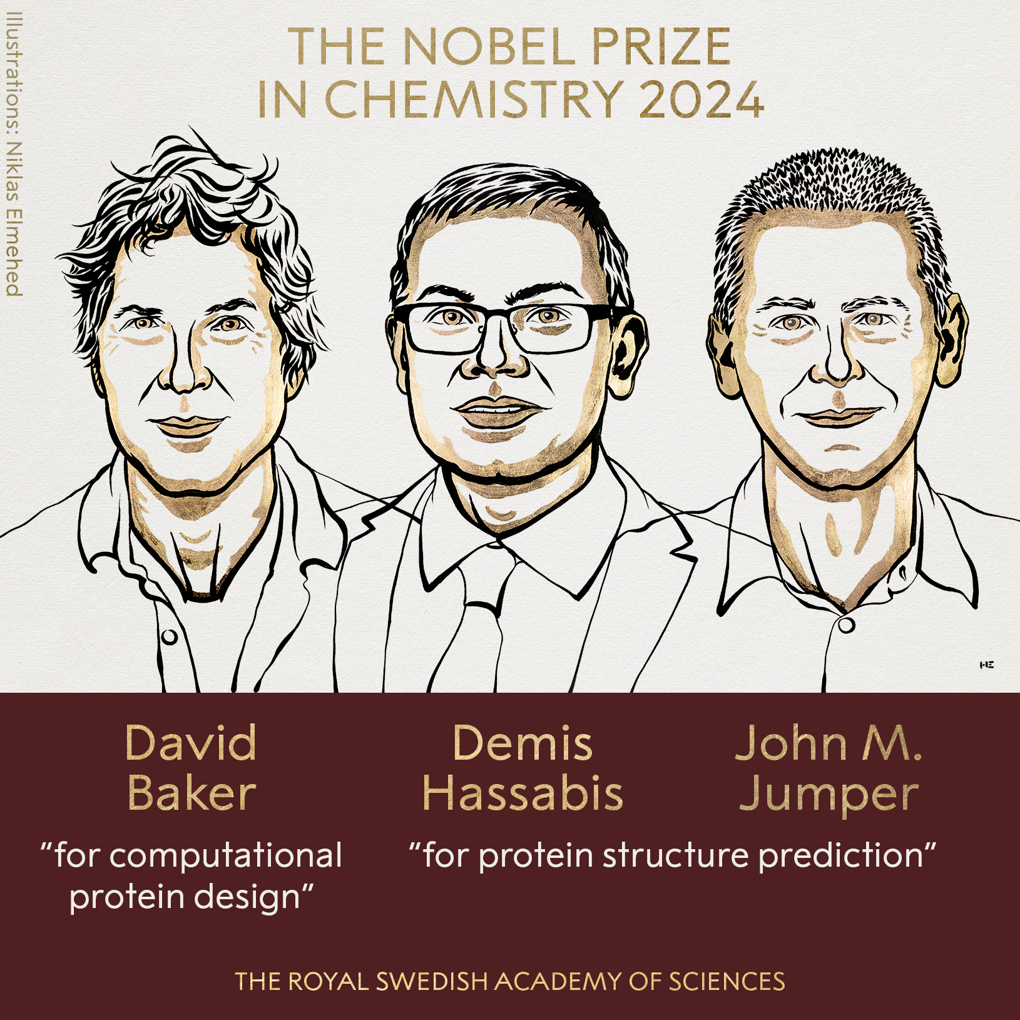
AI is visible, popular, and respectable

Slide 3
The History of AI in 1 slide !
AI, from artisanal handcrafted rules to data-driven
Internet & Google made AI into machine learning
Neural networks became machine learning and was everywhere
Recent Generative AI and embeddings twisted it
For decades AI had been quietly, effectively making things better in healthcare, manufacturing, entertainment

Slide 4
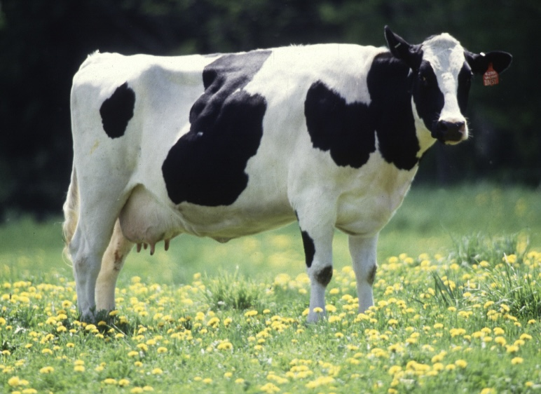
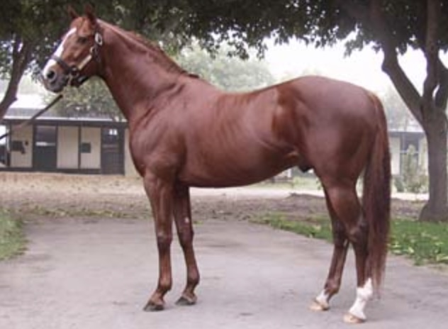
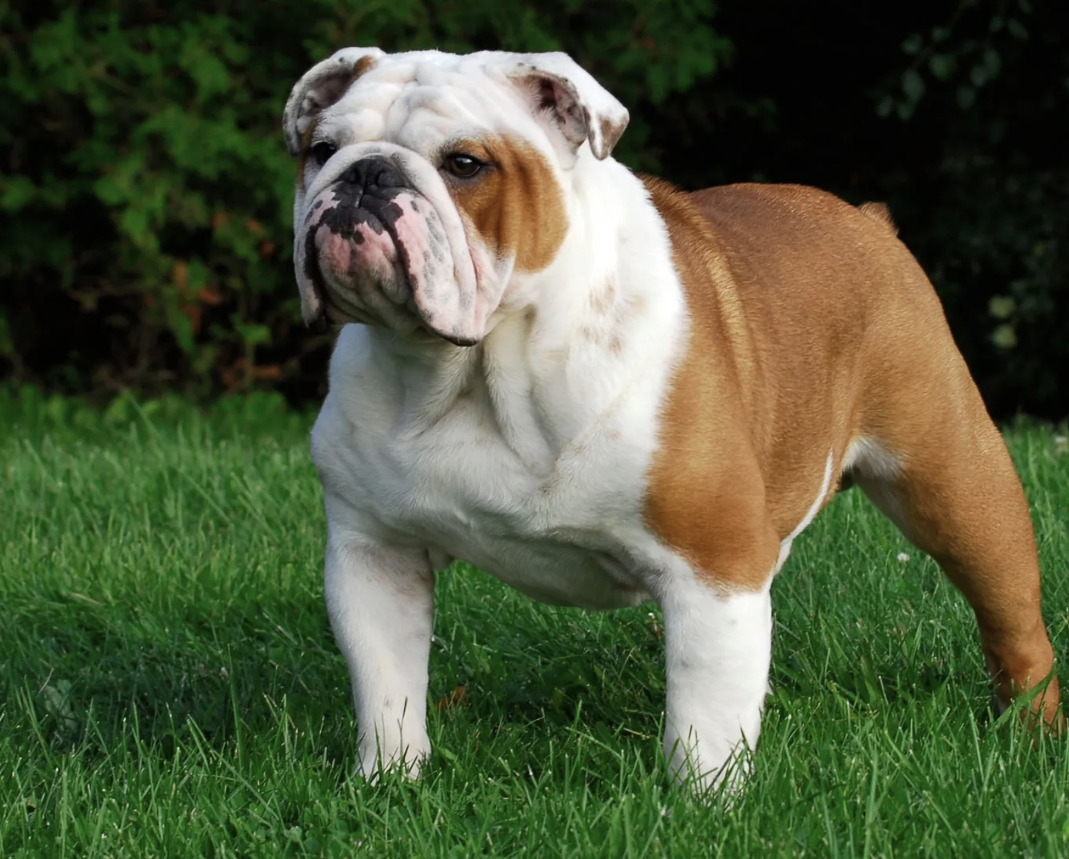
Cat ?

Slide 7
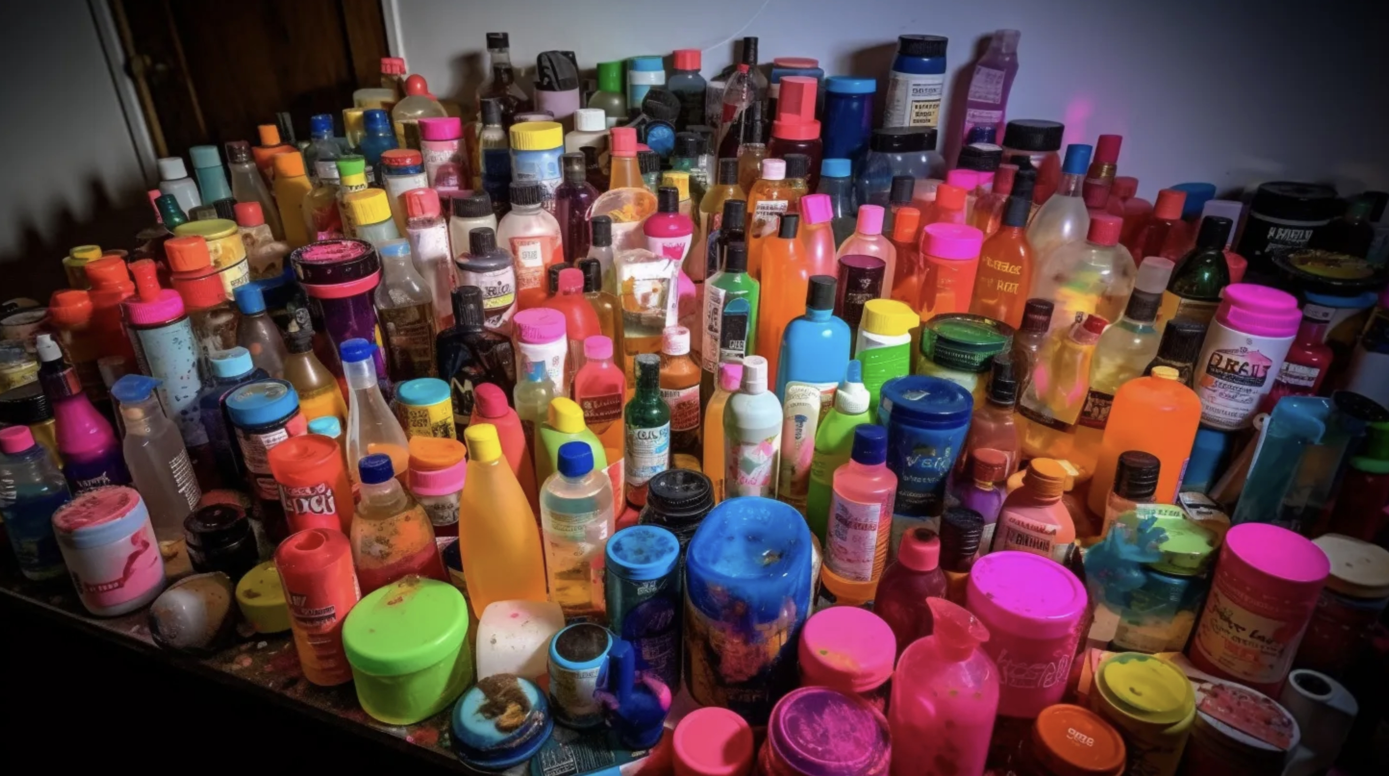
Embeddings
LLMs are models of distributions of any data.
Use large (or small) volumes to train, taking huge computational resources, then cheap to use via prompts and “prompt engineering”.
Used in generative AI, not in AI for classification or for prediction.
Images made with Midjourney

Slide 8
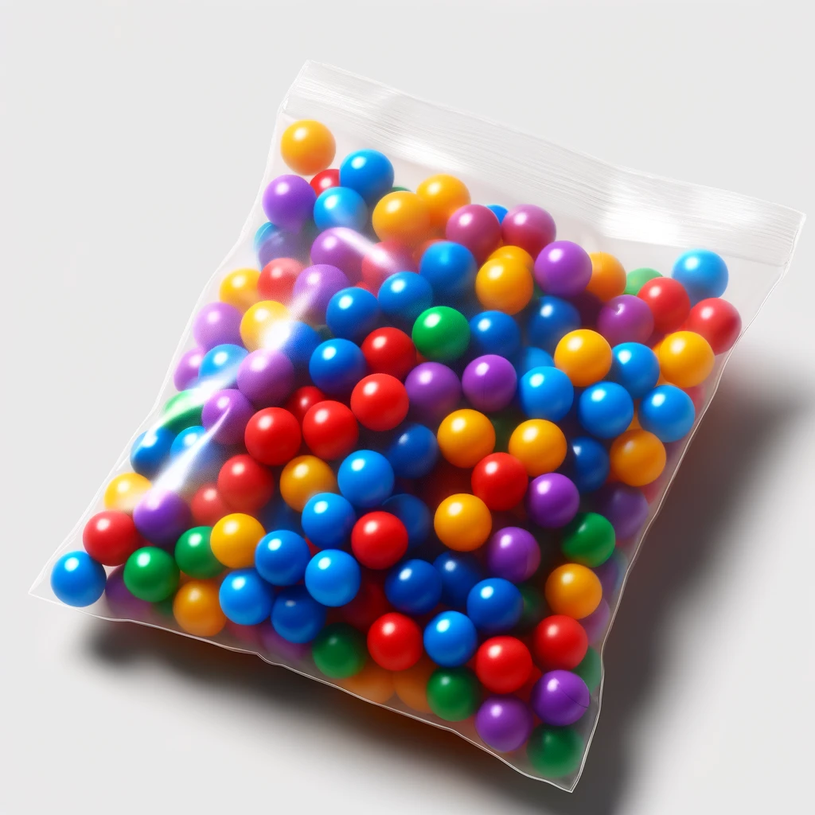
Transformer Architecture
Sequence-to-sequence mapping of each token in training data to an embedding space, while attending to selective long-distance tokens, in parallel.
The table, balls arranged by colour similarity, is the embedding space equivalent.
Creating the arrangement is quadratic computing complexity.

Slide 9
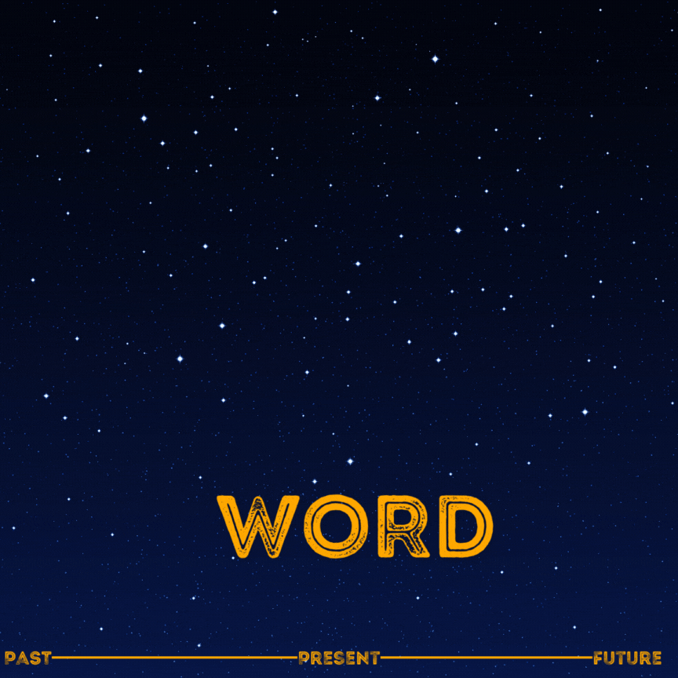
Use previous words to predict likely word sequences into the future.

Slide 10
2.15 x 10^25 using 25,000 GPUs, 50 GWh, cost $63M
2.9 M years on Apple M2)

Slide 11
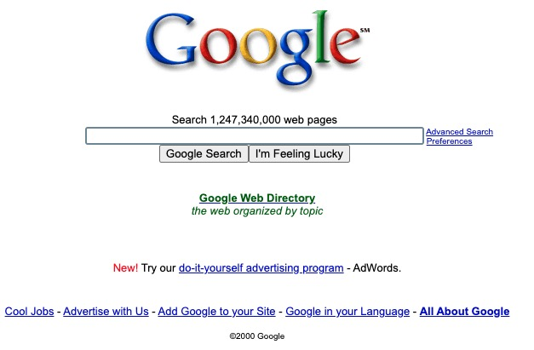
Big Tech LLMs besides OpenAI’s GPT ?
Meta have LLaMA, Google had PaLM (BARD !) and now Gemini, Microsoft (via the flamboyant OpenAI) have GPTs, Naver (Korea) have HyperCLOVA, Samsung have Gauss for mobile, Apple have Ajax and Ferret, Amazon were developing Project Olympus but invested $4B in Anthropic, xAI have GROK, EY have their own called EYQ, Salesforce have XGen, UAE’s TII have Falcon 180B/40B/7.5B/1.3B which are open, as are LLaMA and GROK, and on and on.
Chatbot Arena lists 149 LLMs covering fine tuned, merged, code, quantized, mixture of experts, and more, with benchmark performance scores, sizes, etc.
Anthropic founded 2021 by former OpenAI employees concerned with safety and AI and their LLM claude.ai until recently rated as the “best” answers.
Mistral-7B – French startup – beat LLaMA on some tasks yet is 20% of size, runs on a laptop and is ~187x cheaper to run than GPT4 .. trains using variable size sliding attention windows so it prunes and is efficient.
Some LLMs are open source (LLaMA, Falcon), some are open weights, most are proprietary with free and subscriptions, and multiple sizes.
Llama has been downloaded from Hugging Face +440M times

Slide 12
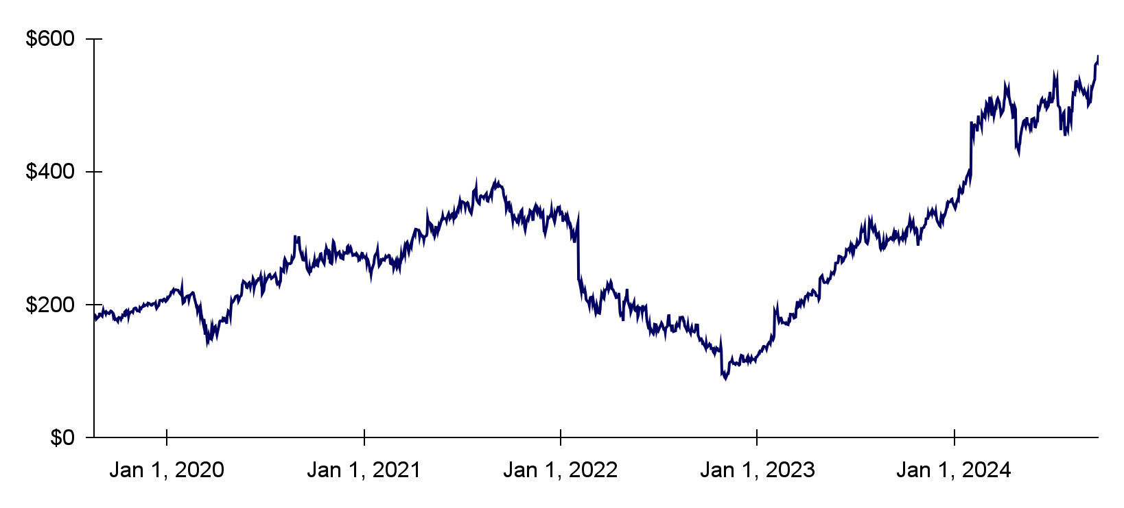
Open Source works for Meta
Meta ditched their substantial metaverse investments and pivoted into open source AI with their Llama models – see what happened to their share price?
1: Oct 28, ‘21: Metaverse investment announced.
7
2: Nov 2022: Major layoffs and metaverse tempering.
6
5
3: Feb 2023: Llama 1.
1
3
4
4: Jul 2023: Llama 2.
5: Apr 2024: Llama 3.
-68.4%
-$601B
+457%
+$1.134T
6: Jul 2024: Llama 3.1 405B.
2
7: Sept 2024: Llama 3.2.
Source: stateof.ai 2024

Slide 13
LLM Training Data – A Dark Side !
Can request to opt out of your data being used to train, but a dark side to scraping to create big tech LLMs.
Sept 2023 Authors Guild of 17x US authors suing OpenAI for “systematic theft on a mass scale”.
Dec 2023 NY Times sued OpenAI and Microsoft for “free-riding on The Times's massive investment in its journalism” having asked nicely in April 2023 for an amicable commercial agreement with guardrails.
Jan 2024 Italy’s DPO formally charges OpenAI of violations of GDPR with potential fine of €20m or 4% global annual revenue.
Feb 2024 Sarah Silverman also sues OpenAI for violating © on her memoir.
March 2024 French Competition Authority fines Google €250m over breaches of copyright law in their training data.
April 2024 8x US newspapers suing OpenAI and Microsoft.
May 2024 Scarlett Johansson forces OpenAI to stop using a voice uncannily like hers in their chat products.
June 2024 non-profit Centre for Investigative Reporting (CIR) sues OpenAI and Microsoft for copyright infringement.
July 2024 Mumsnet launches British legal action against OpenAI.
Aug 2024 OpenAI sued over using YouTube videos without consent.
All jammed up in the court system and likely outcome is licensing will take the sting out of criticisms and the hope is will all “go away”

Slide 14
Hallucinations are “mixed-up” logic The AI butterfly effect !
Singapore hotel near Clark Quay MRT
Cork hotel near Kent railway station
Clarke Kent alias for Superman, associated with railway stations
A railway station has an emergency
No worries, Superman is nearby and will save

Slide 15
How to tailor a LLM / FM for you …
Beyond using an OTS LLM like ChatGPT, Gemini, Copilot or claude.ai with limited contexts, there are 4 ways to provide context for interacting with a LLM / FM … prompt, tune, train or RAG
Prompt engineering: zero programming, use an existing LLM;
Fine-tuning: adjust LLM weights to align with a corpus of documents;
Model building: build and train a model from scratch;
Retrieval Augmented Generation: identify document(s) from a search output and fine-tune (#2) a foundational LLM for this session;

Slide 16
#1 Prompt Engineering
We interact with a trained LLM by querying and traversing, also with inference but called prompt engineering, “mucking around”, or fishing !
Traversing around the huge, unstructured space with a “head” and a “tail” and incrementally and non-deterministically or stochastically synthesising new data sequences.
A long “tail” approach, limited document lengths, prompt “temperature” (0..1) is the lookback + lookahead.
I’ve done this with Heaney poetry (2019), with Oireachtas transcripts (2018), ATC text (2019) .
Photo by Philippe Bout on Unsplash

Slide 17
#2 Fine-tuning LLMs
ChatGPT is an LLM of “everything that ever was on the internet” but LLMs can be fine-tuned.
Here we turn a base (foundational) model into a model specialised for some use case by adjusting it.
This enhances the parametric memory and builds on its logical processing – a good thing - how LLMs will be used.
Requires a foundational / frontier model like GPT-n or any of the others.
Low-Rank Adaptation (LoRA) is a recent method to fine-tune large models such that their generations improve along aspects that the user cares about, such as characters, styles or concepts.

Slide 18
#3 Specialist LLMs ?
The option to pre-train an LLM from scratch using proprietary information is expensive, requires deep expertise, and may fall behind as technology evolves and company data changes.
But there are and will be more, specialist LLMs in domains …
MedAlpaca, a collection of LLaMA models fine-tuned for biomedical tasks using open-sourced biomedical datasets in October 2023 to address privacy concerns.
Legal LLMs focused on legal texts, statutes, case law, and legal documentation – Harvey.AI uses a specialist LLM.
EY have built EYQ, their own LLM, from scratch.
InterCom are building their own LLM (no details).
Financial LLMs: trained on financial reports, market data, economic texts – FLAN-T5.
SEA-LION, an open-source LLM from AI Singapore to represent languages and cultures of southeast Asia.

Slide 19
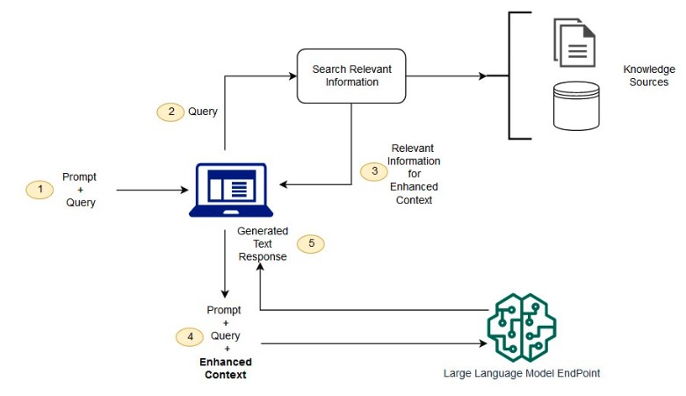
#4 Retrieval Augmented Generation (RAG)
Fine-tune a LLM on-the-fly, at retrieval time .
LLMs usually derive knowledge exclusively from pre-trained (internet/enterprise) text.
RAG dynamically injects knowledge into parametric memory & mitigates some perceived LLM limitations like hallucinations & absence of recency.
Credit: Amazon Web Services blog

Slide 20
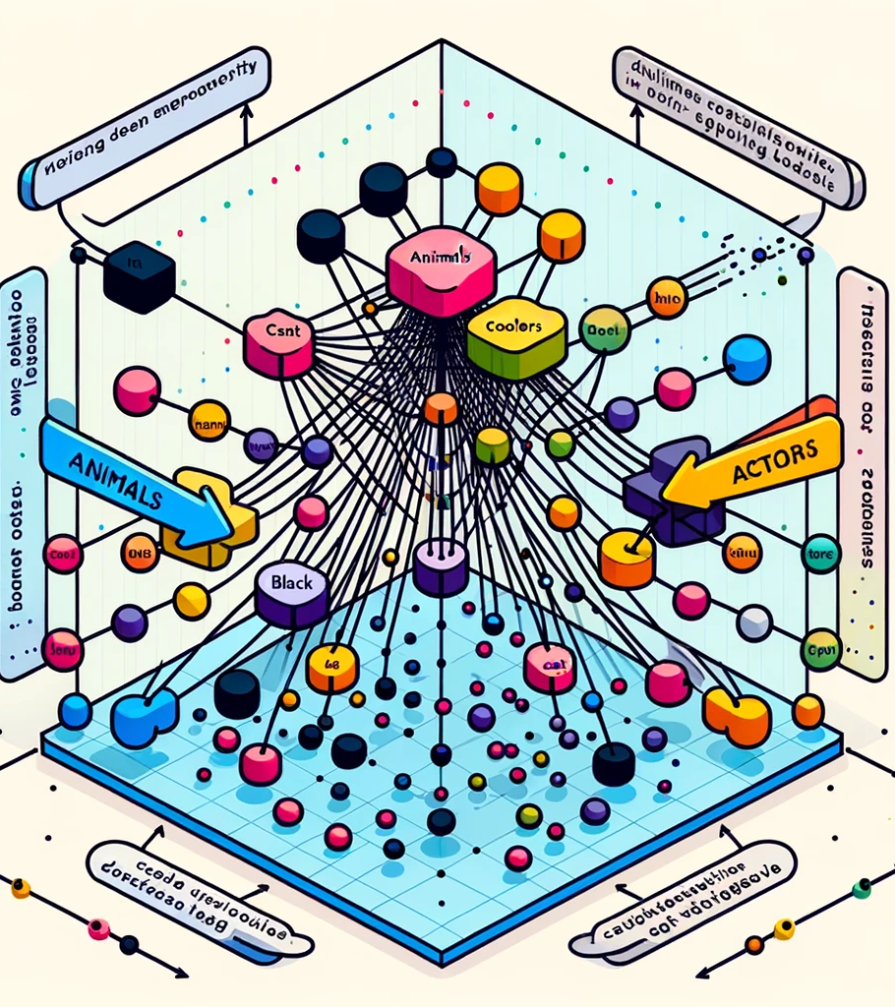
0th
LLM (free)
???
Word Word Word Word Word Word Word ..
😱

Slide 21
1st
LLM (free) +
prompt engineering
???
Word Word Word Word
😱
Instructions

Slide 22
2nd
LLM (paid ?) +
prompt engineering and fine-tuning
???
Word Word Word Word Word …
Instructions

Slide 23
3rd
Specialist LLM
???
Word Word Word Word Word …
Instructions

Slide 24
4th
LLM + RAG
Word Word Word Word …
😱
😱
???

Slide 25
Are we all good with these ?
Prompt engineering
Fine-tuning
Model building
Specialist LLMs
RAG
Hallucinations
Any giveaways that this is generative AI ? (DALL-E)

Slide 26
LLMs on your desk … 5 options
Google Gemini
Microsoft Copilot
OpenAI SearchGPT
Anthropic Claude
Perplexity.ai

Slide 27
Google Gemini
Google caught unaware with the popularity of conversational search from ChatGPT and went “code red”
In December 2023 Google announced Gemini
multiple versions, from lightweight Android to ultra for enterprises and data centres, and it is more efficient, trained on Google’s own TPUs
Chat is available to personal Gmail accounts and on Android
Playing catchup and folding it into G-Suite (Docs, slides, Gmail, etc.)

Slide 28
Microsoft Copilot
MS launched Copilot for enterprises in Nov 2024, integrating with OpenAI, drawing only from information you provide — keeping it inside your organisation
You can .. prompt, access the internet, create images and much much more, just like ChatGPT
Based on GPT-4o, free unlike OpenAI’s €23/month
Microsoft went full gas with Copilot, and Google Gemini followed .. it is planned in all MS services .. WORD, Excel, PPT, etc., it is on the keyboard so we may see it everywhere

Slide 29
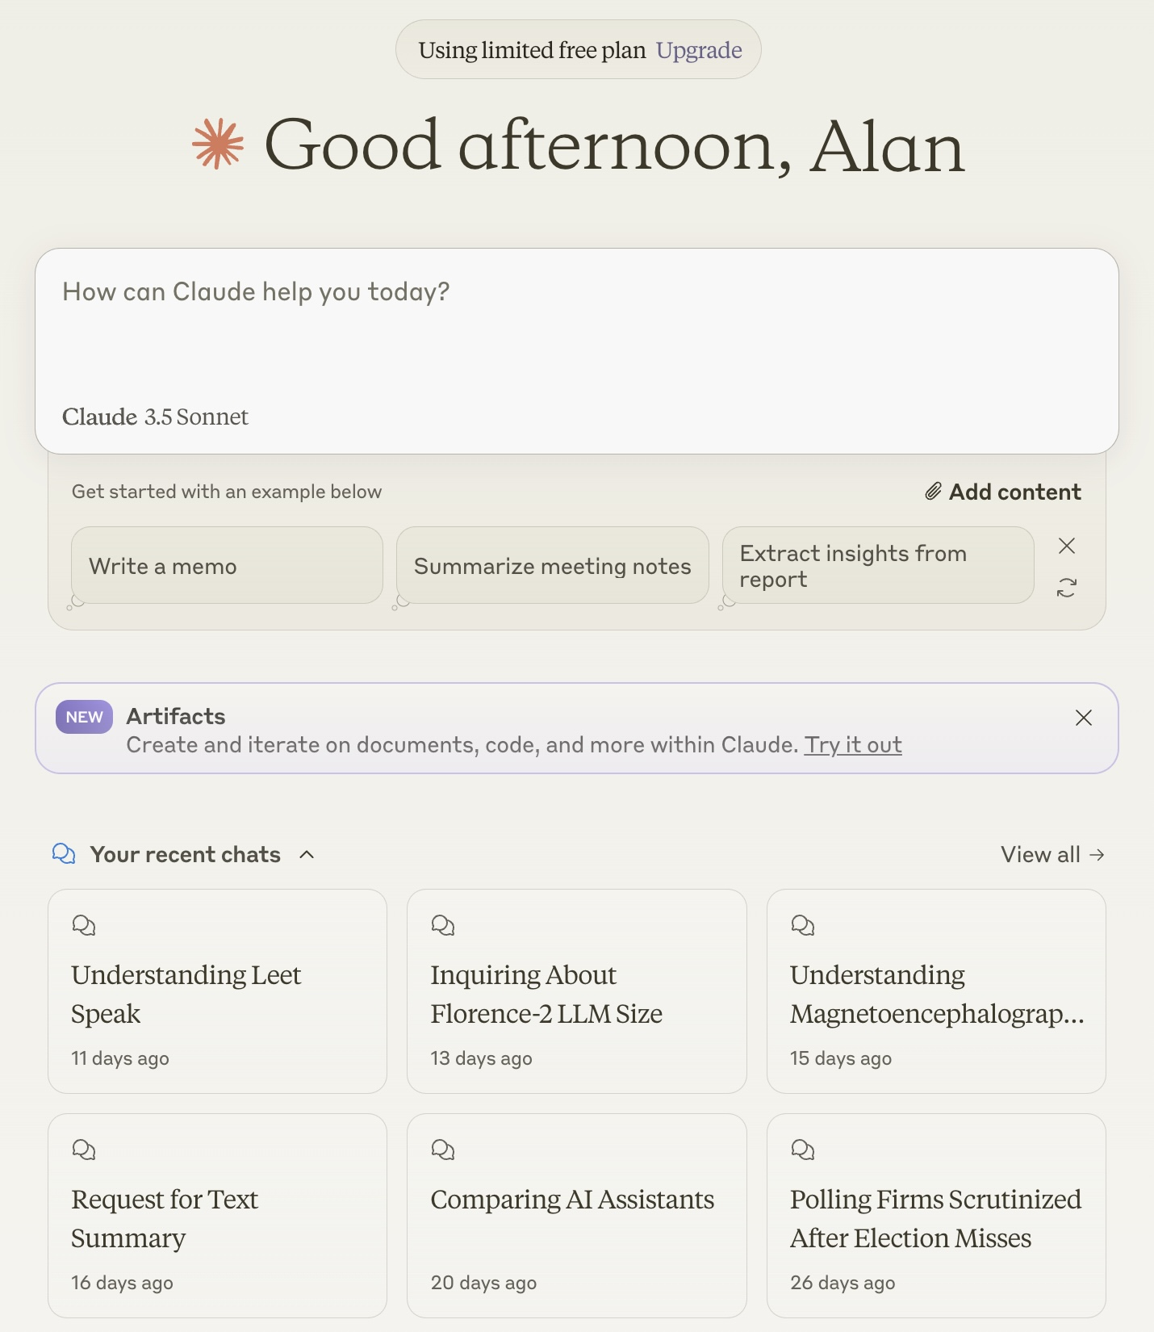
.ai
Anthropic set up by former OpenAI employees
Emphasis on ethical AI, in training material & generated outputs
$4B investment from Amazon
Outputs are consistently ranked high on FM/LLM benchmarks .. we don’t know why or how, those employees have a secret sauce

Slide 30
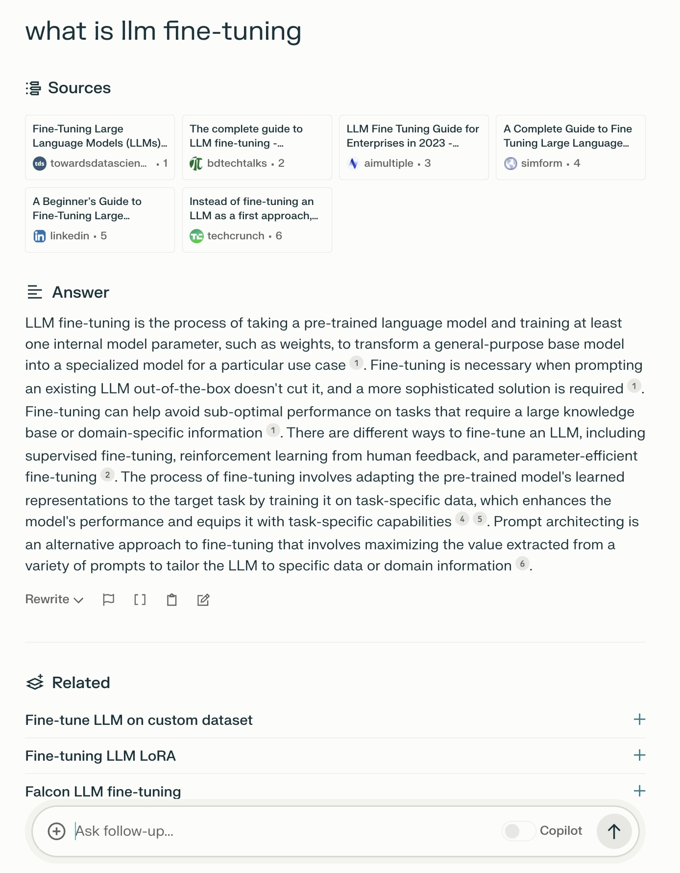
perplexity.ai
Despite upheavals in AI apps, it is still (since 2022) going, still the best at conversational search with accredited sources in summaries.
$165M raised, valuation jumped to $1B.
It cross-checks its answers thus more reliable.
ChatGPT started accrediting fine-tuned RAG documents in December 2023, not the LLM.
Free or $20/m, now includes access to GPT-4, Gemini and Claude.

Slide 31
OpenAI Muscles into Search
Eventually announced SearchGPT in July 2024
Sharing many features of the long-standing perplexity.ai with real-time web data, links to sources
But .. seemlessly blends promoted partner content and organic content .. so adverts are “masked” 😱 😱 😱 😱
Early feedback indicates – ham-fisted, a rip-off, does imagery well but not as good experience as perplexity

Slide 32
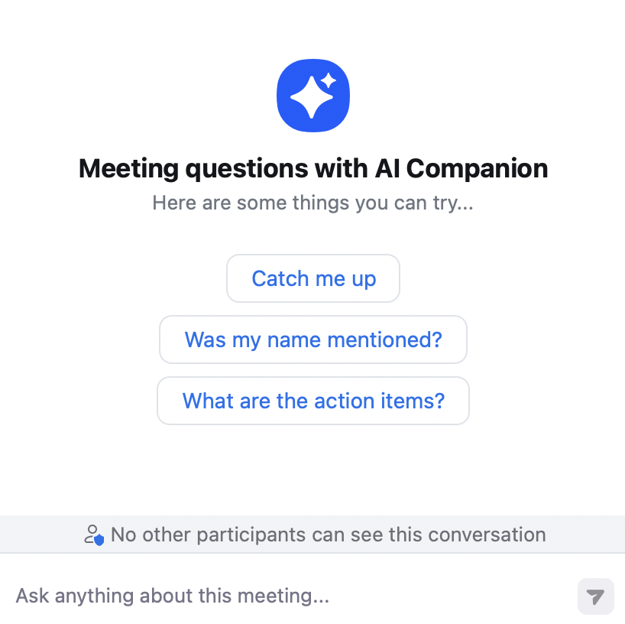
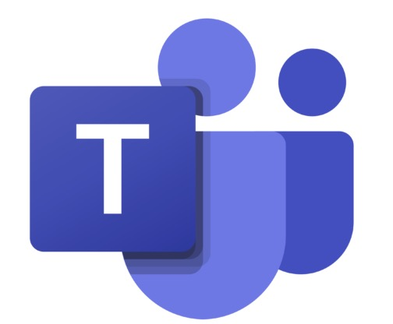
AI Now Happens Everywhere
Places with visibility …
Places under the radar ...

Slide 33
How should you use GenAI ?
For +50 years we have five stages of grief:
Denial
Anger
Bargaining
Depression
Acceptance

Slide 34
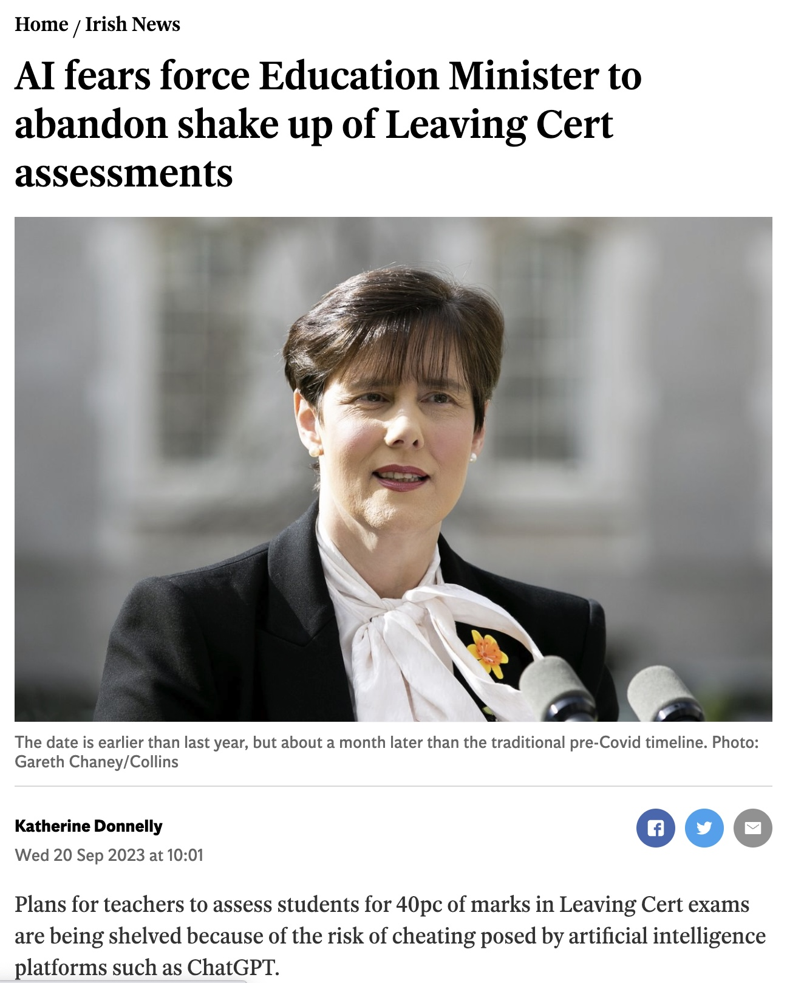
ChatGPT for student essays ?
Globally, Universities were in a moral panic and existential crises re forms of assessment.
Plagiarism detectors cannot detect AI-generated text. Fact, so stop playing whack-a-mole.
OpenAI tried to help but gave up in July 2023 .. their detector maxed at 26% of AI text correctly identified as AI.
We have national guidelines, re-designed assessments to in-class, oral, personal .. but that won’t sustain, scale or leverage GenAI.
Use GenAI as part of learning – create the (course) bot, debate it, grade it, pair it, improve it.
Develop students’ critical faculties, compare and contrast multiple sources not relying on “the textbook”

Slide 35
GenAI in student learning ?
GenAI helps students with ideation, to grow and to think making it a useful skill for employers.
Yet instructivist learning where the teacher or book says “X” since Socrates in 400 BCE, still dominates.
GenAI can support constructivist approaches like project-based and hands-on learning where students build their own knowledge, coached by teachers.
Photo by Tim Gouw on Unsplash

Slide 36
GenAI Opportunities in Education
Instead of wrestling with how to stop cheating, embrace GenAI
Conversational TAs as another lens on content, “QA buddies”.
AI-powered role playing .. interviewing via fine-tuned / prompt engineered LLM on specialist content.
Improve accessibility
Real time, mid-lecture Q&A - individual and private, clarifications.
Assist with content creation / assistance as part of a team

Slide 37
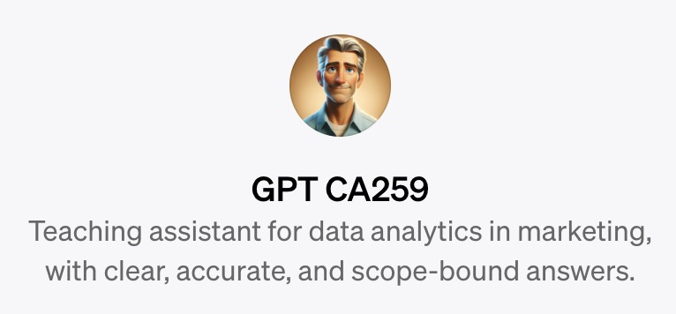
GPT for CA259 (via agenthost.ai)
1
A responsive, personalised and accessible support for students, incrementally fine-tuned thus diluting most of the (free) ChatGPT disadvantages
All slides
YouTube video transcripts
Text from linked web pages
Text from linked papers
Transcripts from audio recordings of my lectures – all 150,000 words from 20 hours
Updated weekly during semester – so no confusion from future content !
Fine-tuned
Prompt engineering, (mucking around) by limiting scope, set temp=0

Slide 38
What did they ask ?
1
Summarise the course
Generate summary notes as revision for each chapter of the course
How much is the first assignment worth ?
When are the assignments due ?
I missed the fourth lecture, what was it about ?
What is digi me and where does it appear in the course ?
What is a p-value ?
What is linear regression ?
Worked example of linear regression ?
How do I use VLOOKUP in Excel ?
What is the formula for linear regression (sic) ?
How to find missing values in a dataset using linear regression ?
What data visualisation should I use for numbers
.. and they all lead to conversations and they ask in English and in French !
Photo by Taylor Flowe on Unsplash
142x undergraduates in DCU

Slide 39
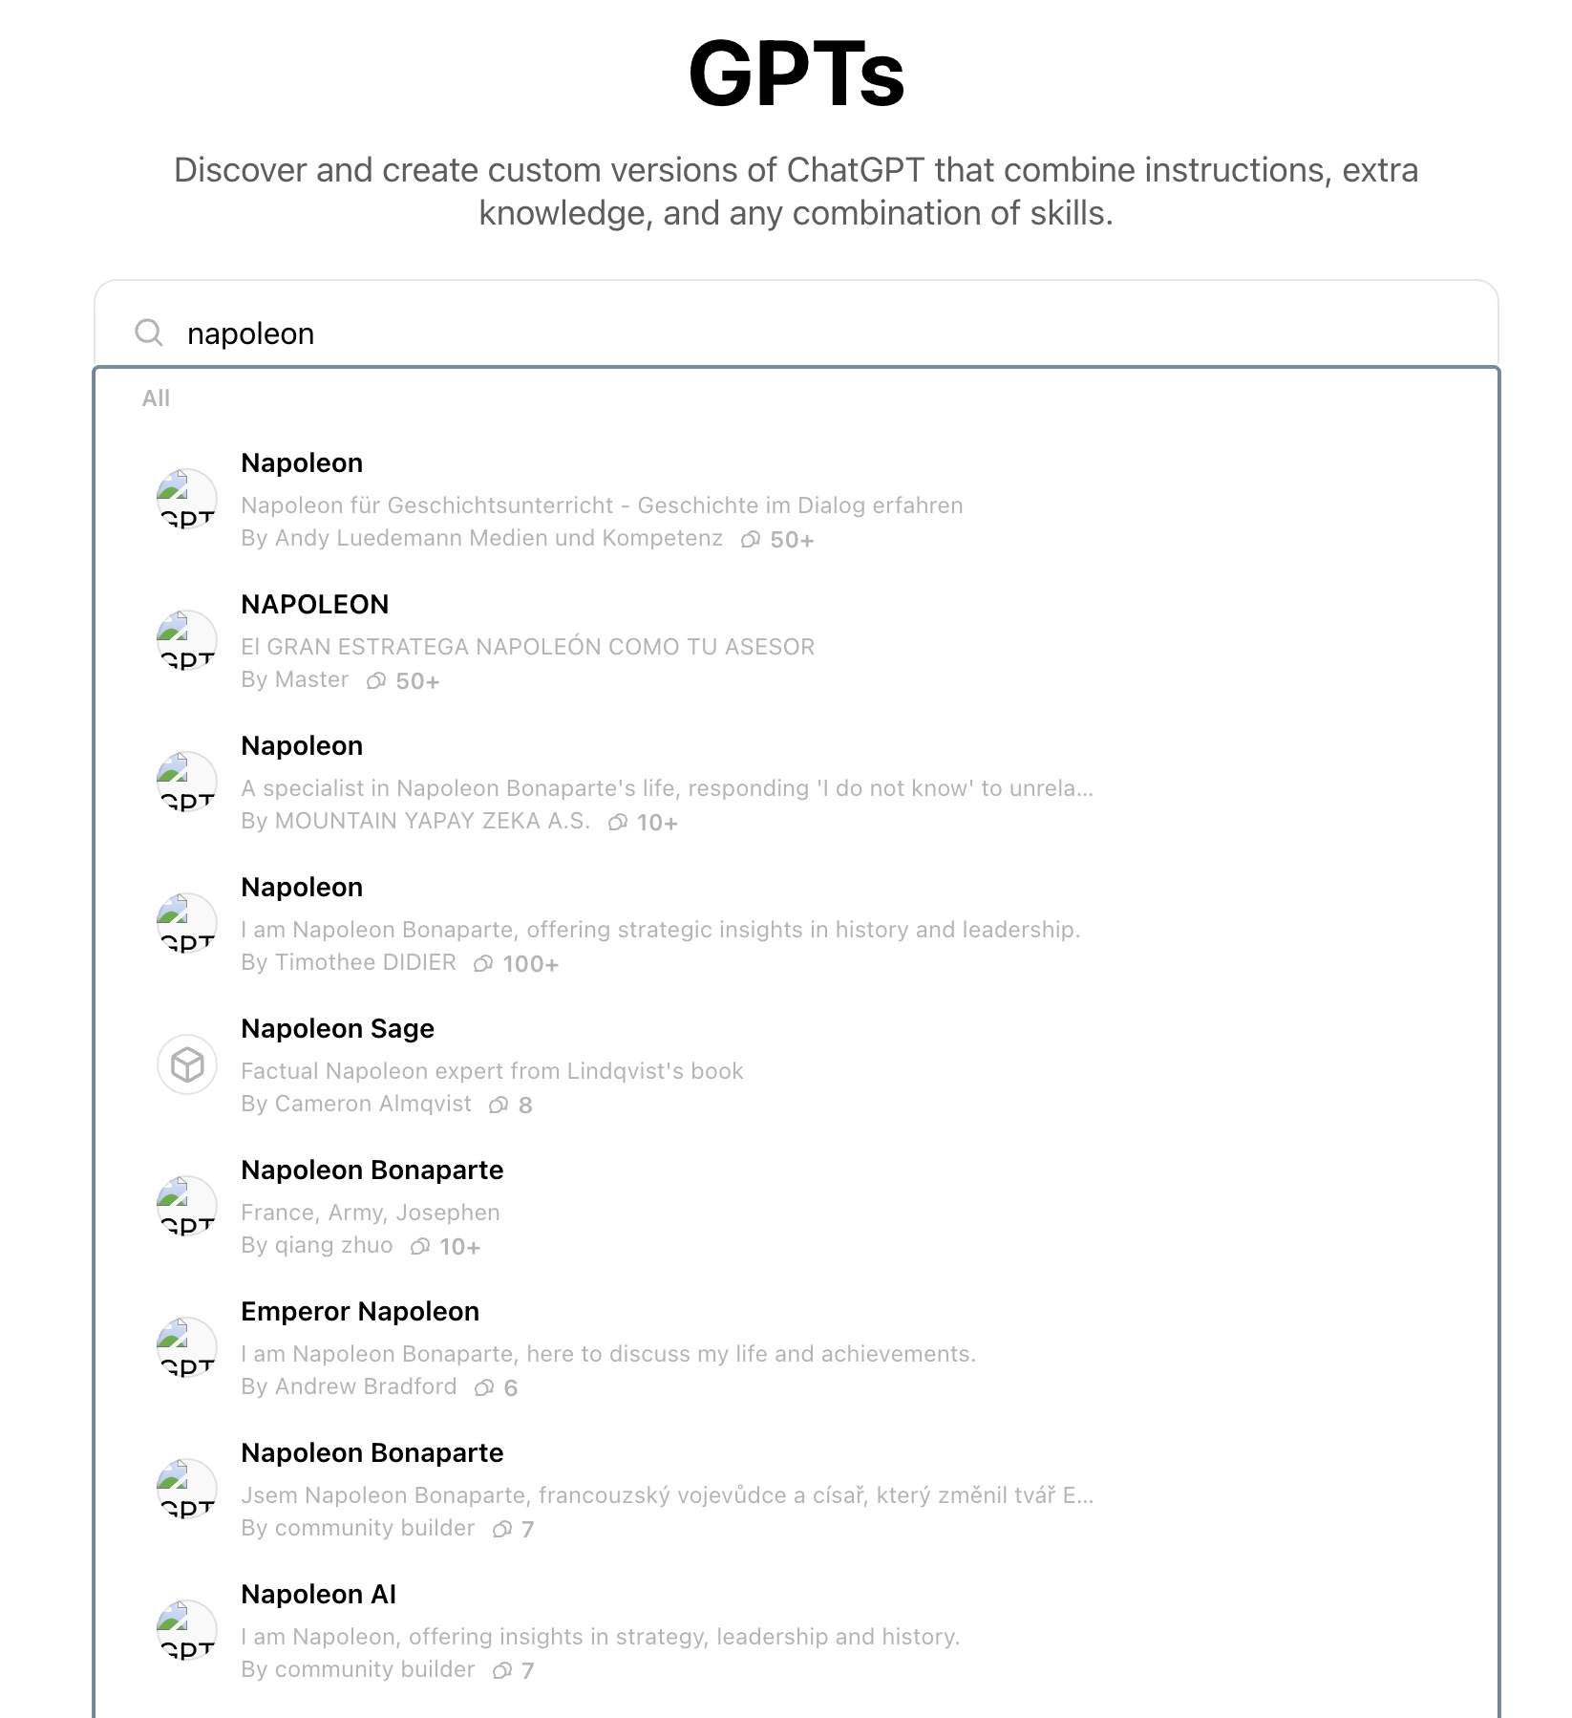
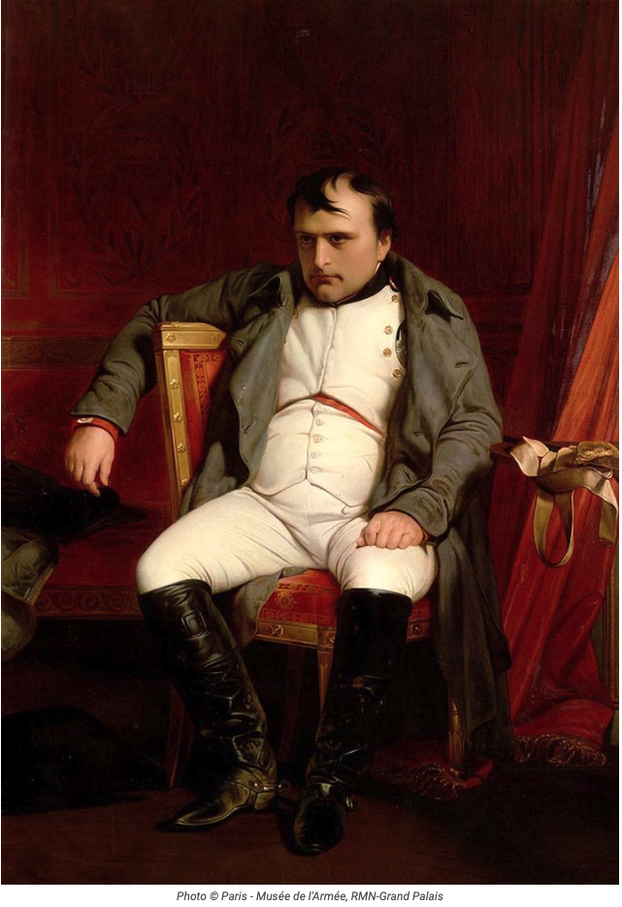
2

Slide 40
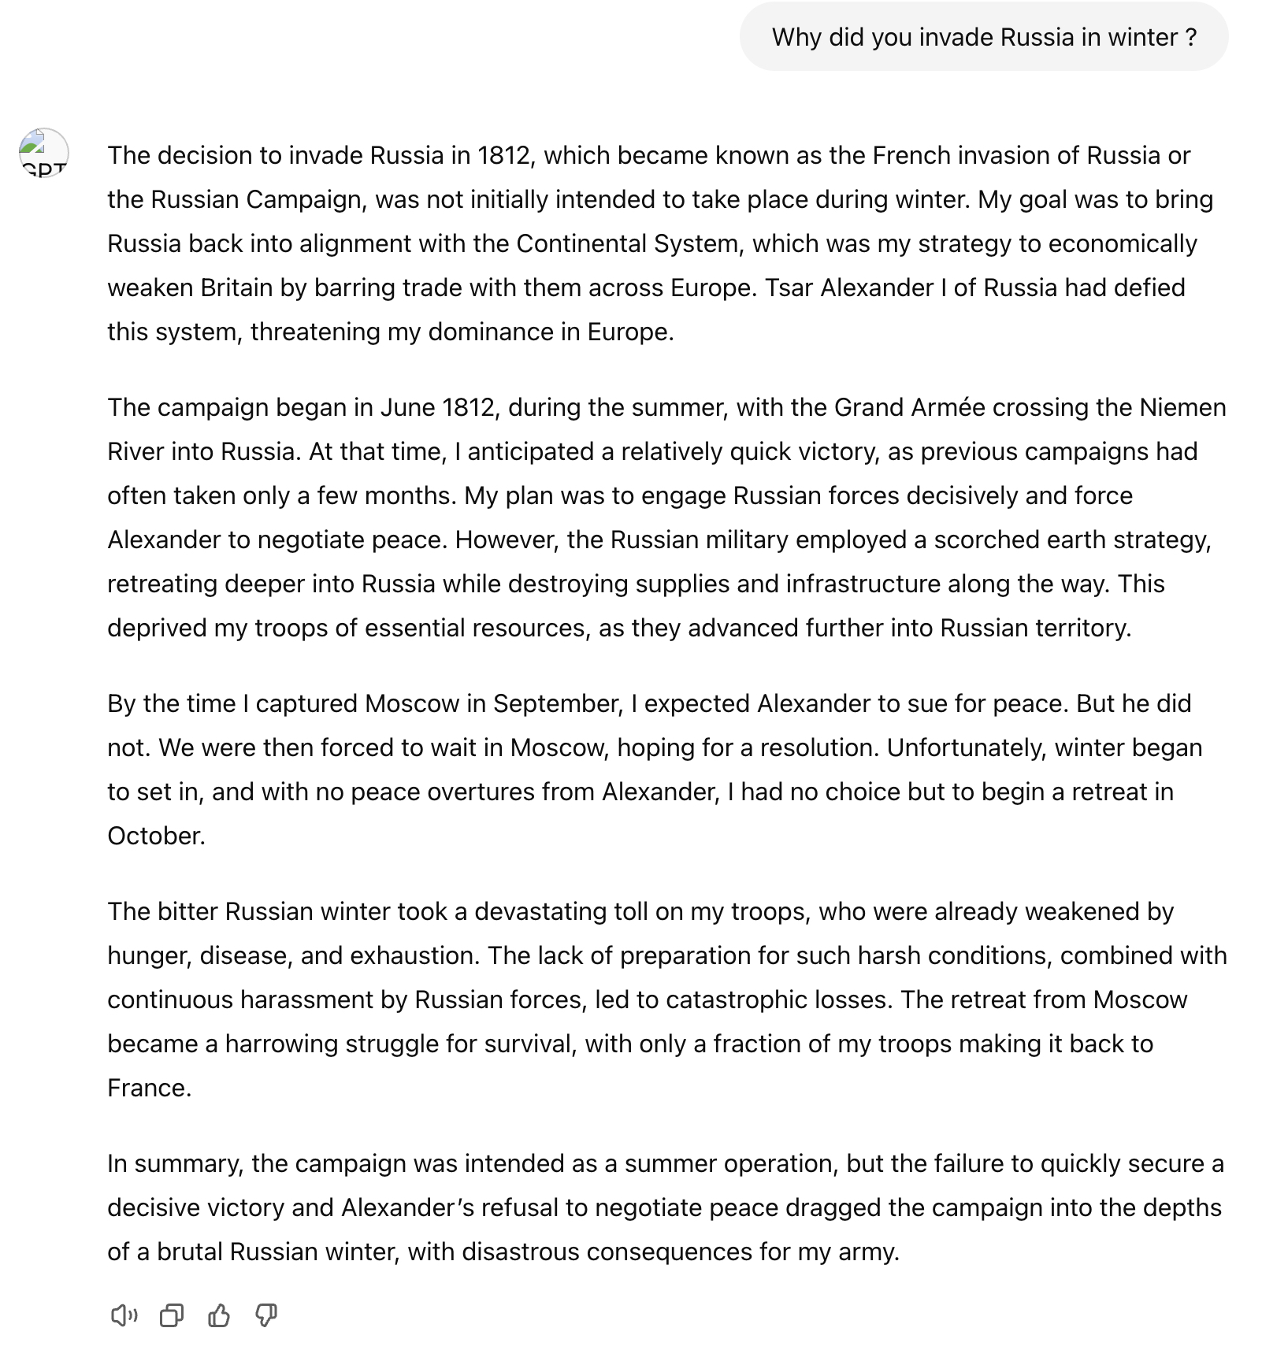
2

Slide 41
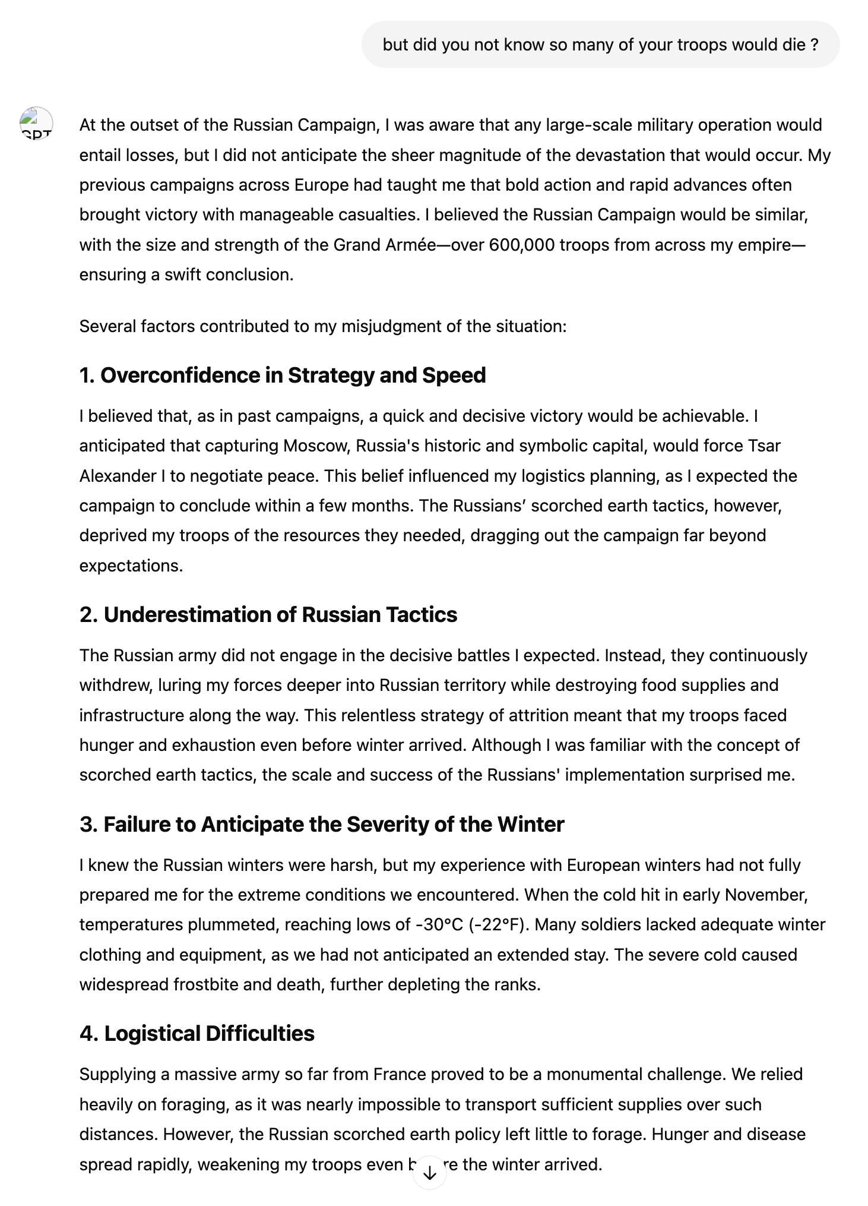
2

Slide 42
Improve Accessibility
3
Re-cast content into a medium / format to accommodate impairments like vision or hearing, ADHD, autism, etc.
Content Adaptation – simplify complex text, create summaries, structure text into bullet points or diagrams.
Transform Modality – text to speech for visual impairment, or into image or animations, or into sign language.
Personalise content – different learning styles, personal examples or analogies, customise pace of delivery.
Support Interactive Learning – real time explanations, answer questions, break down problem solving.
Enrich Content – add examples, generate practice questions or assessment questions, multiple learning pathways.
Support Special Needs – dyslexia-friendly, adapt for neurodivergent learners or motor impairments, sensory-appropriate materials.

Slide 43
4
Real Time Lectures with Zoom AI
The Two-Sigma Problem … Benjamin Bloom identified the phenomenon that the average student tutored one-to-one using mastery learning, performed better than students educated in a regular classroom – 1984.

Slide 44
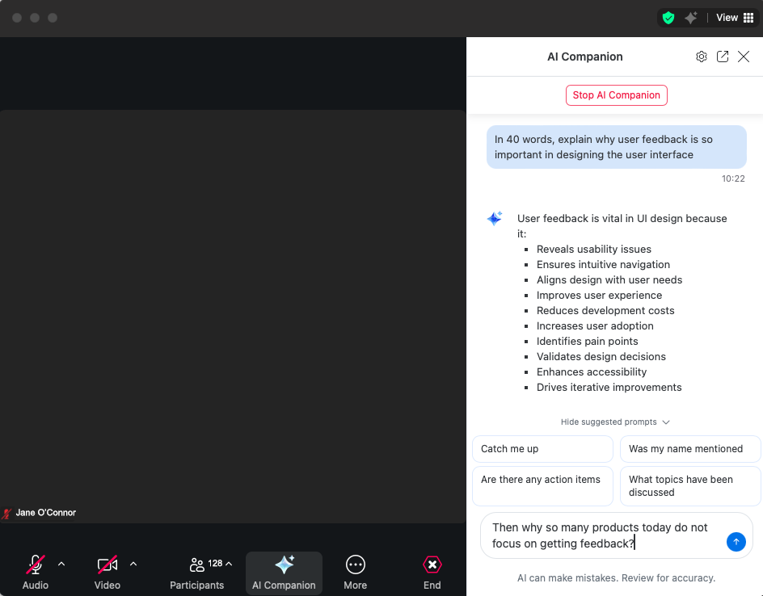
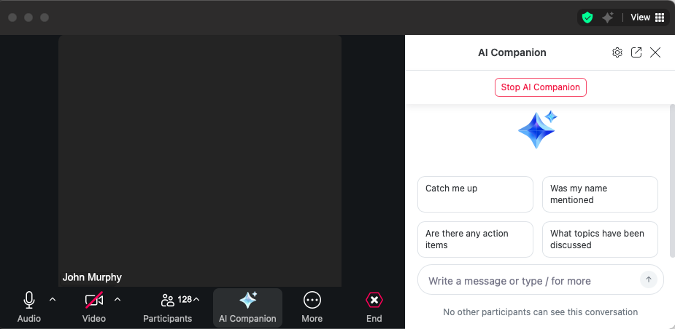
Real Time Lectures with Zoom AI
4
Lecturer
with Zoom and AI Companion on
John Murphy
(lecturer)
Audio & Video OFF
Students
Query lecture material during class, answers to individual student only
John Murphy
(lecturer)
Video OFF
AI Companion ON
199x 2nd year and 219x 3rd year undergraduates in DCU
Notes:
199 2nd year and 219 3rd year
“I found this tool incredibly useful, and I think it would be great to have it available during all lectures.” (UID, Week 6, Anna)
“The AI feature using zoom is very helpful to ensure everybody is up to speed and is able to understand well. I hope this feature remains for the rest of the continuing lectures as well.” (SA, Week 6, Kensho)
“I liked the use of zoom during the lecture it was very helpful.” (SA, Week 6, Glory)
“i found the ai companion very usefull and interesting.” (SA, Week 6, Muhammad)
“Started incorporation of the Zoom's AI companion in the lectures was really unique and interesting.” (UID, Week 7, Sean)
“I thought the Zoom AI tool was very cool and useful it answered any question I had very well without disturbing the lecture.” (UID, Week 7, Tom)
“It’s great that we now have the Zoom link for the AI Companion Q&A. But limiting it to those in class feels a bit restrictive—remote learners could benefit too. Still, it adds an interactive element to in-person sessions.” (UID, Week 7, Faruq)
“I liked how we were able to ask questions through the ai zoom listener thing.”
“I think the Q&A with AI Companion is a great way to keep the learning interesting and is an efficient way to get short answers to my questions during the lectures.” (UID, Week 7, Shane)

Slide 45
GenAI Programming Assistants
5
First year undergraduate programming in MU

Slide 46
Are these ideas new?
U Michigan provides full GPT access to popular LLM models – GPT-4o, Llama, DALL-E, for all 100,00 students and staff through “Maizey”.
Built a private cloud-hosted instances of so no data sharing with big tech.
Instructors switch Maizey on/off using course materials from Canvas VLE which generates a TA with source identification, incremented weekly, 10 minutes set up.
2,500 such use cases
Accessibility for impaired students is in-built.

Slide 47
How to progress this?
Use open LLMs .. LLaMA downloaded +350 times
Individual institutions / researchers access a shared cloud hosting at national level ?
Who could host and maintain such an infrastructure?

Slide 48
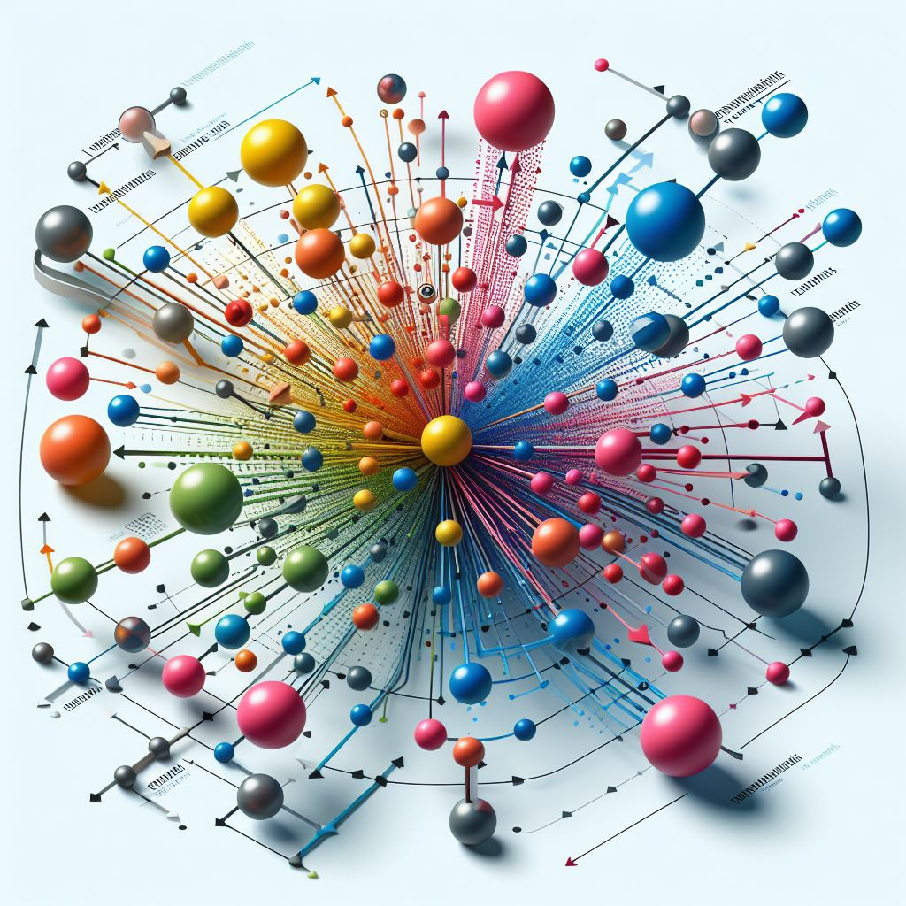
Future developments .. 1/3
LLMs not planned or designed, they happened, their ability surprises us .. modelling sequences of tokens and generating plausible sequences
Criticising them is disingenuous because they do have some form of inferred knowledge as parametric memory which we do not understand
Clear opportunity for improved productivity and scale
raising the floor & allowing people to engage in new skills and tasks
raising the ceiling & allowing people to do complex tasks not heretofore possible

Slide 49
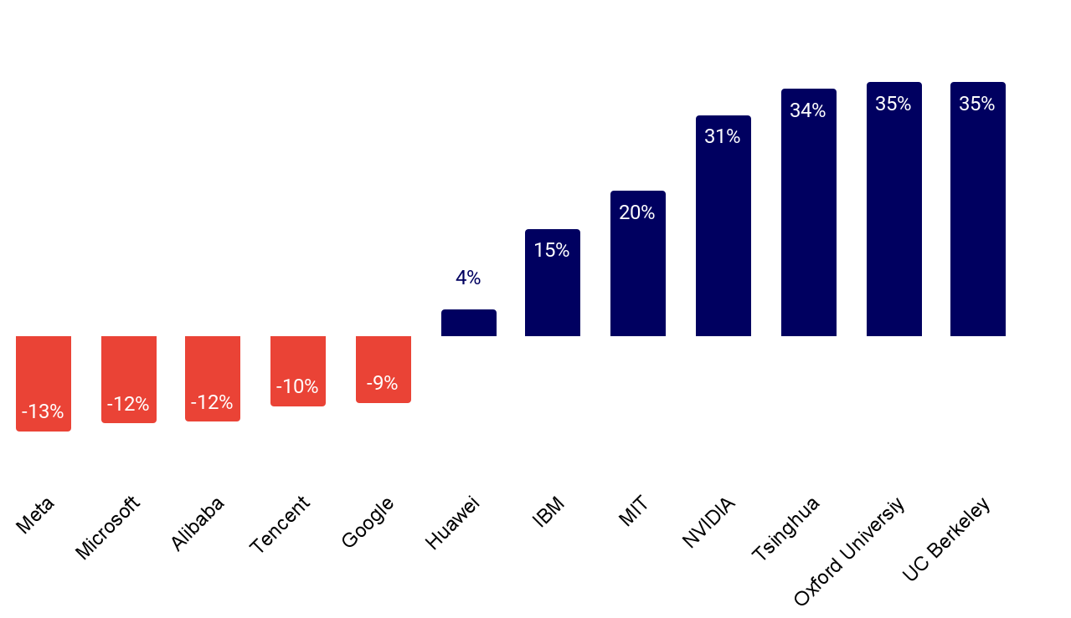
Future developments .. 2/3
AI literacy is mandatory, some form of job displacement is likely
AI research is now production AI for big tech who have the $$$, data and researchers and the science behind understanding is stalling in the gold rush
YoY 2023-4 change in AI publication levels

Slide 50
Future developments .. 3/3
AI is the $600 B question according to Sequoia Capital in June 2024 .. when and from where will the RoI come from?
Copilot or Gemini have not yet set the world on fire though it is still early, and while OpenAI seems to make money from ChatGPT and GPT licensing and subscriptions, it’s probably spending more on costs.
Customer service apps are the early winners in terms of LLM applications followed by personal productivity applications.
Slapping GenAI onto everything – sidecar GenAI – damages AI because it is noise and sounds like snake oil, replays the failed hypes with “metaverse” and “blockchain” and undermines the good AI we have, so the unrealised expectations will badmouth all AI.

Slide 51
Takeaways … 1. GenAI is happening – in your workplace and in mine – you can design it out, or design it in 2. Threat or treat ? An opportunity, a challenge to re- set 3. You will need to evolve, in my world the essay as homework is not dead, just done differently.
Photo by Edwin Andrade on Unsplash

