Slide 1
Data as a Service (DaaS) A unified data pipeline for TCD.
Presenter — Neil Homan (Data Architect / DT4 Technical Lead)
Date: 07/Nov/2024

Slide 2
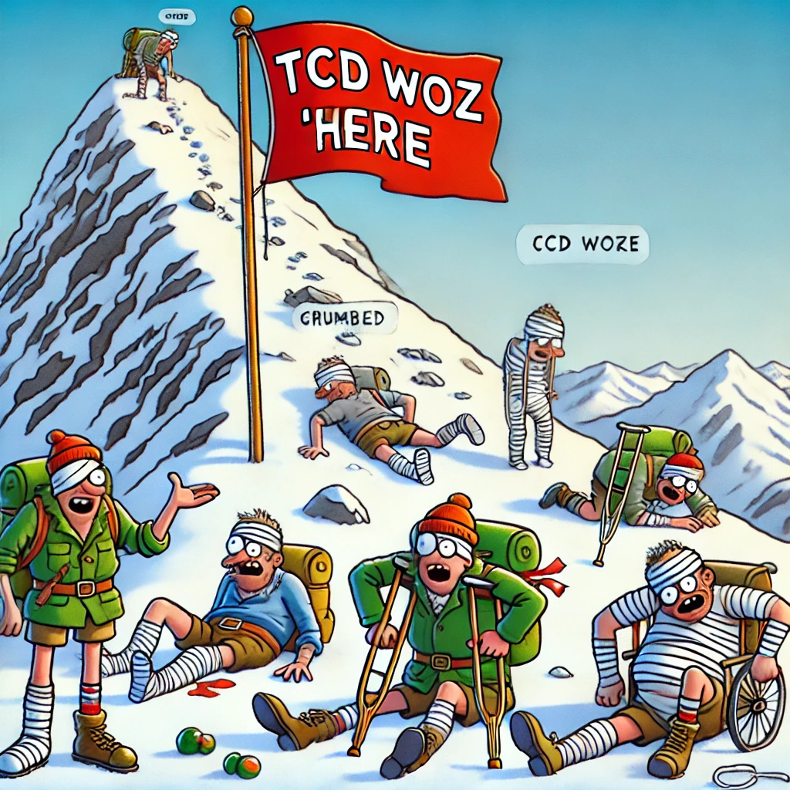
Why present a topic about a (fancy) data hub?
We believe that our data landscape is like that of other third level institutions.
Small and relatively underfunded yet still large enough that we have different departments potentially with discrete data teams.
Data Siloes, very little value derived from data, and so on.
This project is an endeavour to migrate some of our data estate to the cloud.
We believe that we have executed this project reasonably well and have lessons and tangible benefits to share (see diagram!)
TCD DT4 Team - Flying a flag! Image Credit: Dall-e (first attempt inc. typos!)
2

Slide 3
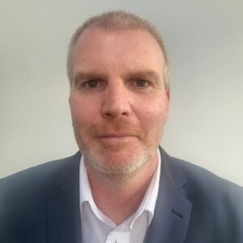
Introduction
Neil Homan:
20+ years of experience in University data systems in development and database-oriented disciplines and as technical lead on various IT projects.
Recently I have become focussed on the importance of developing our data management practices, the need for good data governance and the strategic use of data.
I am very pleased to share this event with so many who share the same passion and enthusiasm in our mission to deliver world class HE.
3

Slide 4
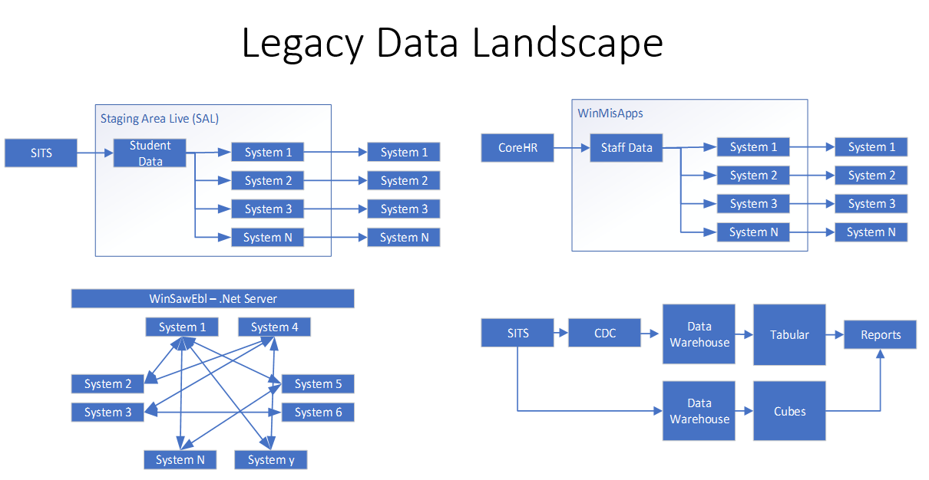
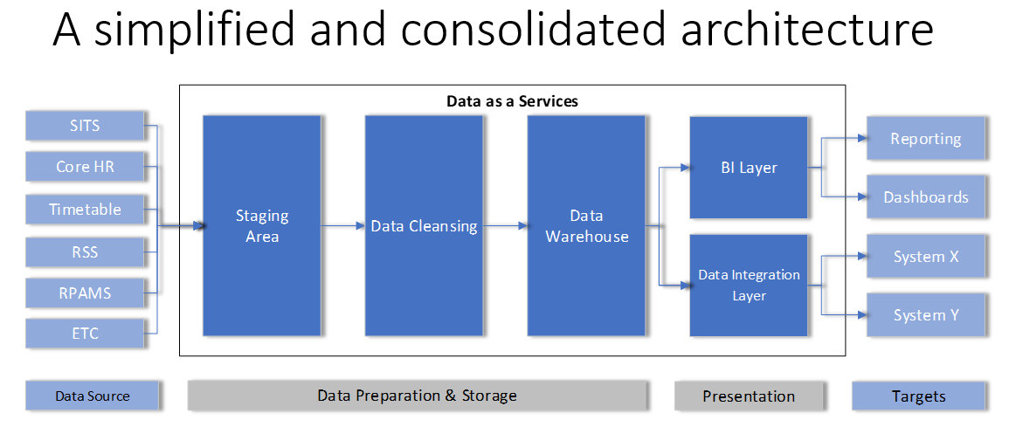
DT4 Project - Inception.
A response to our digital transformation strategy's objective to value data within the University.
Fleshed out by our Enterprise Architects who understood our landscape and knew that things could and should be done better. A business case was drawn up and funded. The DT4 Project was conceived. After a pause during the pandemic, the project was reactivated:
A fast paced, dual phase, parallel implementation with our Technology Partners.
Phase 1: An Enterprise CRM to deliver a shared, single instance CRM initially to two business areas. Additional areas are being added now and they share benefits of University data “plumbed” from the data hub. Phase 2: Data Hub. In parallel the Data Hub known as Data as a Service (DaaS) providing quality data initially scoped to satisfy the CRM’s requirements.
4

Slide 5
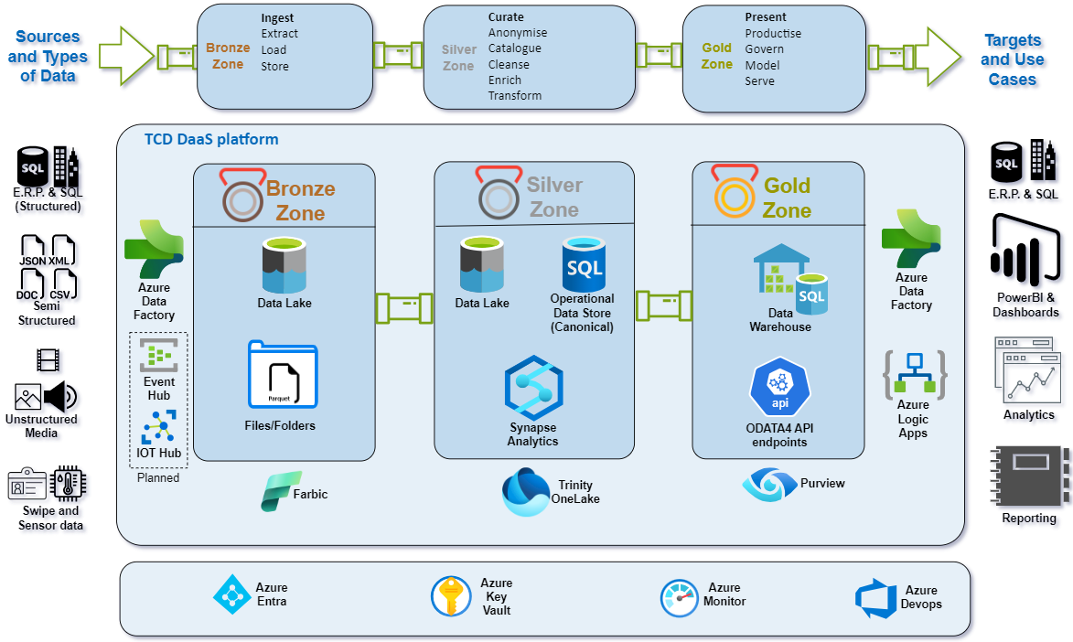
What is Data as a Service (DaaS) at its core?
A unified data pipeline for the university servicing our data integration and analytical needs.
Modern data platform, an architecture, a data lake, and Enterprise Data Model
All backed by a data management framework.
A migration to the cloud for some of our data estate.
5

Slide 6
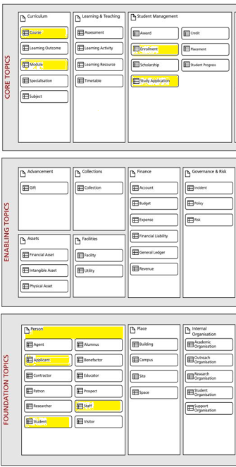
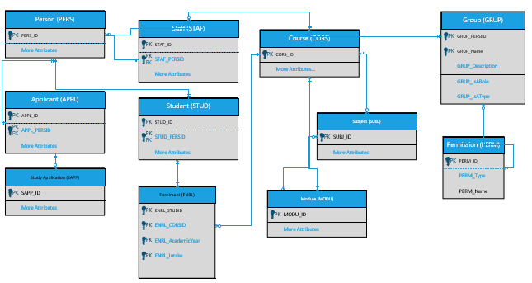
A Standardised Enterprise Data Model and Operational Data Store
Align with international standards: UCISA HEDRM
Unified data representation
Enhanced data integration & interoperability
Reduce complexity and overheads.
Consistent data quality and integrity
Facilitated compliancy and governance
Future readiness and scalability
DaaSCanonicalModel_o.1.vsdx
An enterprise Operational Data Store (just short of ‘text-book’ Master Data Management solution.)
Business Critical Data only – however establishing a shareable golden record.
What we call our Canonical Schema.(working title)
Nightly “data deltas”
An anonymisation strategy that reuses our non-production anonymisation rules allowing us to more widely share production data!
Copyright: Higher Education Data Reference Model v2.61
6

Slide 7
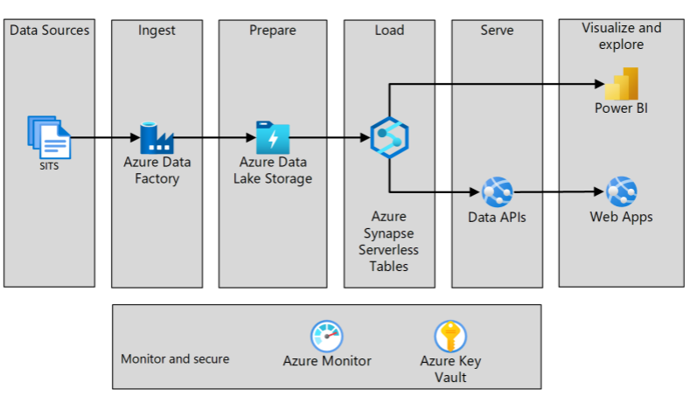
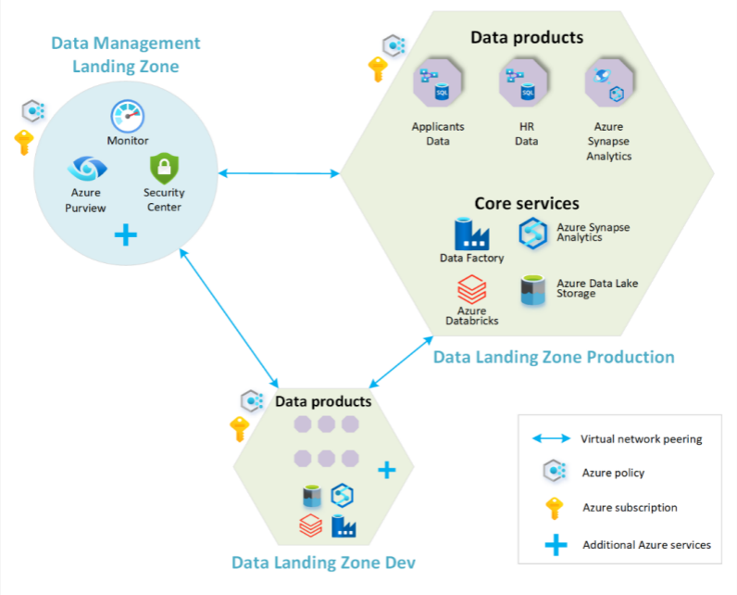
The DaaS platform architecture is in line with Microsoft's Cloud Scale Analytics Framework, ensuring scalability and repeatability tailored to Trinity's modern data platform requirements.
A sample use case (Minimum Viable Product transfer to CRM (no canonical))
Data Landing Zone Structure
7

Slide 8
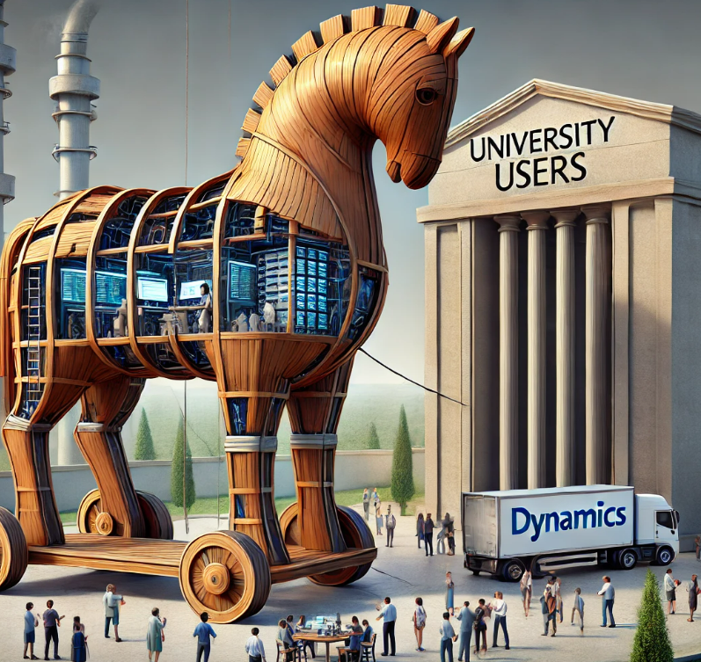
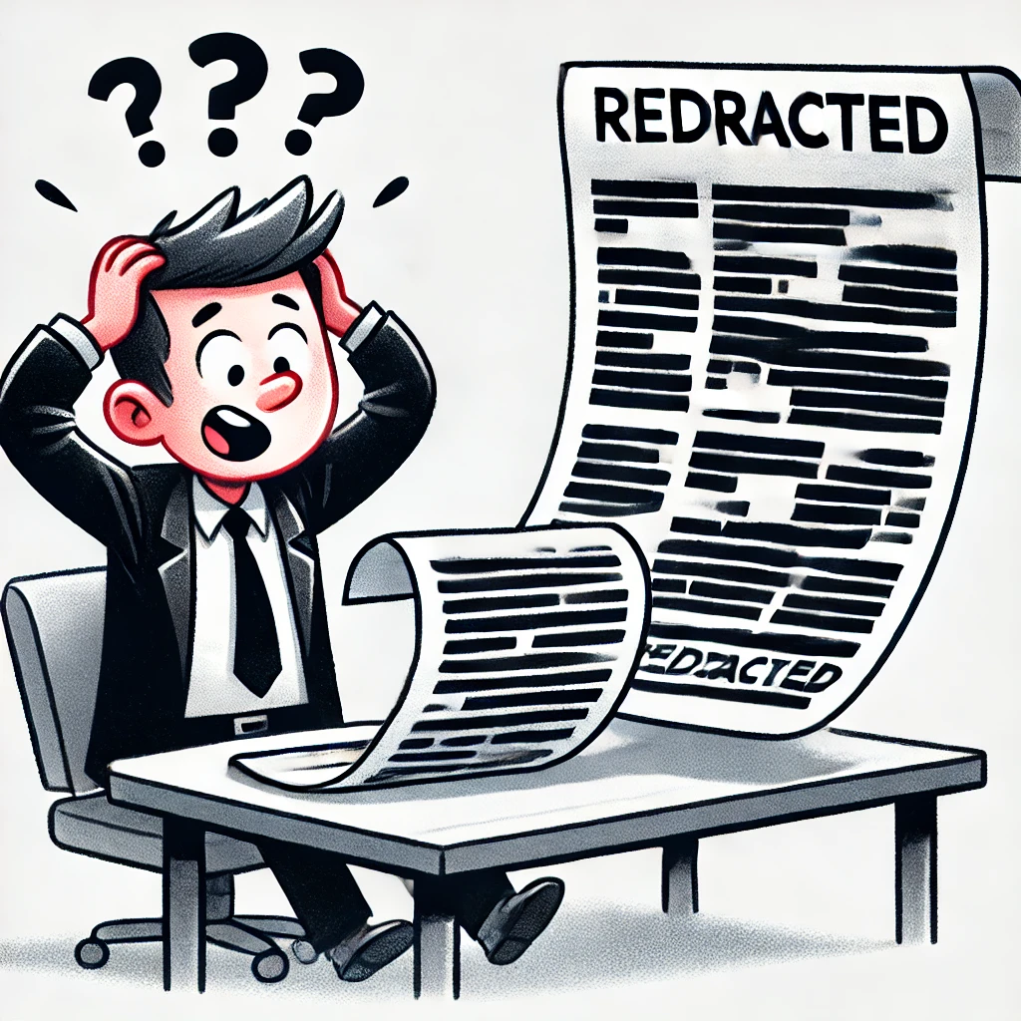
Lessons
z
We went a little overboard on anonymisation!
The CRM phase is the “trojan horse” project which users recognise as valuable immediately. Whereas the data scientists and platform hidden inside are the real long-term value! (A little unfair on the very important CRM phase!)
HERM was useful but only as a guide rail (a very important 5% of the work). Operational/Canonical schemas need to be sold to the user community and better still the University executive (WIP).
Data modelling is difficult and requires the most effort.
There is a lot going on in the Silver Layer of the Data Lake so we added another Zone!
8

Slide 9
Benefits
Consolidate work practices (less reimplementation, repeat patterns, focus on what is important)
Framework best practice – we have a series of How-To and playbook documentation.
We are measuring more things.
Increased Data Quality.
Low or no code tooling, particularly out of the data hub.
Automated deployments via DEVOPS. Using IAC/key vault so that there is no developer access to Production.
Data discoverability and improved governance using Purview.
Democratised data.
We are more data driven…
Using the human body as an analogy for the enterprise or university
… data is ubiquitous like oxygen…
Only with quality processed oxygen
and a means of transfer can each organ and the organism as whole, function optimally.
9

Slide 10
Next Steps
Coming Soon:
Release 2 including the Canonical Schema. Also, part of the initial vision of the platform and the reasoning for the name Data as a Service was to develop a consumption-based model to charge for use of data from the platform. We have some limited first steps on this in R2.
Release 3 including Purview.
Our tech partner TEKenable are working with Microsoft to migrate to MS Fabric.
Operationalising the platform. Under planning for now:
On-boarding of additional data repositories enhancing the canonical schema.
Data Governance has yet to be tackled at the University scale. We are exploring the sharing of our anonymised data sets. There is potential here for data sharing with institutions like those present today and indeed the wider ed-tech and business communities.
10

Slide 11
Thank You homann@tcd.ie Neil Homan Acknowledgments I will likely not have time for: Joe Lakes and Twinkle Mathur (PM and BA on the DT4 team) and the wider IT Services involvement. TEKenable : Our tech partners, patient listeners, they have over-performed time and again to help us realise our vision. Slides 2,8,9 contain images generated by AI. (No other AI was used in the generation of this presentation.) Canonical Schema (TCD working name) was first used in the University of Surrey. (We were unable to talk to them about their project) The Data as Oxygen concept was not originally conceived in TCD.

