Slide 1
https://alliance4xr.eu/

Slide 2
CREATION OF ALLIANCE4XR
ALLIANCE4XR is an Erasmus+ project co-funded by the European Union
This project brings together 13 partners from 8 countries
(Belgium, Cyprus, Greece, Ireland, Ukraine, Portugal, Spain, and Sweden) to work together for 3 years, January 2024 - 2027.

Slide 3
ALIGNMENT WITH ERASMUS+ OBJECTIVES
Enhancing Digital Competencies
Developing Green Skills
Promoting Lifelong Learning
Fostering Entrepreneurial Spirit
Ensuring Inclusive and Accessible Education
Supporting Responsive Education Systems
Promoting Innovation and Creativity
Strengthening Collaboration and Mobility

Slide 4
IDENTIFYING THE NEED
.
Notes:
In today's world, there is a significant gap between theoretical and practical training in Extended Reality (XR) technologies.
Educational institutions struggle to integrate these technologies into their programs due to a lack of resources and proper training
Recognizing this need, the desire emerged to empower universities and vocational training centers (VTC) in the use of XR technologies.
The goal is to bridge the digital skills gap and better prepare students for the current job market.

Slide 5
PROJECT GOALS
Empower Educators:
Bridge the Gap:
Through workshops, webinars, and collaborative activities, we aim to empower educators to adopt XR.
Focus on key areas such as structural engineering, energy, and the maritime sector.
Prepare Students:
Equip students with XR skills to succeed in their future job search.

Slide 6
1. Identify market needs
2.Analyse current requirements
3.Create educational and training material that remain constantly relevant at a market and society level.
4. Test the newly created material and bring it closer to the targeted audience.
5.Deliver the material through an online platform where software, data, and 3D designs can be matched with lectures and training courses.
6. Advocate for the adoption and mainstreaming of the training/ teaching modules through multiplier activities.
METHODOLOGY 1

Slide 7
Methodology 2
Questionnaires
Open-ended questions about barriers
(96 respondents)
Current and future provision of courses (28 respondents)
In-depth interviews
General discussion about barriers with 11 participants
Desk studies
Use case descriptions
(57 use cases)
Existing course syllabi at 38 education institutes
Draft XR taxonomy of concepts and terms
CLIK HERE

Slide 8
Survey [n=96]
Barriers limiting XR usage
Interviews
[n=11]
High costs - Up-front costs of getting XR equipment and then the ongoing costs associated with keeping them current
Resistance to Change - Organizations are not familiar with or skeptical of their benefit or utility, limited awareness
Infrastructure and Access - Robust infrastructure available that includes high-speed internet and compatible devices
Proving Value and Generating Buy-In - Stakeholders need hard evidence of the benefits and Return On Investment (ROI) from using XR applications
Regulatory and Content Challenges - Adhering to standards, ensuring data security and privacy, and navigating evolving regulatory frameworks
Technological Complexity - integration with existing systems and ensuring interoperability and ergonomic considerations
Insufficient training/resources – lack of training opportunities at all levels – pedagogy first, language barriers – most resources are in English

Slide 9
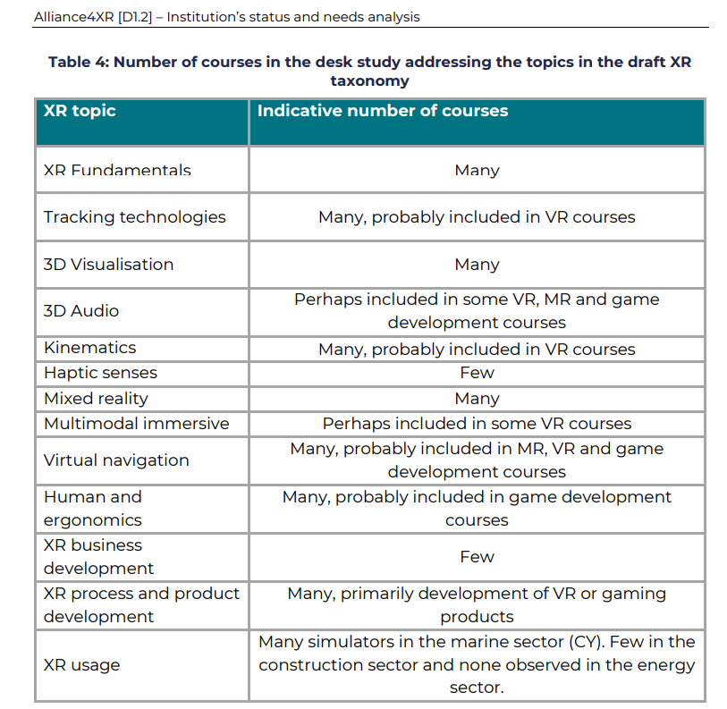
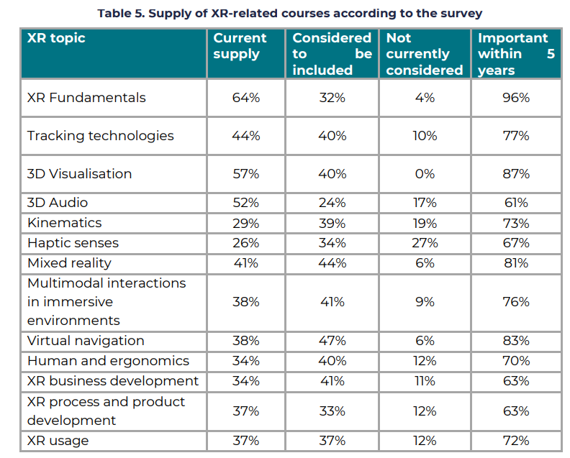
Desk study of of existing course syllabi [n=38]
Survey of current and future provision [n=28]

Slide 10
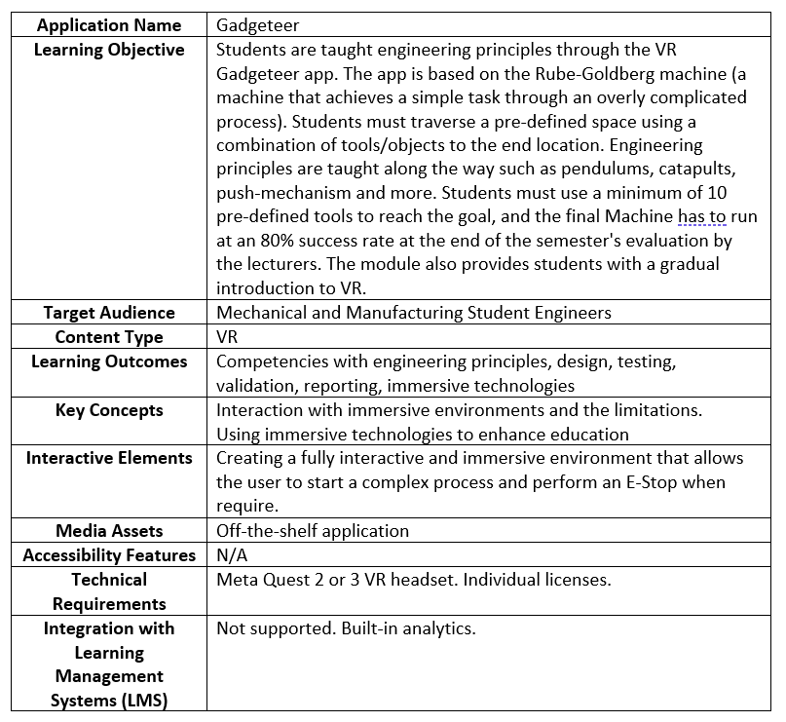
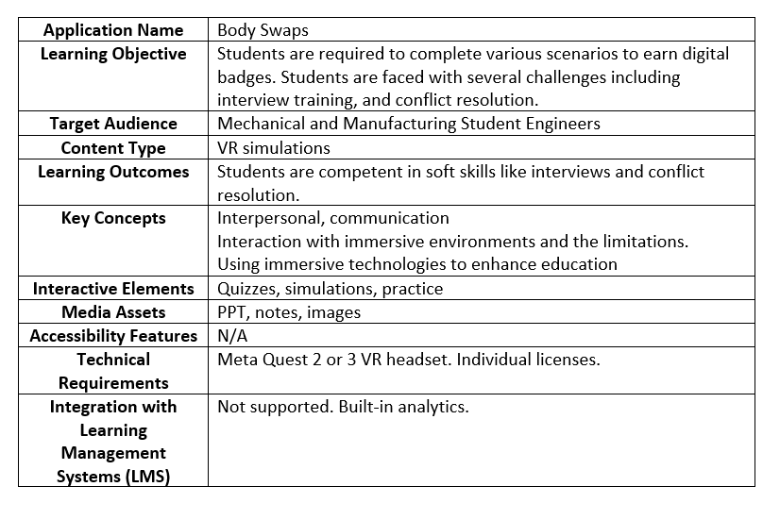
Desk study of use cases [n=57]

Slide 11
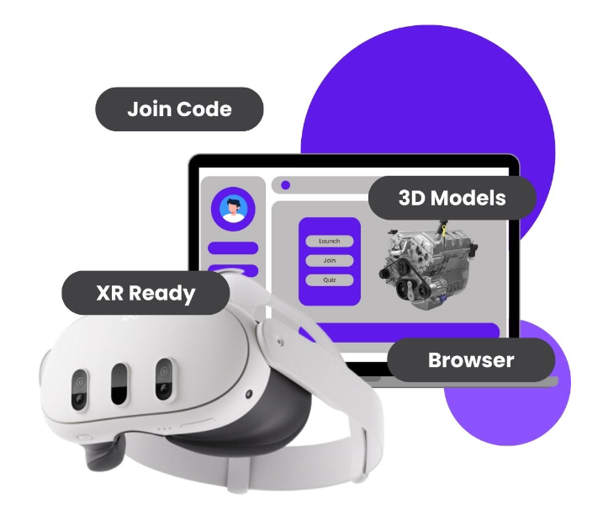
Resource Development

Slide 12
EXPECTED IMPACT
Educational Alliances: Foster alliances between the educational and private sectors.
Innovation Advancement: Drive research and innovation in XR technologies.
Promote Entrepreneurship: Promote education and entrepreneurship in XR skills and ecological competencies.

Slide 13
Future developments?
Basic principles of XR
Mixed reality
XR usage in various sectors
Virtual navigation
Tracking technologies
3D visualization and 3D audio
XR in product and process development
XR for business development
…
Picture from https://reedi.ie/home/

Slide 14
CONTACT INFORMATION
www.alliance4xr.eu
EMAIL ADDRESS
FACEBOOK
X (TWITTER)
info@alliance4xr.eu
@Alliance4XR
@alliance4xr
INSTAGRAM
YOUTUBE
LINKEDIN
@Alliance4XR
Alliance4XR
@Alliance4XR

