Slide 1
Enhancing Campus Security
Implementing Network Access Control at Dublin City University

Slide 2
Table of Contents
Introduction to Network Access Control (NAC)
Challenges
Architecture
Insights
Conclusion

Slide 3
Introduction to Network Access Control (NAC)
Definition of NAC
Importance of DCU
Network Access Control (NAC)
ensures only authorised devices
and users can access the network,
enforcing security policies
dynamically.
NAC is essential for managing access and security in a university environment with a large number of BYOD, IoT, and guest devices.
Notes:
Network Access Control, or NAC, plays a vital role in securing modern networks, especially in complex environments like universities. Dublin City University faces the challenge of managing thousands of devices—everything from student laptops to IoT sensors across campus. NAC systems, such as Aruba ClearPass, ensure that only authorized devices and users can access network resources. This is critical to prevent unauthorized access, protect sensitive data, and comply with security policies. Aruba ClearPass is a leader in NAC technology, offering a range of features like role-based access and endpoint profiling, making it the ideal choice for DCU. We'll dive deeper into how this solution fits the unique requirements of a university network in the coming slides.

Slide 4
DCU Network Challenges
Device Overload:
Managing thousands of devices, including BYOD, IoT, and guest access, led to potential security risks.
Security Risks:
Without a unified control system, the network was vulnerable to unauthorised access and data breaches.
Compliance Challenges:
Difficulty in meeting regulatory standards like GDPR/NIST2 due to a lack of visibility and control over user activities.
Configuration Complexity Across Different Devices
Configuring NAC across different switch types (e.g., HP and Juniper) required script customisation, device-specific adjustments, and testing.
Notes:
Before implementing Aruba ClearPass, Dublin City University faced significant challenges with their network. The growing number of devices, especially BYOD and IoT, created a complex environment that lacked visibility and control. Security risks were a major concern, with potential for unauthorized access and data breaches. Furthermore, compliance with regulations like GDPR was difficult without a central system to manage and monitor network access. These issues highlighted the need for a robust NAC solution like Aruba ClearPass to safeguard the network and ensure compliance.

Slide 5
NAC Architecture
802.1X Switches (Juniper, HP)
Switches enforce access control using 802.1X for device authentication, ensuring only authorized users and devices can connect.
Aruba ClearPass
Acts as the policy manager, handling authentication, authorization, and role-based access control.
Microsoft Intune / JAMF
Provides device compliance checks, ensuring that endpoints meet security requirements before gaining access.
Active Directory (AD)
Integrates for user authentication allowing centralized identity management and access control.
Notes:
Aruba ClearPass was selected for its advanced role-based access control (RBAC), which ensures that network users—students, staff, and guests—are authenticated dynamically according to their roles. This greatly improves network security at DCU. ClearPass's ability to integrate seamlessly with the university's existing infrastructure was another key advantage, allowing for smooth deployment. The enhanced visibility it offers into user and device activity means that IT staff now have a clearer picture of the network, which helps with both threat monitoring and compliance.

Slide 6
Automation
657 switches and 23 routers were configured for 802.1X using Ansible to automate tasks and ensure consistent policies across devices.
Used Python scripts and Rundeck to automate VLAN assignments on devices through API calls to ClearPass Policy Manager.
Automation reduced manual errors, quickly fixed wrong VLAN classifications, and allowed for rapid deployment across campuses, significantly saving time.
Notes:
Aruba ClearPass was selected for its advanced role-based access control (RBAC), which ensures that network users—students, staff, and guests—are authenticated dynamically according to their roles. This greatly improves network security at DCU. ClearPass's ability to integrate seamlessly with the university's existing infrastructure was another key advantage, allowing for smooth deployment. The enhanced visibility it offers into user and device activity means that IT staff now have a clearer picture of the network, which helps with both threat monitoring and compliance.

Slide 7
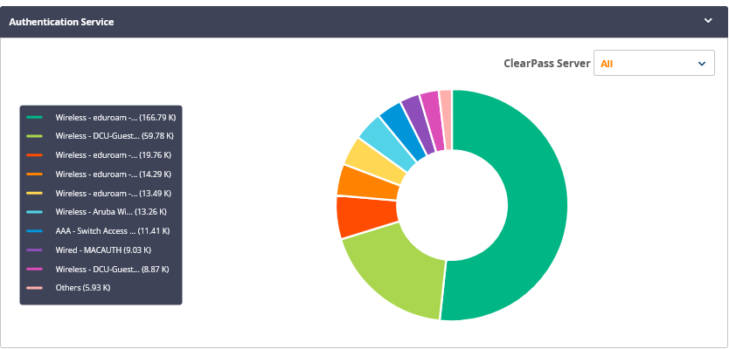
Insights
Per day:
300k total authentication requests (wireless and wired).
40k wired authentication requests (802.1X and MAC Auth).
19k unique connected endpoints.
Notes:
Aruba ClearPass was selected for its advanced role-based access control (RBAC), which ensures that network users—students, staff, and guests—are authenticated dynamically according to their roles. This greatly improves network security at DCU. ClearPass's ability to integrate seamlessly with the university's existing infrastructure was another key advantage, allowing for smooth deployment. The enhanced visibility it offers into user and device activity means that IT staff now have a clearer picture of the network, which helps with both threat monitoring and compliance.

Slide 8
Conclusion
Enhanced Security
Implementation of Network Access Control has significantly improved DCU’s network security, ensuring that only authorized users and devices can access the network.
Increased Efficiency Through Automation
Automation of device configurations and network policies has reduced manual errors and streamlined network management across campuses.
Scalability for Future Growth
The NAC system is designed to scale with DCU’s expanding network, accommodating more devices, users, and future technological needs.
Compliance and Visibility
The implementation provides real-time insights and compliance capabilities, helping meet regulatory standards and improving network transparency.
Notes:
Aruba ClearPass was selected for its advanced role-based access control (RBAC), which ensures that network users—students, staff, and guests—are authenticated dynamically according to their roles. This greatly improves network security at DCU. ClearPass's ability to integrate seamlessly with the university's existing infrastructure was another key advantage, allowing for smooth deployment. The enhanced visibility it offers into user and device activity means that IT staff now have a clearer picture of the network, which helps with both threat monitoring and compliance.

