Slide 1
Notes:
With a title like this it might seem a bit presumptuous what we have achieved but hopefully I can convey properly in the following slides
So our so called Odyssey started back in 2022

Slide 2
Phased approach for departments
Gathering sheet from consultants that we redesigned for our own needs
Schedule and plan for onboarding for new teams
01
02
03
Notes:
It was an opportunity to revamp all our old processes, service catalogue and start fresh in a way
So we did not import any information from our previous system
A lot of teams we currently have onboard were only using email communication to handle their queries
01 – This was good so not everyone was thrown on the system at once and with smaller teams it is easier to handle queries and work on feedback
02 – After the first two teams filled in the sheet we were able to sculpt it to our own needs

Slide 3
Team Onboarding Process
Gather team information
Set up training and workshops
Feedback from team members
Set up on staging system
Two weeks for testing
Go Live with week of hyper care
Notes:
Best to mark down the testing time so people are not delaying their go live for too long as that would push everyone else on our schedule down the line
We had set out the same timeline for each team
At the start our consultants would set up the teams on the staging site with the information from the sheet

Slide 4
Simple Approach to Roles
Analyst
Super User
Self Service
Regular back-end users to log incidents and service request and follow up with staff queries
Elevated permissions to create reports and service request forms for their team’s specific requests.
All other users to access the system to log their tickets
Notes:
Each department got the same number roles
Each set of roles came their own partition
Thought pattern behind this is that everyone on the department would have access to the same data anyone outside of that department won’t have access due to the partition
Exception on the IT Services partition as we hire students on our helpdesk so they had their own roles so they do not have as much access as the other roles

Slide 5
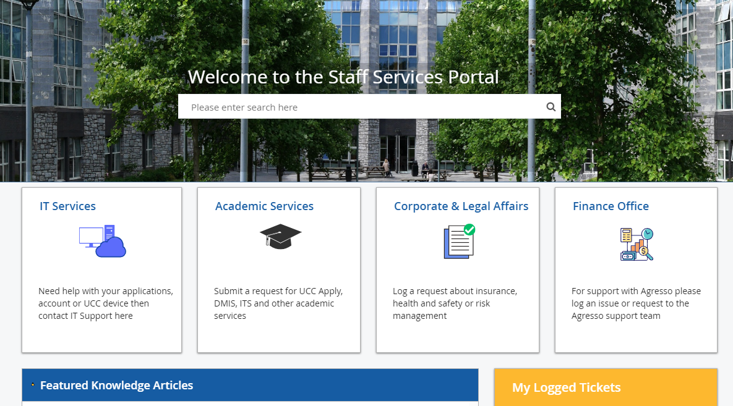
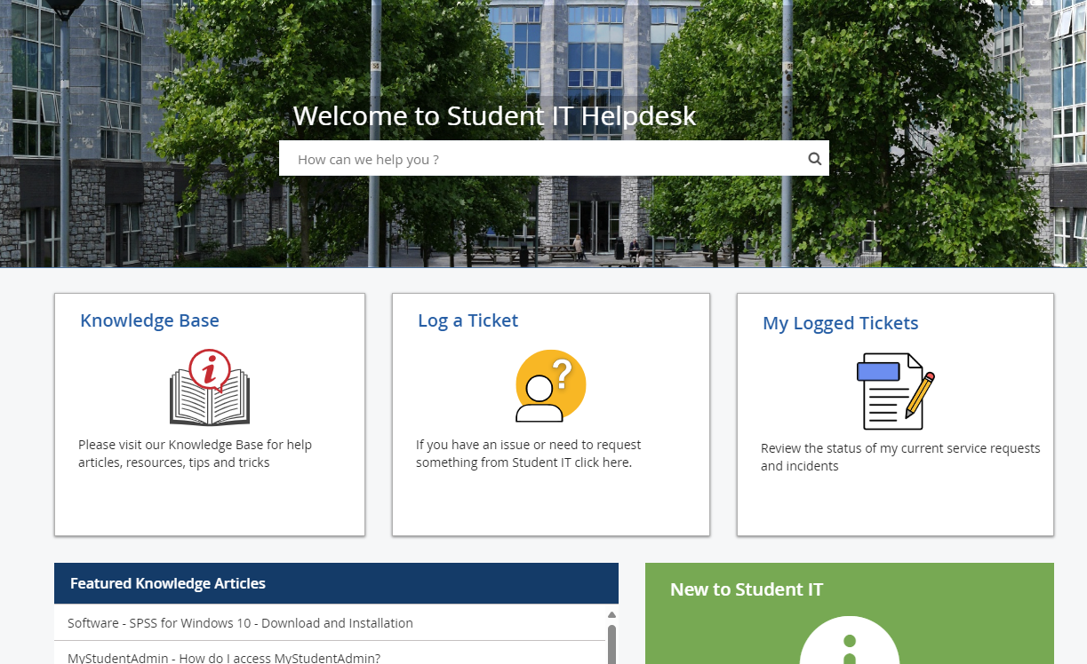
Self Service Portal
Notes:
One stop shop for staff and students
Two areas depending on account used to sign in
List of different departments
Specific forms to automate a lot of work before being directed to the team responsible

Slide 6
Dedicated Support
Monthly Catchups
Announce new changes or features
Share feedback / bugs
Share helpful tips that work well for their teams
Suggest feature idea
SharePoint Site
Instructions on how to log incidents and requests
Short videos on how to create workflows and quick actions
Previous recorded workshops
Direct Support
System administrator
Project manager
External consultants
Extra Workshops
In dept training for specific features in the system
New Super Users added to teams
Notes:
Broke down the sharepoint in regard to roles. Analyst section and a super user section
Under super user section I have various short videos so show people how to correctly setup the workflows for all the forms
Best to have various forms of information available as you don’t know what people prefer to get the information

Slide 7
Advantages
1 central location for all students and staff
Define processes
Move away from email – contingency when members of the team are out of office
Data protection by partitioning different departments
Request workflows allowing a lot manual work be automated
Cloud vs On Prem
SSO – linked with local machine credentials
Web based
More access possibilities via mobile due to browser support
Notes:
Biggest Hurdle was getting people use to the difference between incidents and service requests
Gave departments an opportunity to work on their internal processes and team structures
With everyone using the same role most team processes were aligned
Contingency when team members were out of office
Information accessible to all team members
Data protection for departments by partitioning tickets and users
Contingency for issues in staging – can always refresh the data from the live site to overwrite any errors
Setup two inboxes to one for the test site and one for the live site.
Helpful for troubleshooting – seeing how emails are displayed for the end user
UAT site to see if moving any new changes from the staging site to another site causes any issues that might disrupt the Production site.
Web based - – originally logging in via Virtual App to access On Prem application on the campus network

Slide 8
1
2
3
4
5
July ‘22
August ‘22
October ‘22
November ‘22
Work on feedback received from end users and teams
Kick of the project and design of the system
Onboarding of first two teams
Go Live for Student IT and System Administration
Knowledge base build and design
April ‘23
6
Onboarding and testing for IT Services
11
10
9
8
7
October ‘23
September ‘23
August ‘23
August ‘23
July ‘23
Change Module design & workshops
Go Live for Risk Management Team
Onboard for one team from Office of Corporate and Legal Affairs
Go Live second phase IT Services
Go live first phase of IT Services
12
November ‘23
Create new partition for IT Admins in other departments
13
14
15
16
January ‘24
April ‘24
May ‘24
July ‘24
Go Live for IT Admins
Go live with Change Management
Onboarding one team from Finance department
Go Live for Finance department
USERS
TEAMS
DEPARTMENTS
SERVICES
REQUEST FORMS

Slide 9
USERS
TEAMS
DEPARTMENTS
SERVICES
REQUEST FORMS
Notes:
~70 % Reduction in emails received to individual inboxes
All emails are available within the system
All notes available alongside emails to give everyone an insight on the ticket at hand

Slide 10
,
,
SERVICE REQUESTS
INCIDENTS
October 2022 – October 2024

