Slide 1
Lessons from the trenches on managing cybersecurity Gaining control by breaking it down
Christo Butcher ◂ Executive Consultant ◂ Fox-IT (NCC Group)

Slide 2
Threats
System

Slide 3
Threats

Slide 4
Threats

Slide 5
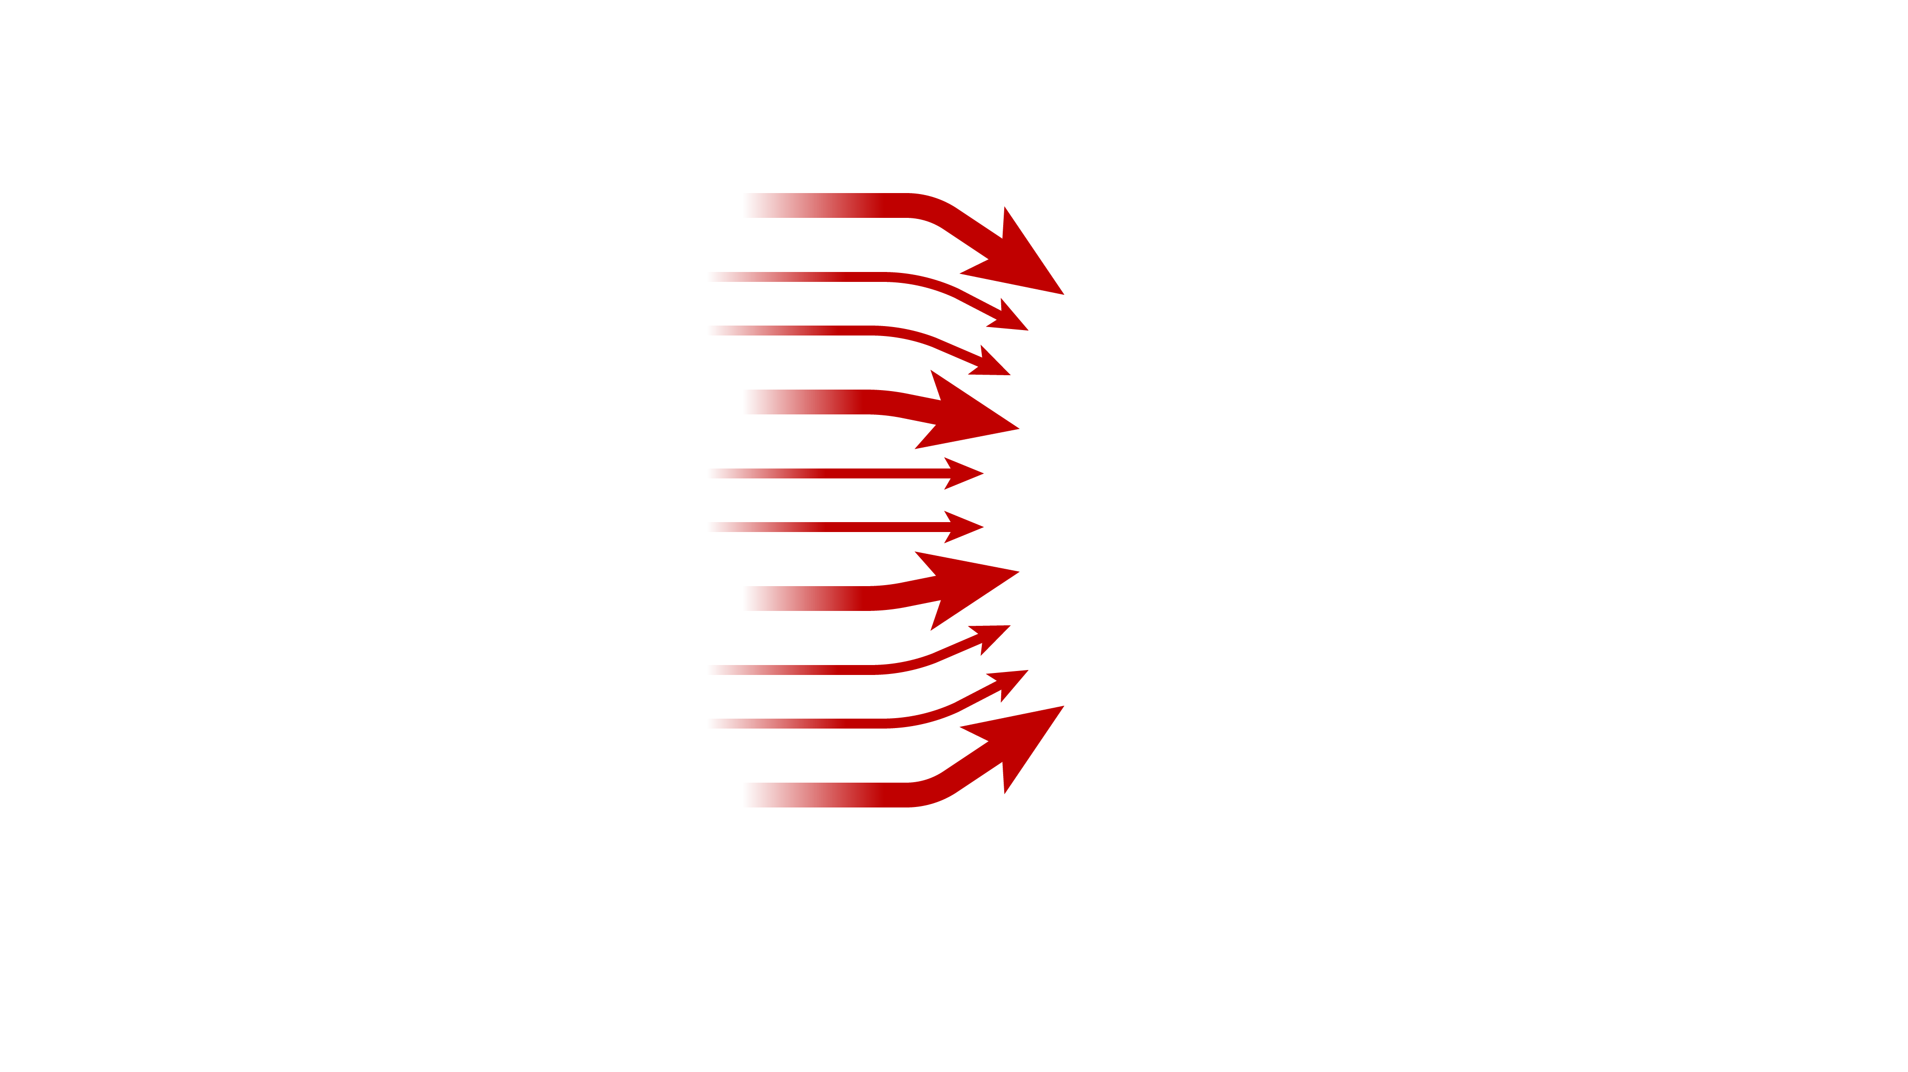
Threats

Slide 6
Ransomware
Data leaks
Business e-mail compromise
Denial of service
Espionage
Sabotage

Slide 7
Social engineering
Ransomware
Data leaks
Attacks targeting clouds
Business e-mail compromise
Denial of service
Attacks on perimeter devices
Espionage
Sabotage
OT & IoT

Slide 8
Social engineering
Ransomware
Data leaks
Attacks targeting clouds
Business e-mail compromise
Denial of service
Attacks on perimeter devices
Espionage
Sabotage
OT & IoT

Slide 9
Welcome to my world

Slide 10
Threats
System

Slide 11
Threats
System
How to think about threats
How to think about security

Slide 12
Threats
System
How to think about threats

Slide 13
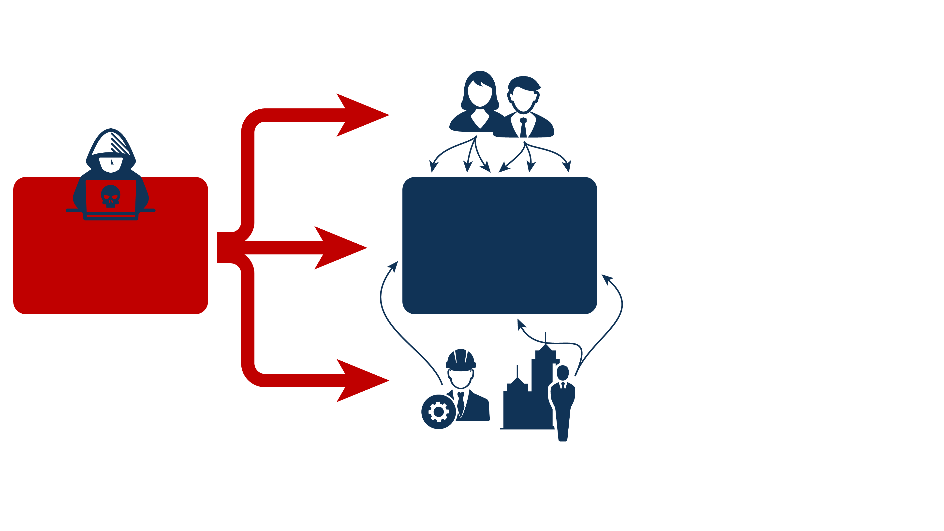
Users
Threats
Tech
Third-parties

Slide 14
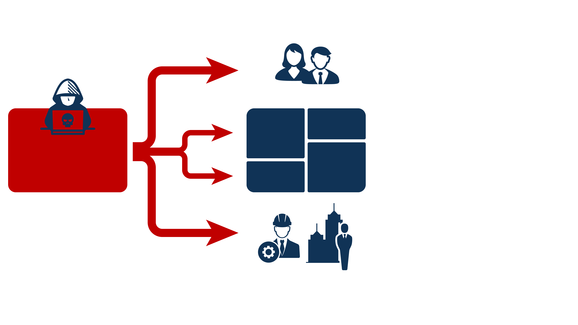
Users
Every organization has multiple
Attack surfaces
Threats
Third-parties

Slide 15
Adversaries use specific
Toolkits (TTPs) for each target environment
Threats

Slide 16
Cyber attacks consist of
Attack chains
Threats

Slide 17
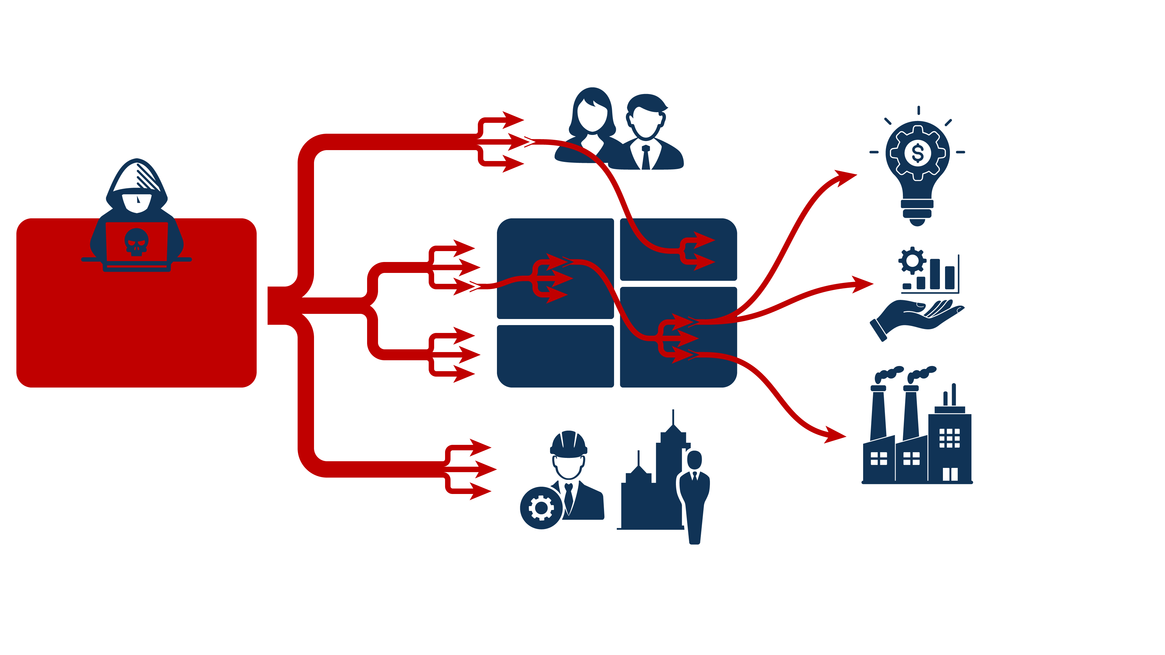
Complex dependencies between IT and Business
Threats
Business

Slide 18
Strategic threats
Where the threats are coming from and what they are targeting
The people (“threat actors”) and their motivations
Tactical threats
How cyberattacks manifest in practice
The tools and techniques (“TTPs”) used by threat actors
Threats
Strategic threats
Who and why
Tactical threats
How and where

Slide 19
Strategic threats
Where the threats are coming from and what they are targeting
The people (“threat actors”) and their motivations
Tactical threats
How cyberattacks manifest in practice
The tools and techniques (“TTPs”) used by threat actors
Threats
Strategic threats
Who and why
Tactical threats
How and where

Slide 20
Threats

Slide 21
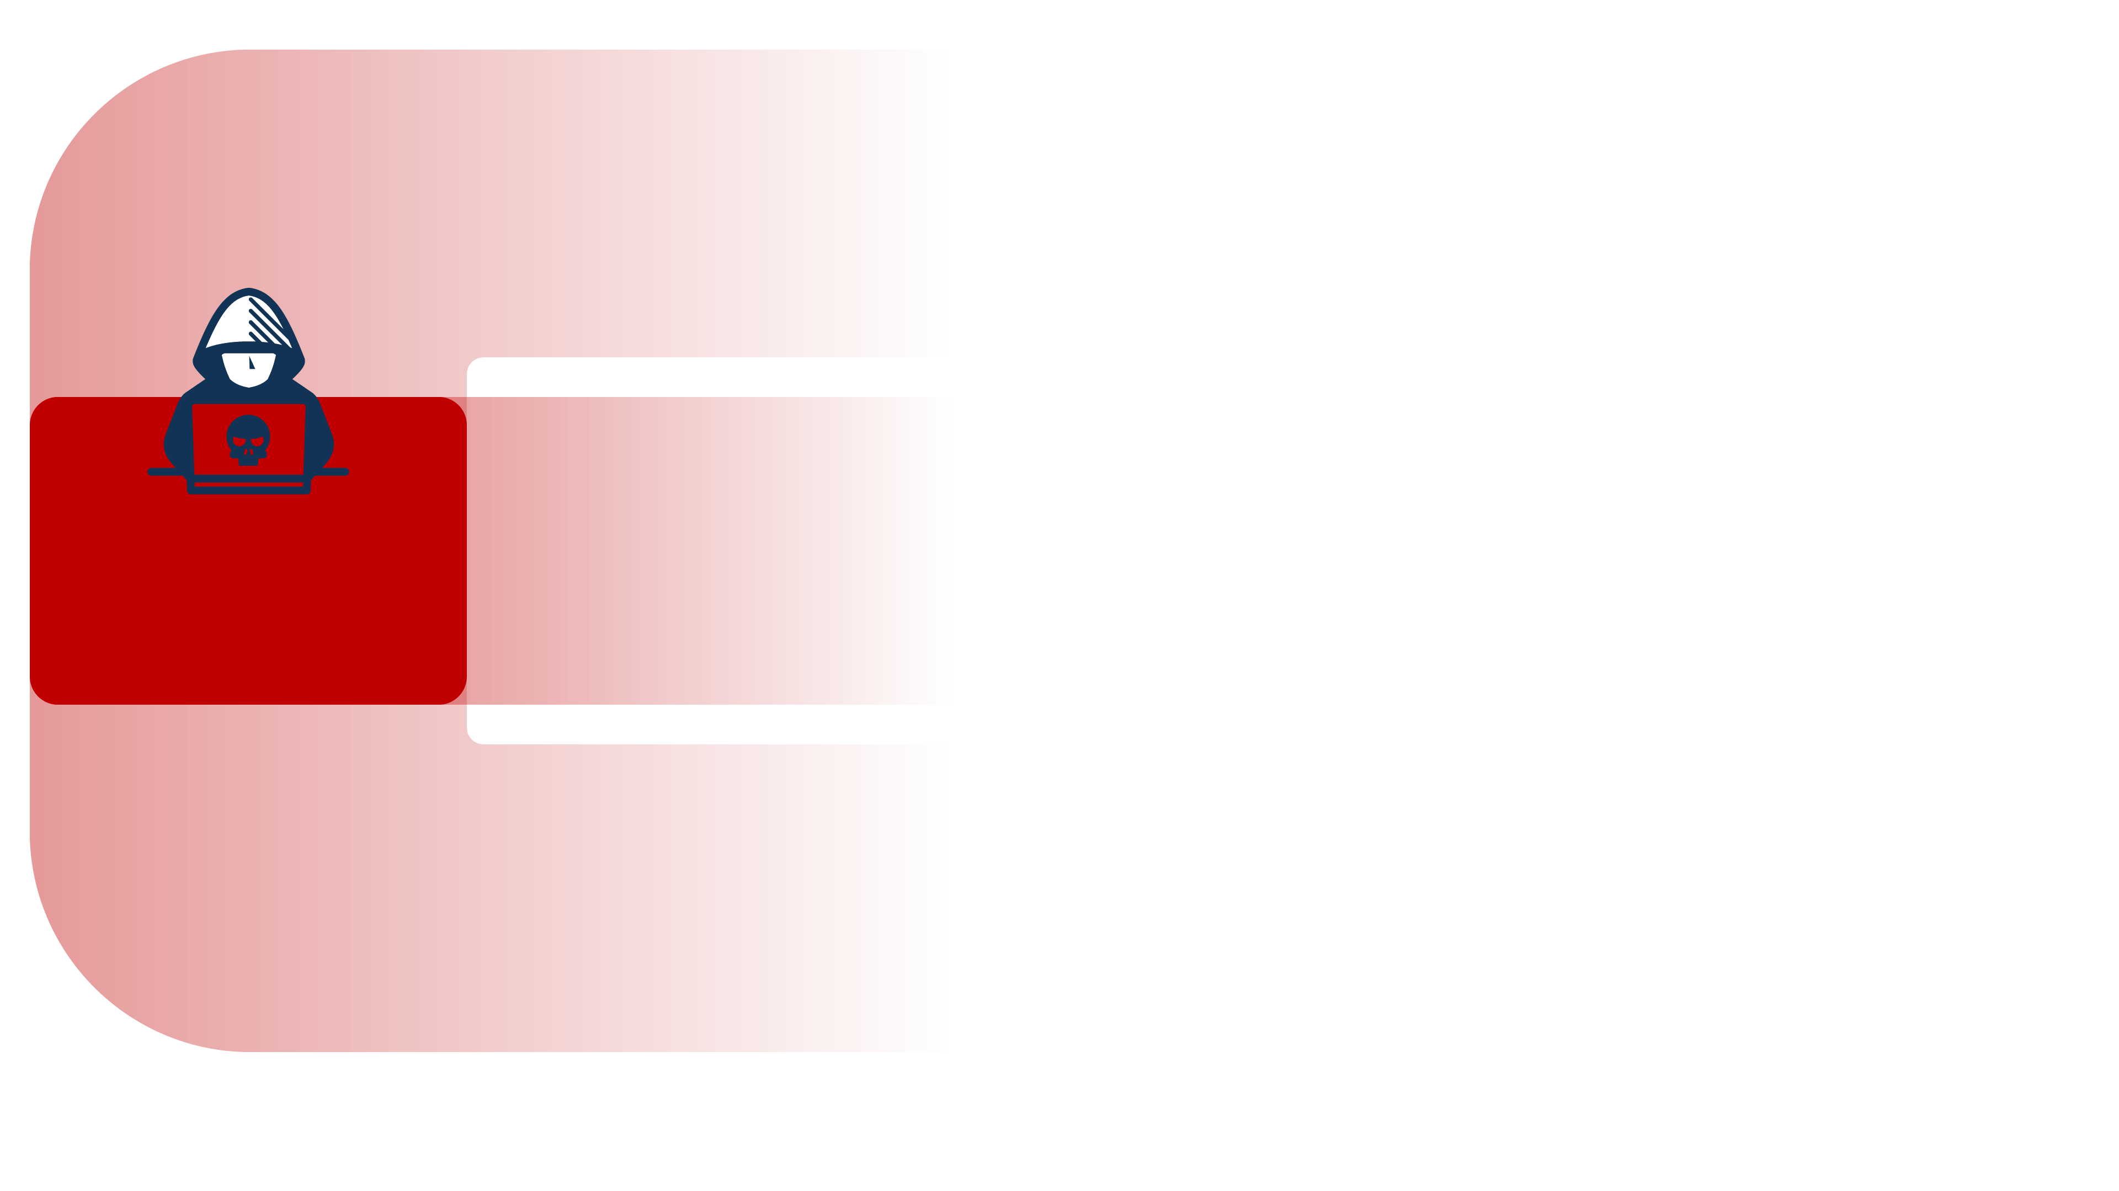
State actors
Driven by national interests and geopolitics
Russian influence operations and sabotage
Chinese espionage and prepositioning
North Korean financial theft
…
Threats
Cyber criminals
Driven by personal gain: money
Ransomware and data theft extortion
Business e-mail compromise
Mobile malware
…
Other motivations
Driven by personal motivations
Intentional insiders, disgruntled empolyees
Unintentional insiders
Hacktivists
…

Slide 22
State actors
Driven by national interests and geopolitics
Russian influence operations and sabotage
Chinese espionage and prepositioning
North Korean financial theft
…
Threats
Cyber criminals
Driven by personal gain: money
Ransomware and data theft extortion
Business e-mail compromise
Mobile malware
…
Cybercrime ecosystem
Money, money, money!
Huge ecosystems
Everything as a service
Other motivations
Driven by personal motivations
Intentional insiders, disgruntled empolyees
Unintentional insiders
Hacktivists
…

Slide 23
Strategic threats
Where the threats are coming from and what they are targeting
The people (“threat actors”) and their motivations
Tactical threats
How cyberattacks manifest in practice
The tools and techniques (“TTPs”) used by threat actors
Threats
Strategic threats
Who and why
Tactical threats
How and where

Slide 24
Strategic threats
Where the threats are coming from and what they are targeting
The people (“threat actors”) and their motivations
Tactical threats
How cyberattacks manifest in practice
The tools and techniques (“TTPs”) used by threat actors
Threats
Strategic threats
Who and why
Tactical threats
How and where

Slide 26
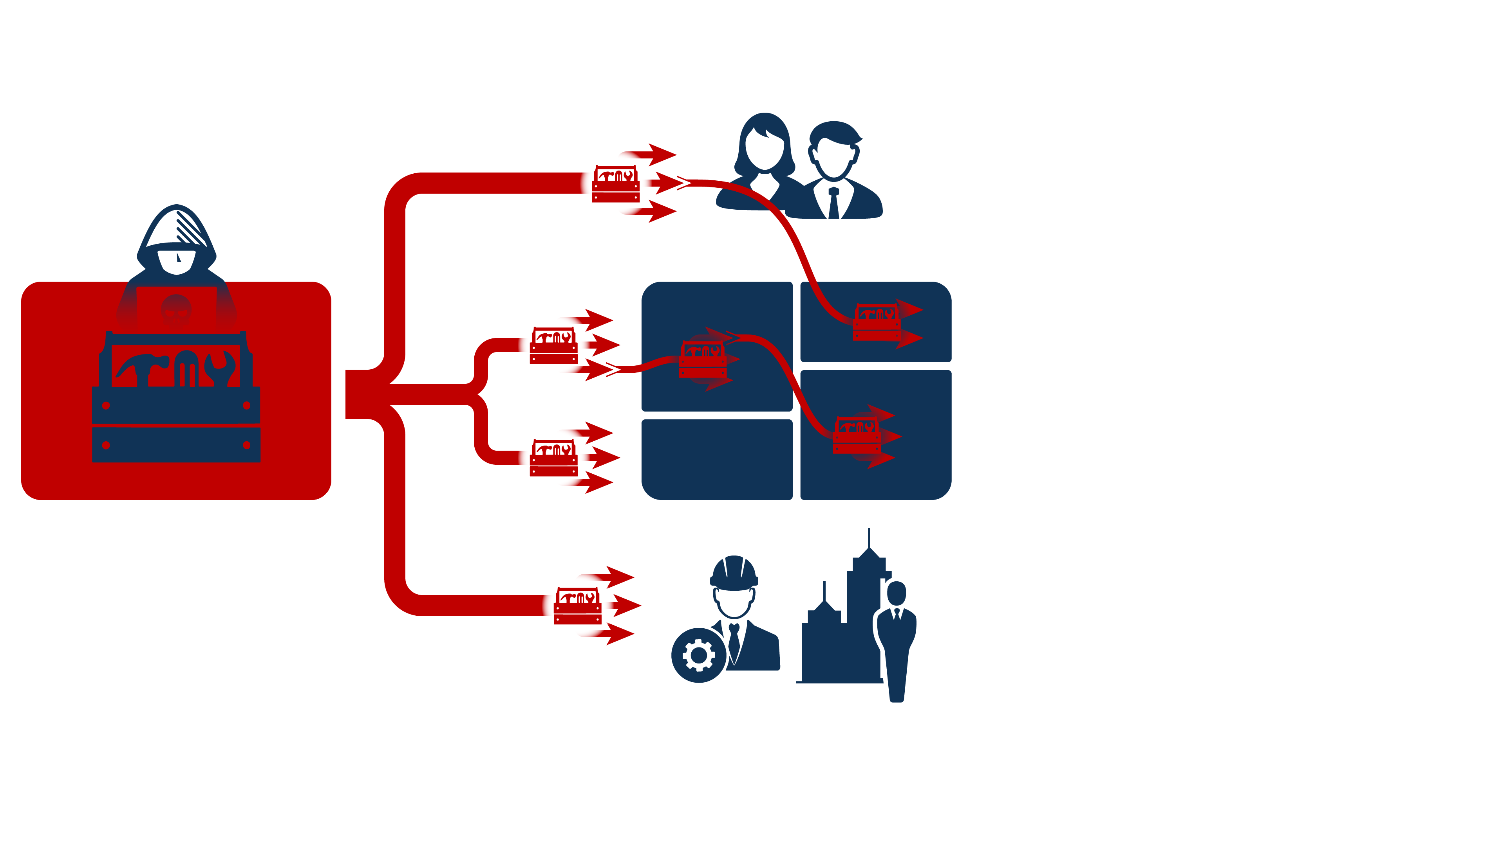
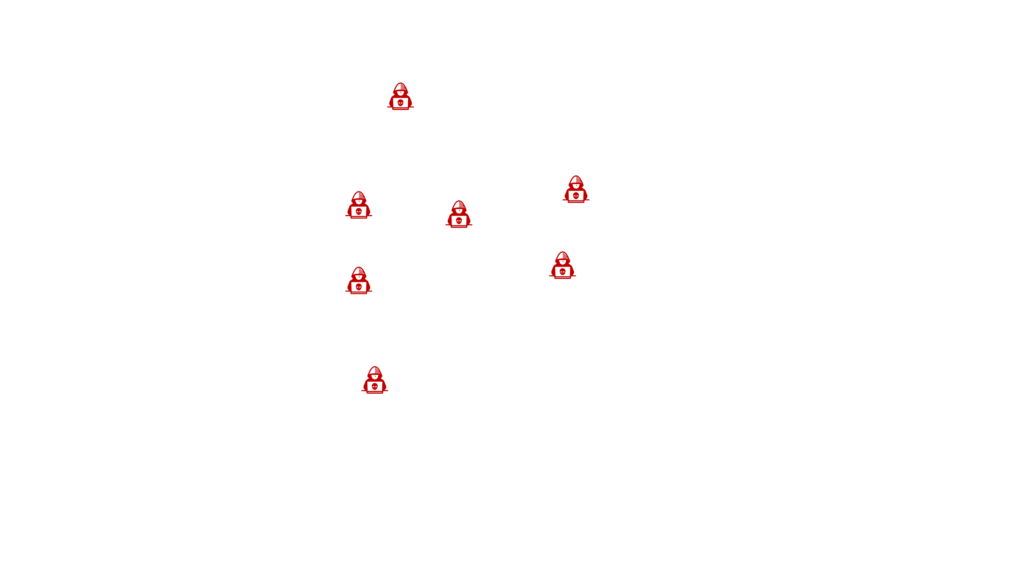

Slide 27
Cloud adoption
Almost everyone is using cloud environments
Applications (SaaS)
Infrastructure (IaaS)
Identity and access management (IAM)

Slide 28
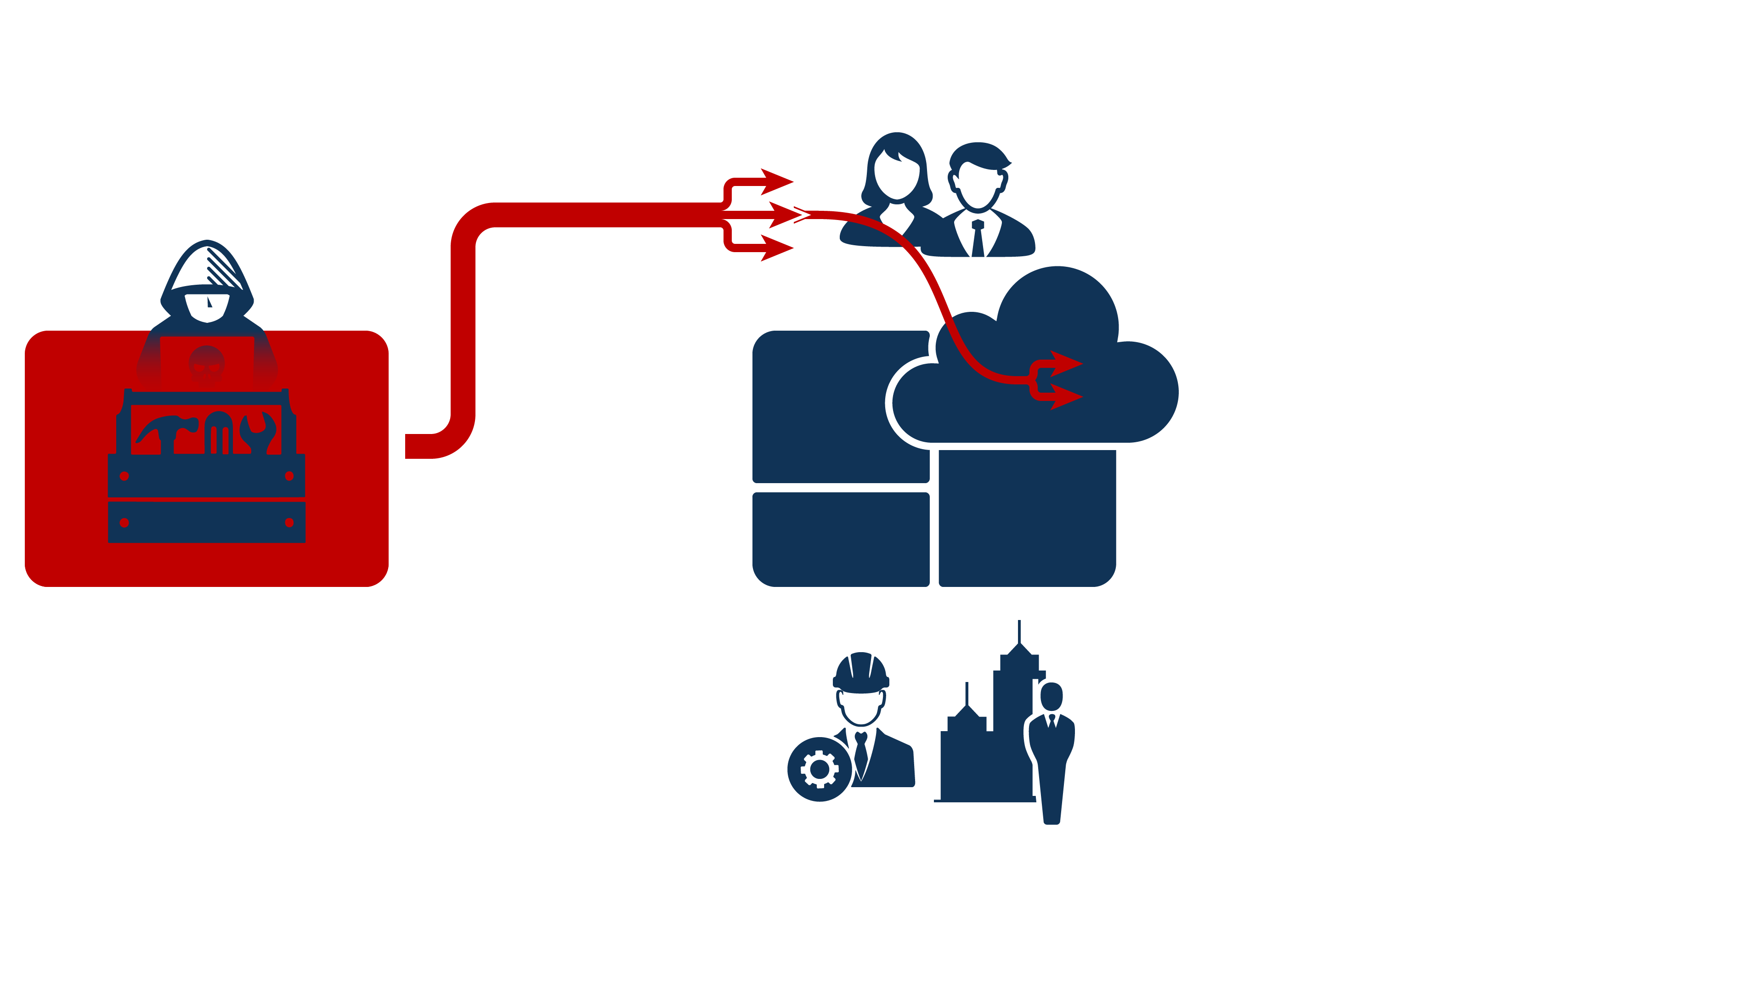
Cloud adoption
Almost everyone is using cloud environments
Applications (SaaS)
Infrastructure (IaaS)
Identity and access management (IAM)
Cloud targeting
Threat actors are following their victims into the clouds

Slide 29
Cloud is everywhere
… and threat actors know it 😈
Identity is key
They want your MFA
And they have backdoors

Slide 30
Cloud is everywhere
… and threat actors know it 😈
Adversary logs in to compromised user account
Initial access
Adversary phishes user and steals session token
Initial access
Adversary prepares infrastructure to bypass MFA
Resource development

Slide 31
Adversary creates backdoor to maintain persistence
Persistence
Cloud is everywhere
… and threat actors know it 😈
Adversary creates inbox rules to hide activity
Defense evasion
Adversary steals data, performs fraud, …
Impact, exfiltration
Adversary logs in to compromised user account
Initial access
Adversary phishes user and steals session token
Initial access
Adversary prepares infrastructure to bypass MFA
Resource development

Slide 32
Adversary creates backdoor to maintain persistence
Create new user accounts
Register new apps
Hijack existing apps
Persistence
Cloud is everywhere
… and threat actors know it 😈
Adversary creates inbox rules to hide activity
Defense evasion
Adversary steals data, performs fraud, …
Impact, exfiltration
Adversary logs in to compromised user account
Mimic legitimate users: geo location, user agent, …
Initial access
Defense evasion
Adversary phishes user and steals session token
Initial access
Adversary prepares infrastructure to bypass MFA
Open source tools
MFA bypass “as-a-Service”
Resource development

Slide 33
Lessons
Good MFA, bad MFA Use phishing resistant MFA
Protect identities Respond to suspicious activity
Post-compromise TTPs Identify, protect, detect, respond
Adversary creates backdoor to maintain persistence
Create new user accounts
Register new apps
Hijack existing apps
Persistence
Adversary creates inbox rules to hide activity
Defense evasion
Adversary steals data, performs fraud, …
Impact, exfiltration
Adversary logs in to compromised user account
Mimic legitimate users: geo location, user agent, …
Initial access
Defense evasion
Adversary phishes user and steals session token
Initial access
Adversary prepares infrastructure to bypass MFA
Open source tools
MFA bypass “as-a-Service”
Resource development

Slide 34
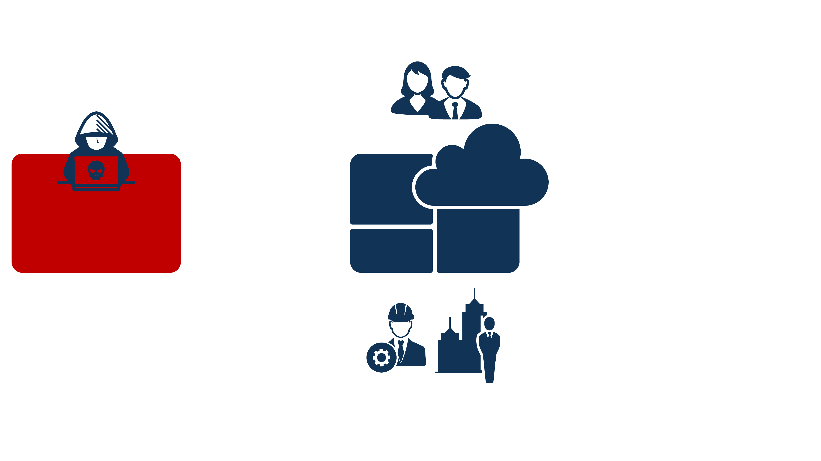
Bring your own device (BYOD)
People like to bring their own devices

Slide 35
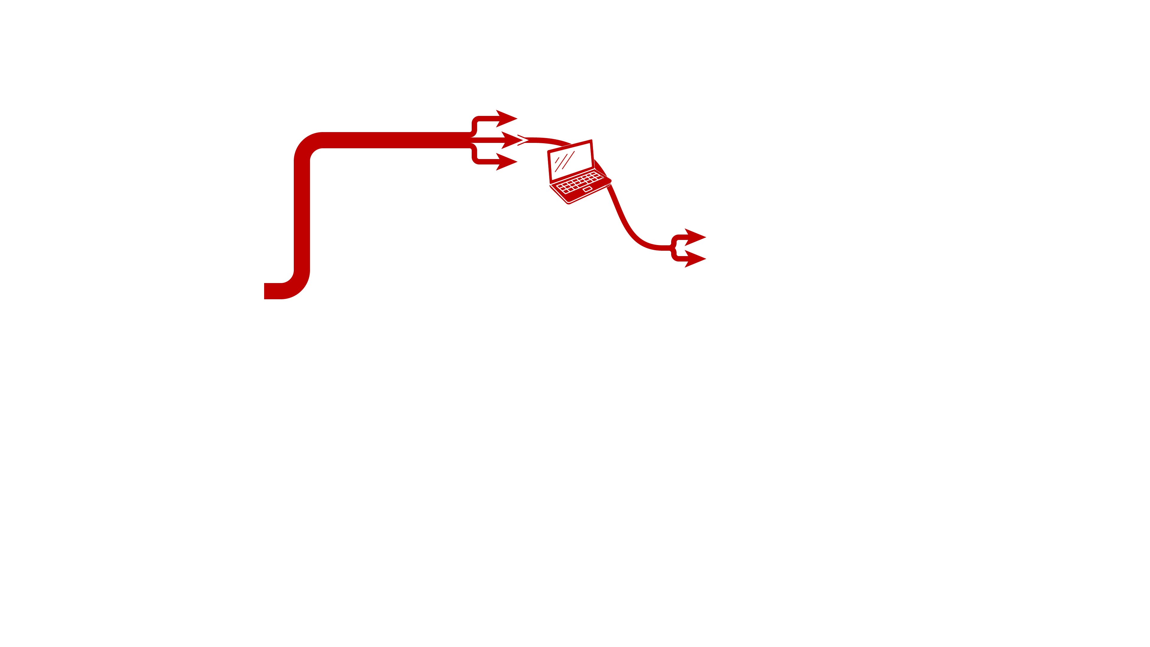
Bring your own device (BYOD)
People like to bring their own devices
Bring your adversary’s device (BYAD)
Adversaries also like to bring their own devices 😈

Slide 36
Lessons
BYOD introduces big risk Avoid if possible: allow access only from managed devices
BYOD threat modeling If BYOD cannot be avoided, then mitigate its risks by threat modeling using up-to-date threat intelligence
Adversary creates backdoor to maintain persistence
Create new user accounts
Register new apps
Hijack existing apps
Persistence
Adversary steals data, performs fraud, deploys ransomware, …
Impact, exfiltration
Adversary logs in to compromised user account
BYAD: Access resources from adversary-controlled device
Initial access
Defense evasion
Adversary phishes user and steals session token
Initial access
Adversary prepares infrastructure to bypass MFA
Open source tools
MFA bypass “as-a-Service”
Resource development

Slide 37
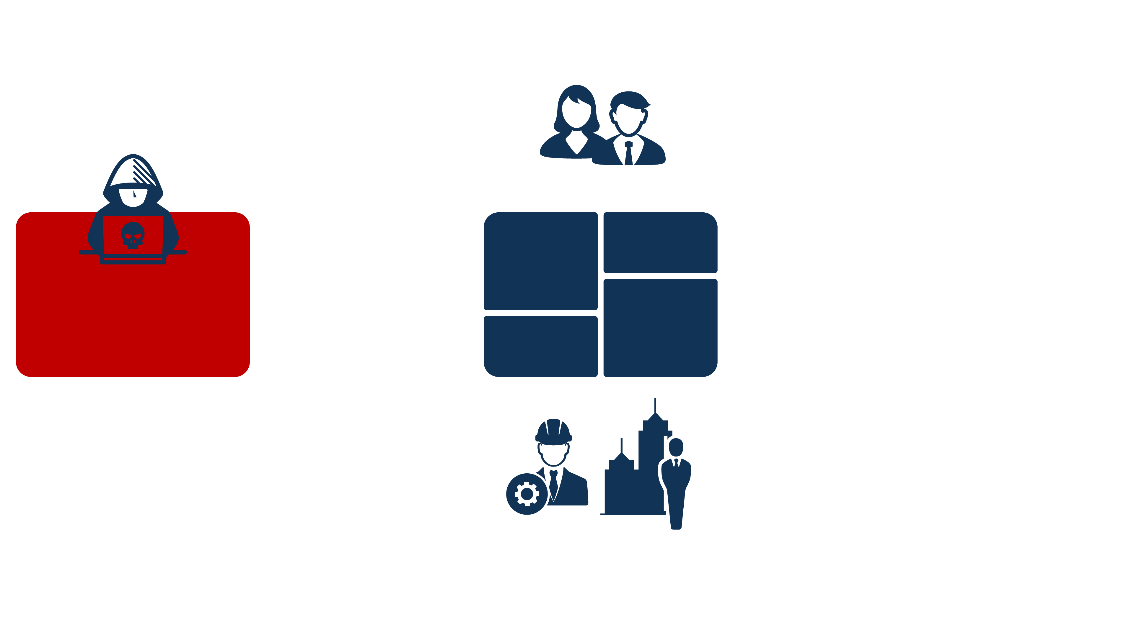
Most organizations have an
external attack surface full of complex systems
Perimeter devices are popular
for remote access, VPN, file transfer, etc.

Slide 38
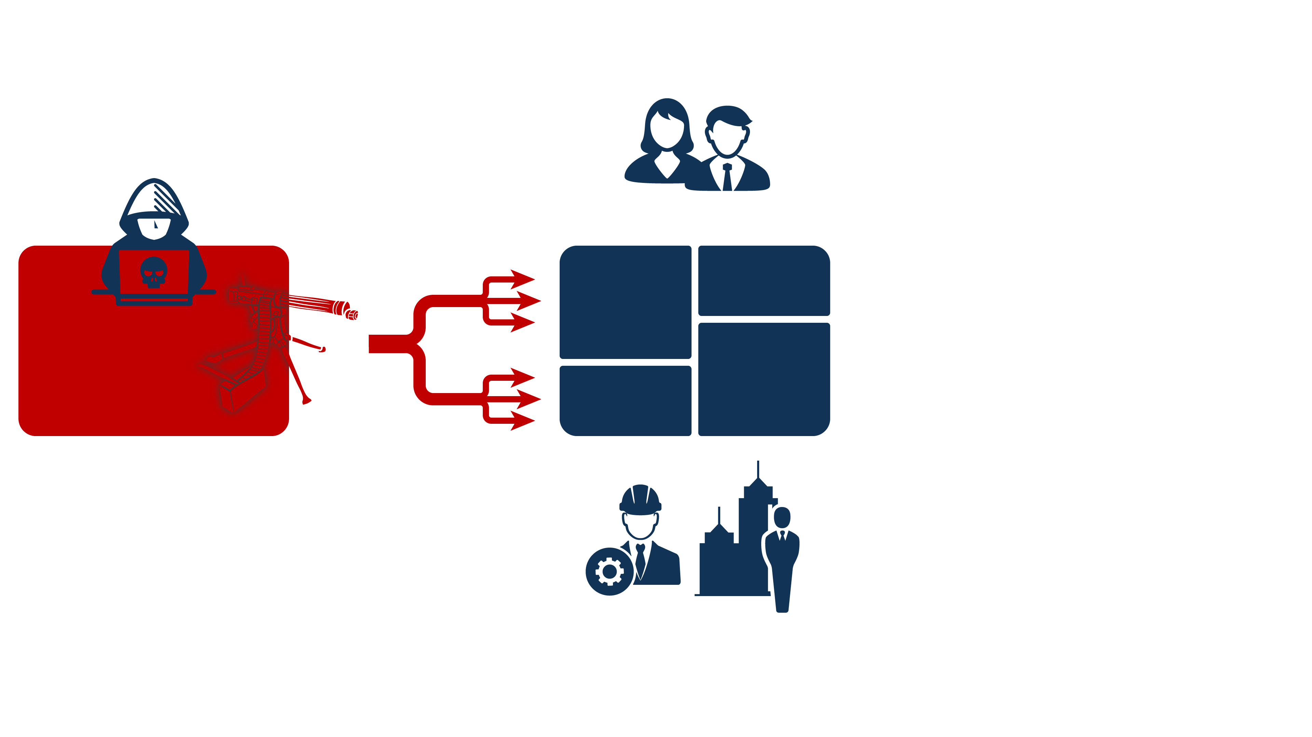
Adversaries are always looking for “opportunities” to get in

Slide 39
Front door
… with backdoor included 😈
Perimeter devices targeted by large scale campaigns
Perimeter devices introduce significant security risk due to ideal positioning in networks
First targeted espionage, then mass cybercrime

Slide 40
Front door
… with backdoor included 😈
Gain initial access by exploiting vulnerable device
Initial access
Scan internet for vulnerable devices
Reconnaissance
Find vulnerabilities and develop exploits
Resource development

Slide 41
Front door
… with backdoor included 😈
Months
Gain initial access by exploiting vulnerable device
Espionage, data theft
Initial access
Exfiltration
Scan internet for vulnerable devices
Reconnaissance
Persistence
Discovery
Find vulnerabilities and develop exploits
Privilege escalation
Resource development
Lateral movement
Pivot into target network

Slide 42
Front door
… with backdoor included 😈
Months
Gain initial access by exploiting vulnerable device
Initial access
Location of edge devices makes them ideal stepping stone into network
Espionage, data theft
Exfiltration
Scan internet for vulnerable devices
Reconnaissance
Persistence
Stealthy attacks, living-off-the-land
Custom tools and techniques to avoid detection
Discovery
Find vulnerabilities and develop exploits
Privilege escalation
Zero-day development: research, buy, steal, …
No patches available 😉
Resource development
Lateral movement
Pivot into target network

Slide 43
Front door
… with backdoor included 😈
Public CVE
Months
Gain initial access by exploiting vulnerable device
Initial access
Location of edge devices makes them ideal stepping stone into network
Espionage, data theft
Exfiltration
Scan internet for vulnerable devices
Reconnaissance
Persistence
Stealthy attacks, living-off-the-land
Custom tools and techniques to avoid detection
Discovery
Find vulnerabilities and develop exploits
Privilege escalation
Zero-day development: research, buy, steal, …
No patches available 😉
Resource development
Lateral movement
Pivot into target network

Slide 44
Mass exploitation of vulnerable devices
Race to compromise systems
Sometimes multiple threat actors on a system
Initial access
Persistence
Common cybercrime tools and techniques
Circumvent early patching from vendors
Discovery
Privilege escalation
Mass scanning for vulnerable devices
Lateral movement
Reconnaissance
Pivot into target network
Data theft
Ransomware
Exfiltration
Many developers
Public, security researchers, cybercrime communities
Race to develop exploits
Resource development
Impact
Profit! 😈
Public CVE
Days
Months
Gain initial access by exploiting vulnerable device
Initial access
Location of edge devices makes them ideal stepping stone into network
Espionage, data theft
Exfiltration
Scan internet for vulnerable devices
Reconnaissance
Persistence
Stealthy attacks, living-off-the-land
Custom tools and techniques to avoid detection
Discovery
Find vulnerabilities and develop exploits
Privilege escalation
Zero-day development: research, buy, steal, …
No patches available 😉
Resource development
Lateral movement
Pivot into target network

Slide 45
Mass exploitation of vulnerable devices
Race to compromise systems
Sometimes multiple threat actors on a system
Initial access
Persistence
Common cybercrime tools and techniques
Circumvent early patching from vendors
Discovery
Privilege escalation
Mass scanning for vulnerable devices
Lateral movement
Reconnaissance
Pivot into target network
Data theft
Ransomware
Exfiltration
Many developers
Public, security researchers, cybercrime communities
Race to develop exploits
Resource development
Impact
Profit! 😈
Public CVE
Days
Months
Gain initial access by exploiting vulnerable device
Initial access
Location of edge devices makes them ideal stepping stone into network
Espionage, data theft
Exfiltration
Scan internet for vulnerable devices
Reconnaissance
Persistence
Stealthy attacks, living-off-the-land
Custom tools and techniques to avoid detection
Discovery
Find vulnerabilities and develop exploits
Privilege escalation
Zero-day development: research, buy, steal, …
No patches available 😉
Resource development
Lateral movement
Pivot into target network

Slide 46
Mass exploitation of vulnerable devices
Race to compromise systems
Sometimes multiple threat actors on a system
Lessons
All internet facing systems are targets Don’t rely on their security
Patching is important! But doesn’t stop zero-days
Assume breach Defense in depth, zero trust
Initial access
Persistence
Common cybercrime tools and techniques
Circumvent early patching from vendors
Discovery
Privilege escalation
Mass scanning for vulnerable devices
Lateral movement
Reconnaissance
Pivot into target network
Data theft
Ransomware
Exfiltration
Many developers
Public, security researchers, criminal darkwebs
Race to develop exploits
Resource development
Impact
Profit! 😈
Public CVE
Days
Months
Gain initial access by exploiting vulnerable device
Initial access
Location of edge devices makes them ideal stepping stone into network
Espionage, data theft
Exfiltration
Scan internet for vulnerable devices
Reconnaissance
Persistence
Stealthy attacks, living-off-the-land
Custom tools and techniques to avoid detection
Discovery
Find vulnerabilities and develop exploits
Privilege escalation
Zero-day development: research, buy, steal, …
No patches available 😉
Resource development
Lateral movement
Pivot into target network

Slide 47
Mass exploitation of vulnerable devices
Race to compromise systems
Sometimes multiple threat actors on a system
Initial access
Persistence
Common cybercrime tools and techniques
Circumvent early patching from vendors
Discovery
Privilege escalation
Mass scanning for vulnerable devices
Lateral movement
Reconnaissance
Pivot into target network
Data theft
Ransomware
Exfiltration
Many developers
Public, security researchers, criminal darkwebs
Race to develop exploits
Resource development
Impact
Profit! 😈
Public CVE
Days
Months
Gain initial access by exploiting vulnerable device
Initial access
Location of edge devices makes them ideal stepping stone into network
Espionage, data theft
Exfiltration
Scan internet for vulnerable devices
Reconnaissance
Persistence
Stealthy attacks, living-off-the-land
Custom tools and techniques to avoid detection
Discovery
Find vulnerabilities and develop exploits
Privilege escalation
Zero-day development: research, buy, steal, …
No patches available 😉
Resource development
Lateral movement
Pivot into target network

Slide 48
Citrix
Juniper
SonicWall
Ivanti
ConnectWise
Ivanti
Cisco
Cisco
Ivanti
Ivanti
Cisco
F5
Ivanti
Citrix
Fortinet
Fortinet
Palo Alto
Check Point
SonicWall
Fortinet
Fortinet
Oct
Nov
Dec
Jan
Feb
Mar
Apr
May
Jun
Jul
Aug
Sep
Oct
2023
2024

Slide 49
Threats
System
How to think about threats
How to think about security

Slide 50
Threats
System
How to think about security

Slide 51
Photo by Nam Anh on Unsplash

Slide 52
Threats
System
How to think about security

Slide 53
Threats
How to think about security

Slide 54
Threats
System

Slide 55
Threats
System

Slide 56
Users
Threats
System
Third-parties

Slide 57
Users
Threats
Third-parties

Slide 58
Threats

Slide 59
Threats

Slide 60
Threats
Business

Slide 61
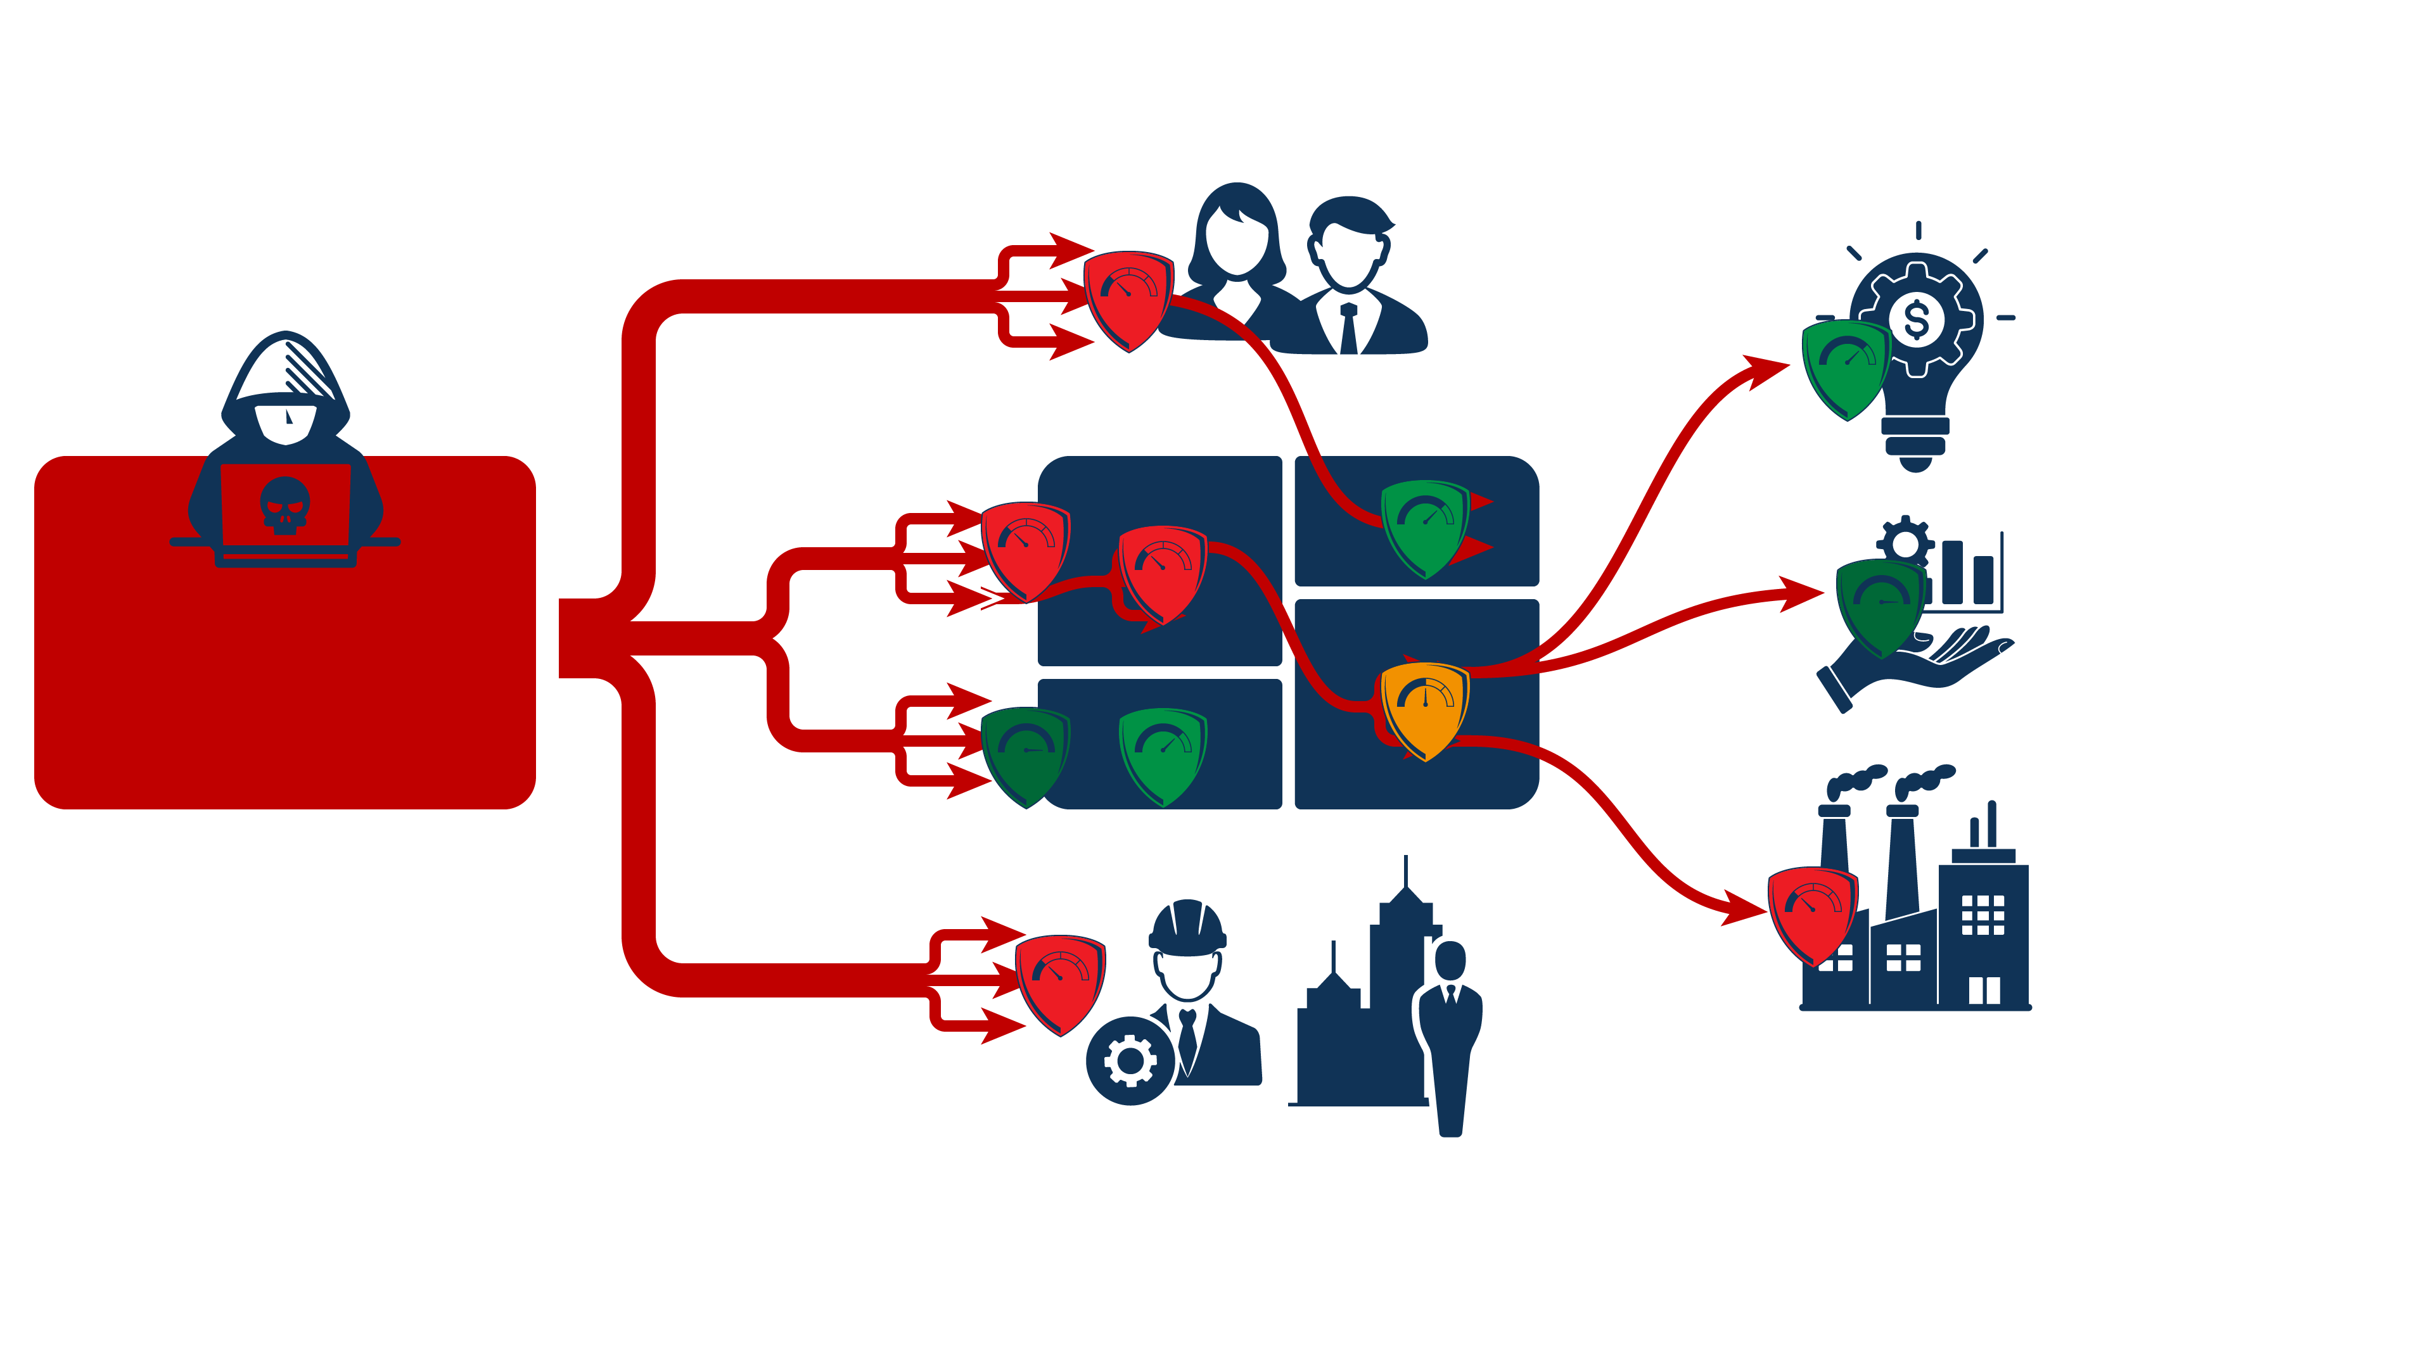
Threats
Business

Slide 62
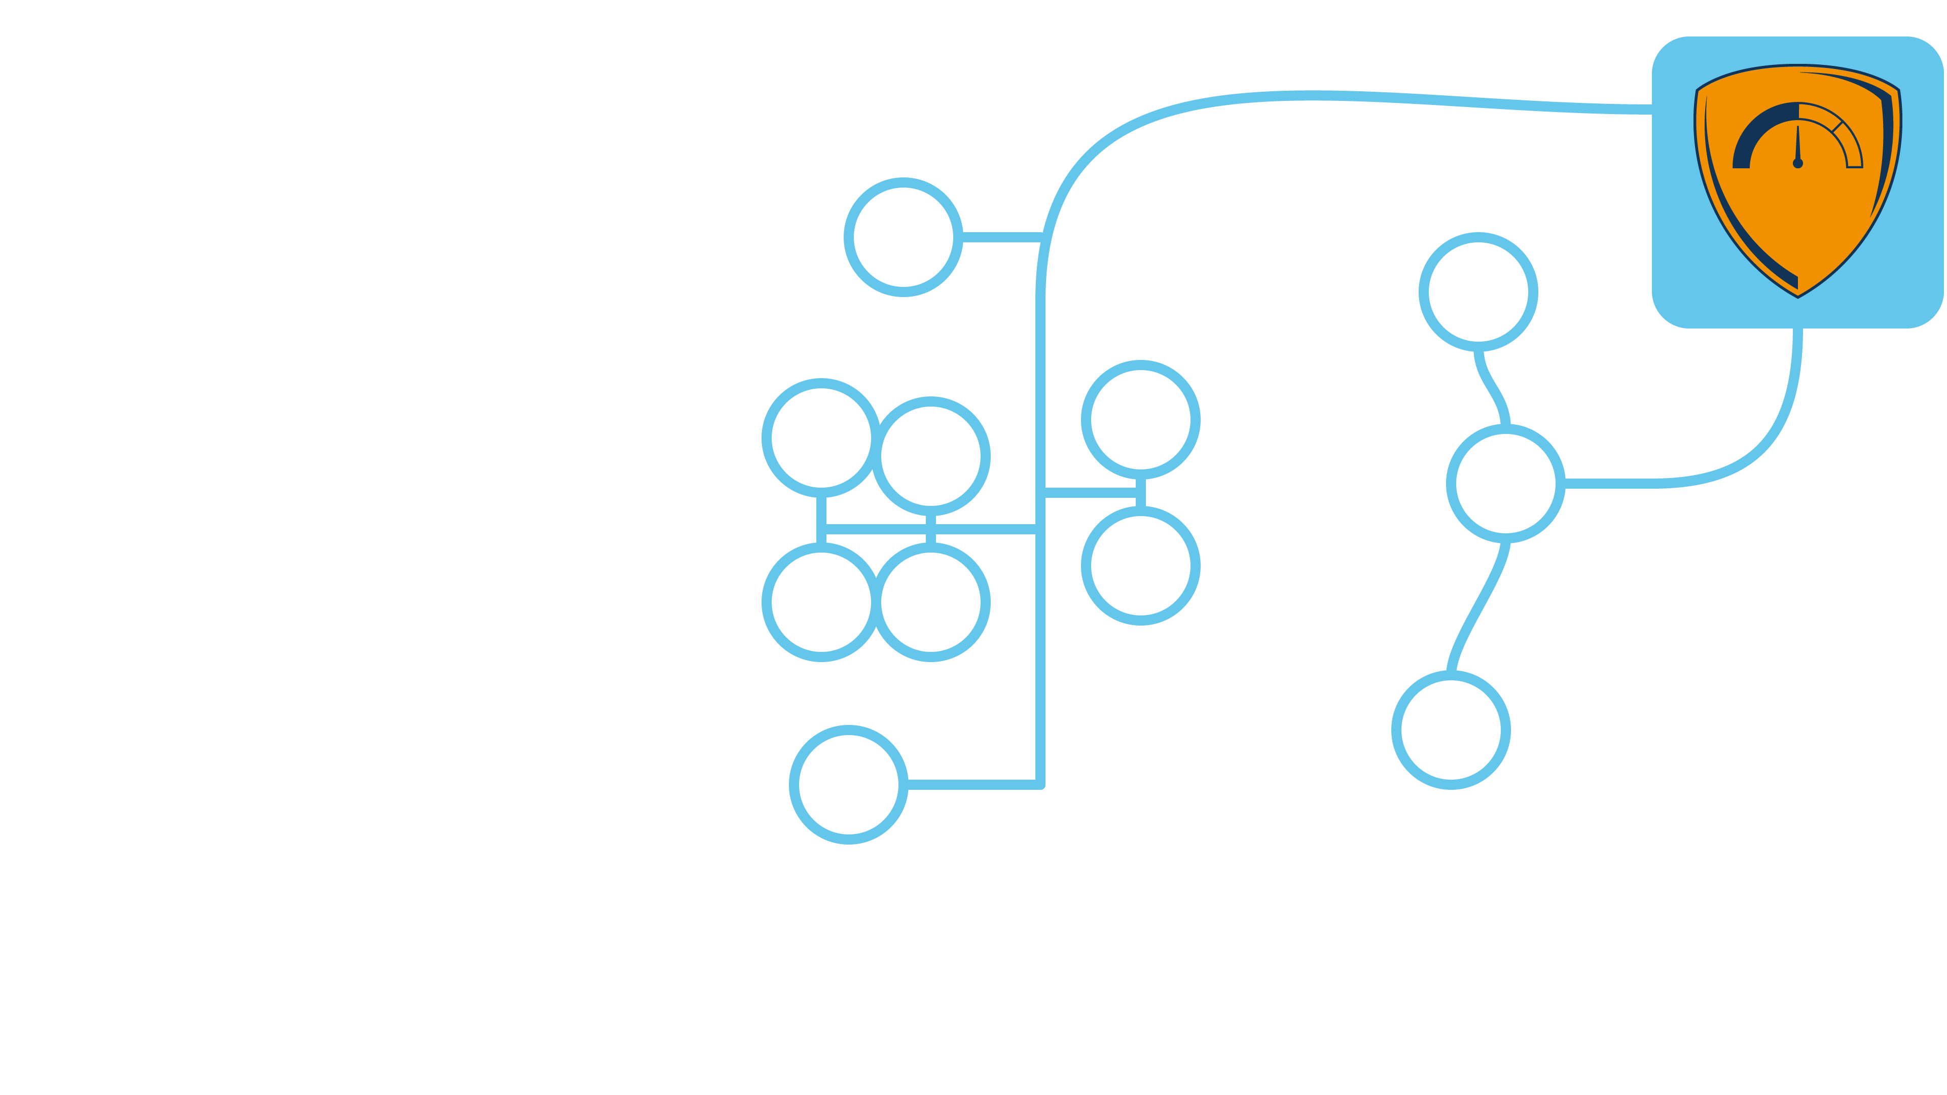
“The security” of an organization?
Security is like a chain, weakest link and all…
No! Security is like a multidimensional dance floor where adversaries can perform acrobatic feats moving, pivoting and jumping!

Slide 63
“The security” of an organization?
Combination of the security of its parts
Combined in a way that fits with its “business”
Choosing the right “parts” makes security clear, concrete, and measurable

Slide 64
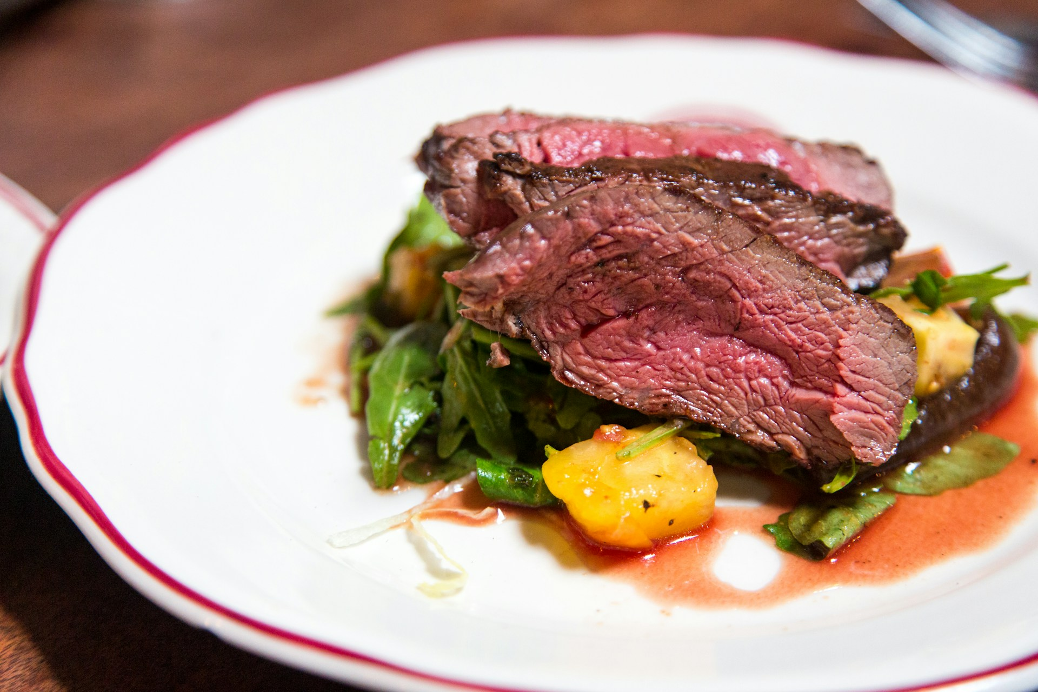
Photo by Jason Leung on Unsplash

Slide 65
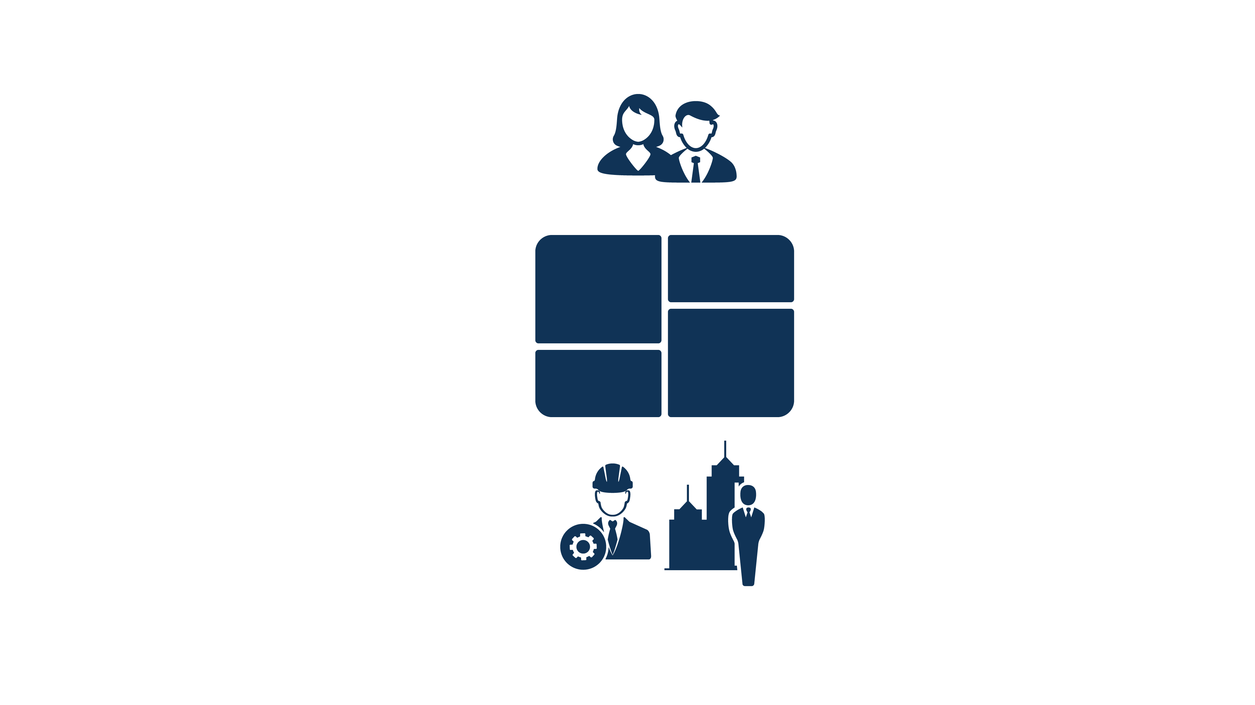
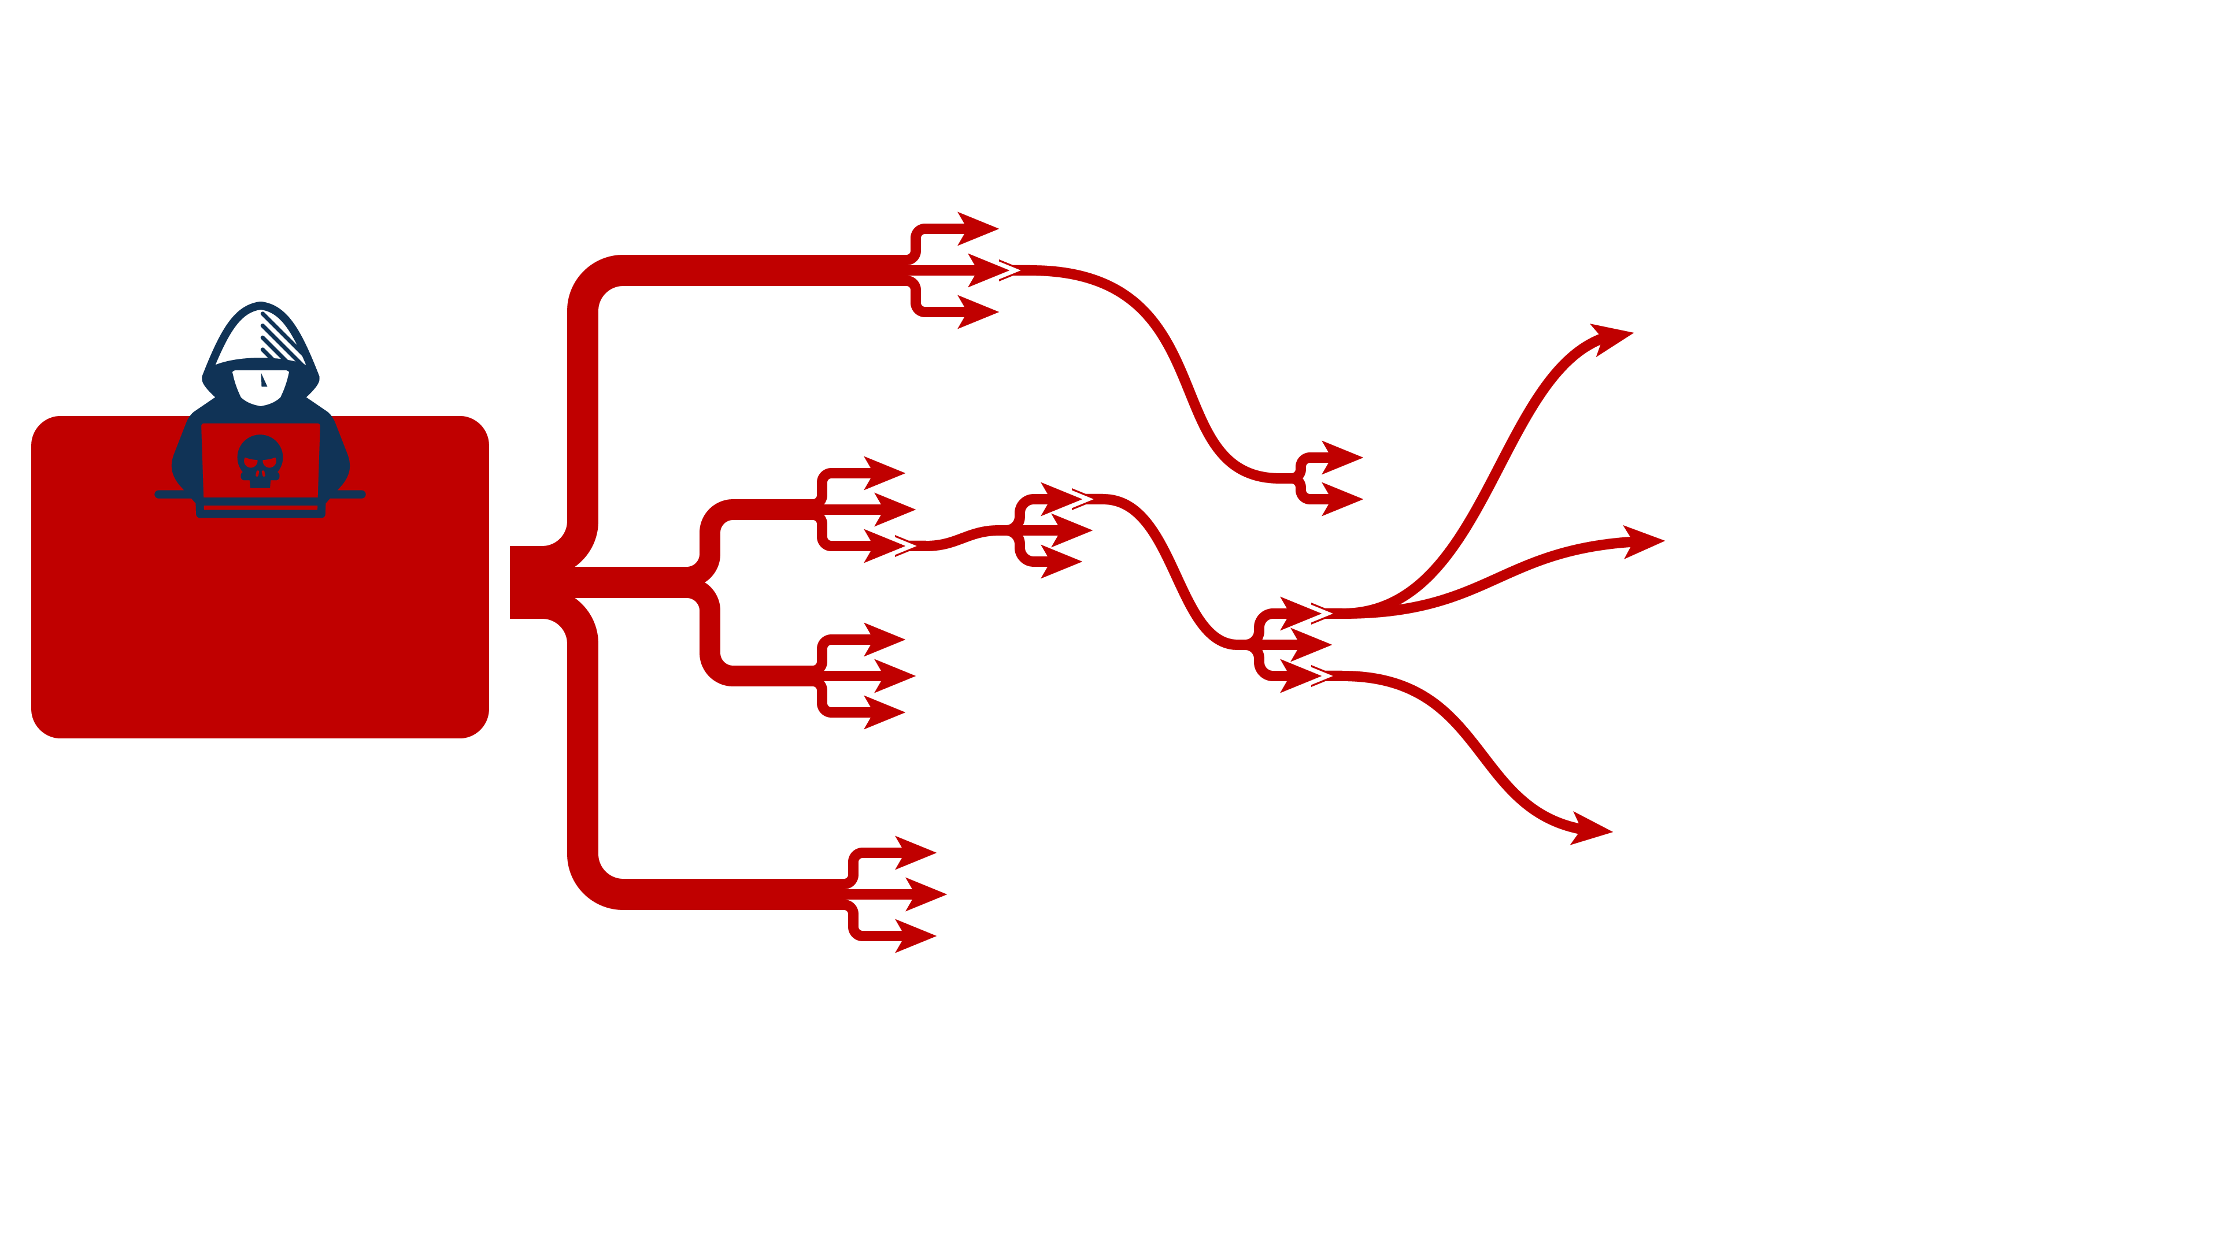
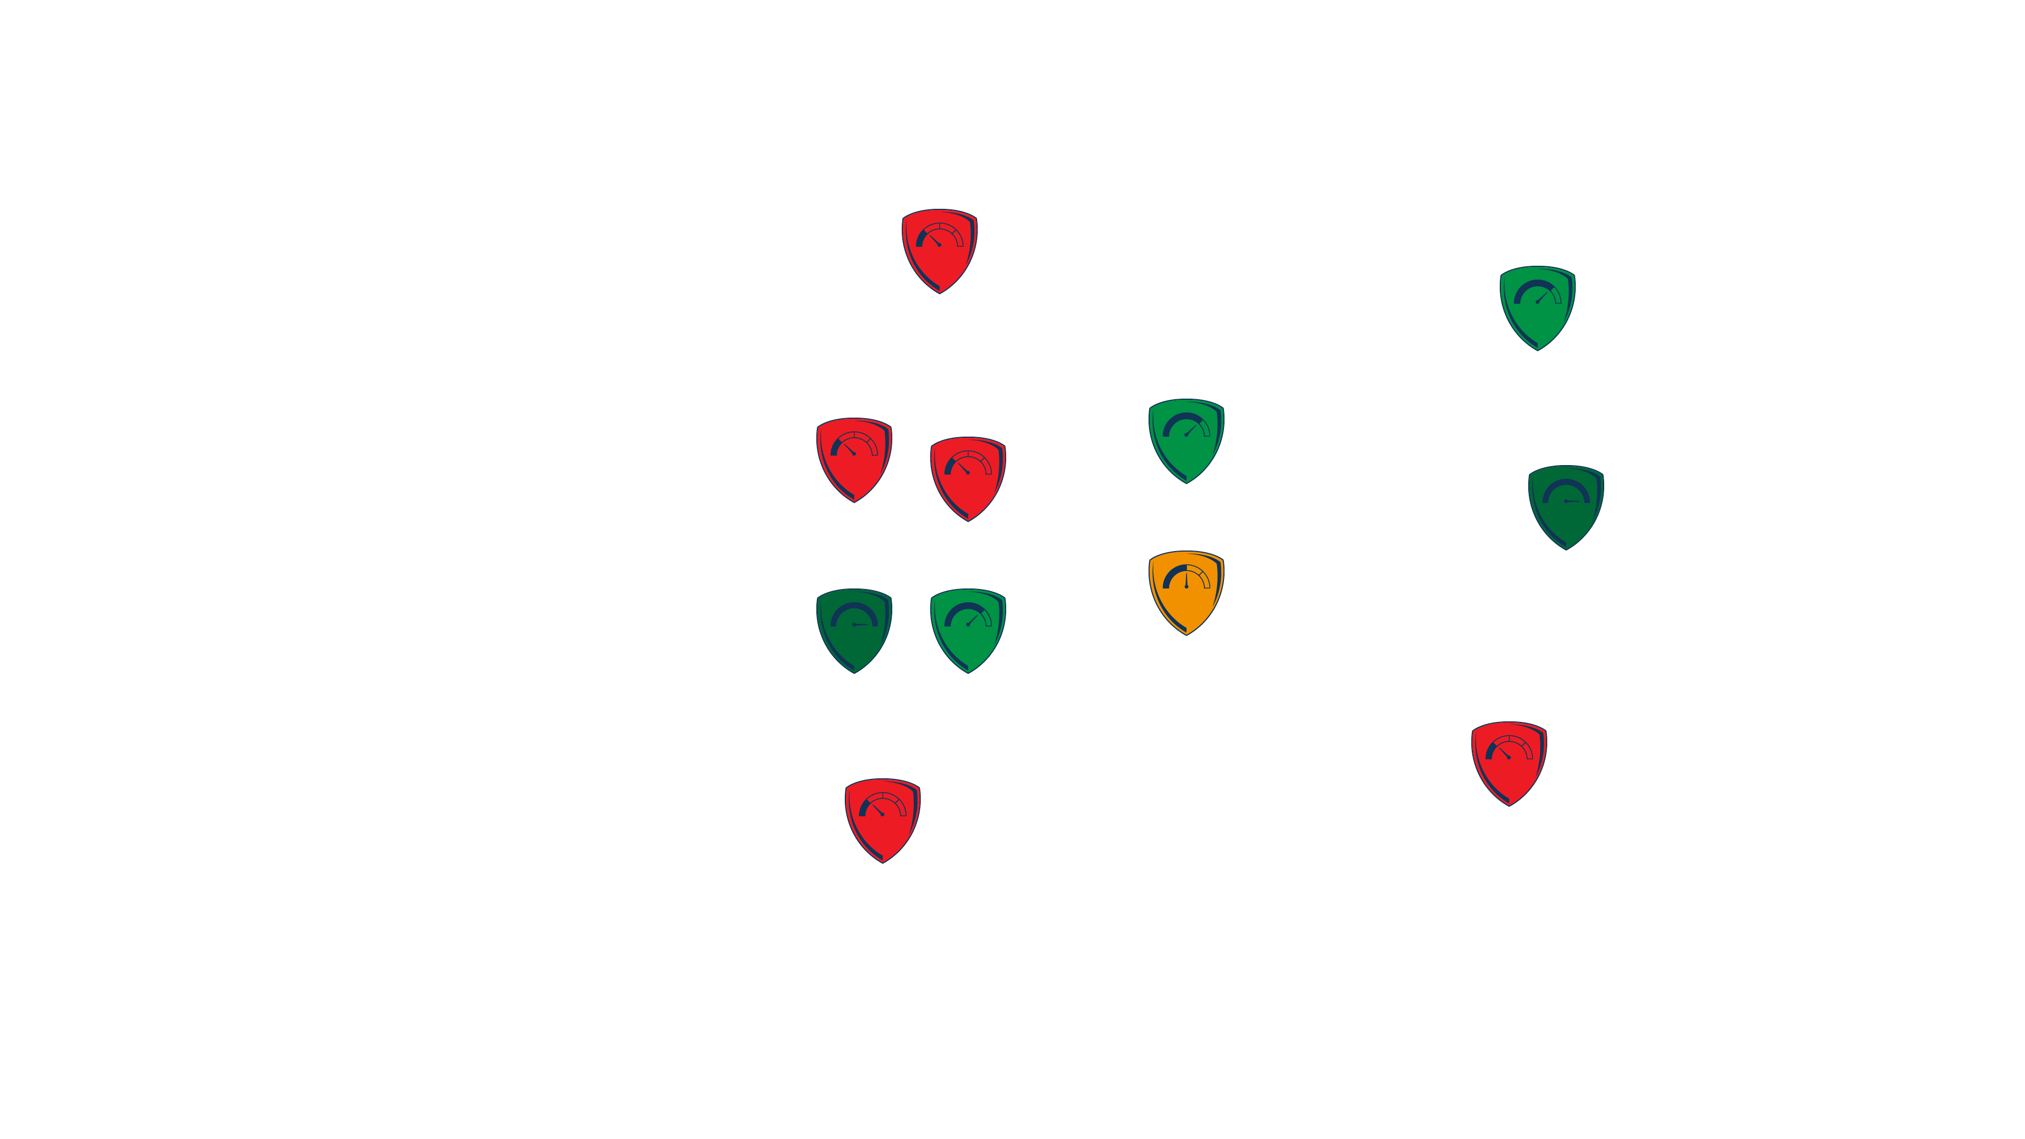
“The security” of an organization?
Combination of the security of its parts
Combined in a way that fits with its “business”
Choosing the right “parts” makes security clear, concrete, and measurable

Slide 66
Each part (“segment”) has specific:
Risk level Threats ⬌ Security
Risk level acceptability Risk level ⬌ Risk appetite
Ownership Responsible for determining the risk level and keeping it acceptable

Slide 67
Common segment categories:
Tech & people
People
General staff
Special roles, eg helpdesk
Technology
User devices
Identity and access
Business applications
Compute and storage
Networking and connectivity
Third-parties
SaaS applications
Products and services
Business
Core business
Crown jewels
Processes
Data
Risk-based
What would really hurt
Impact of disrupted operations
Which data would damage the business if leaked

Slide 69
General staff
Everyone is a target
Entra ID
Identity and access management
IT administrators
Highly privileged roles
Microsoft 365
Outlook, Teams, SharePoint, …
Managed laptops Windows
Backoffice SaaS apps
Salesforce, …
Company website
Custom built
Cloud infrastructure
AWS, Azure, …
Remote access VPN
Perimeter device
On-prem infrastructure
Servers, virtualization clusters, …

Slide 70
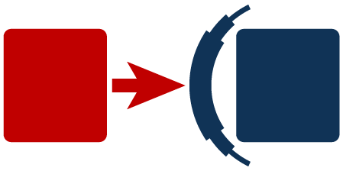
General staff
Everyone is a target
Entra ID
Identity and access management
IT administrators
Highly privileged roles
Microsoft 365
Outlook, Teams, SharePoint, …
Managed laptops Windows
Backoffice SaaS apps
Salesforce, …
Company website
Custom built
Cloud infrastructure
AWS, Azure, …
Remote access VPN
Perimeter device
On-prem infrastructure
Servers, …

Slide 71
Risk management
Risk
Risk appetite
Cybersecurity
Threats
Security

Slide 72
🫣 Unacceptable risk
Sleep comfortable 😴
🧑‍🎓 Very certain
Sound evidence
🚀
Improve
Some indication
🤷 Guessing / hoping

Slide 73
General staff
Everyone is a target
Entra ID
Identity and access management
IT administrators
Highly privileged roles
Microsoft 365
Outlook, Teams, SharePoint, …
Managed laptops Windows
Backoffice SaaS apps
Salesforce, …
Company website
Custom built
Cloud infrastructure
AWS, Azure, …
Remote access VPN
Perimeter device
On-prem infrastructure
Servers, …

Slide 74
General staff
Everyone is a target
Entra ID
Identity and access management
IT administrators
Highly privileged roles
Microsoft 365
Outlook, Teams, SharePoint, …
Managed laptops Windows
Backoffice SaaS apps
Salesforce, …
Company website
Custom built
Cloud infrastructure
AWS, Azure, …
Remote access VPN
Perimeter device
On-prem infrastructure
Servers, …

Slide 75
General staff
Everyone is a target
Entra ID
Identity and access management
IT administrators
Highly privileged roles
Microsoft 365
Outlook, Teams, SharePoint, …
Managed laptops Windows
Backoffice SaaS apps
Salesforce, …
Company website
Custom built
Cloud infrastructure
AWS, Azure, …
Remote access VPN
Perimeter device
On-prem infrastructure
Servers, …

Slide 76
Het is niet moeilijk maar het is wel moeite
— senior incident responder

Slide 77
It is not rocket science but it does take effort
— senior incident responder

Slide 78
General staff
Everyone is a target
Entra ID
Identity and access management
IT administrators
Highly privileged roles
Microsoft 365
Outlook, Teams, SharePoint, …
Managed laptops Windows
Backoffice SaaS apps
Salesforce, …
Company website
Custom built
Cloud infrastructure
AWS, Azure, …
Remote access VPN
Perimeter device
On-prem infrastructure
Servers, …

Slide 79
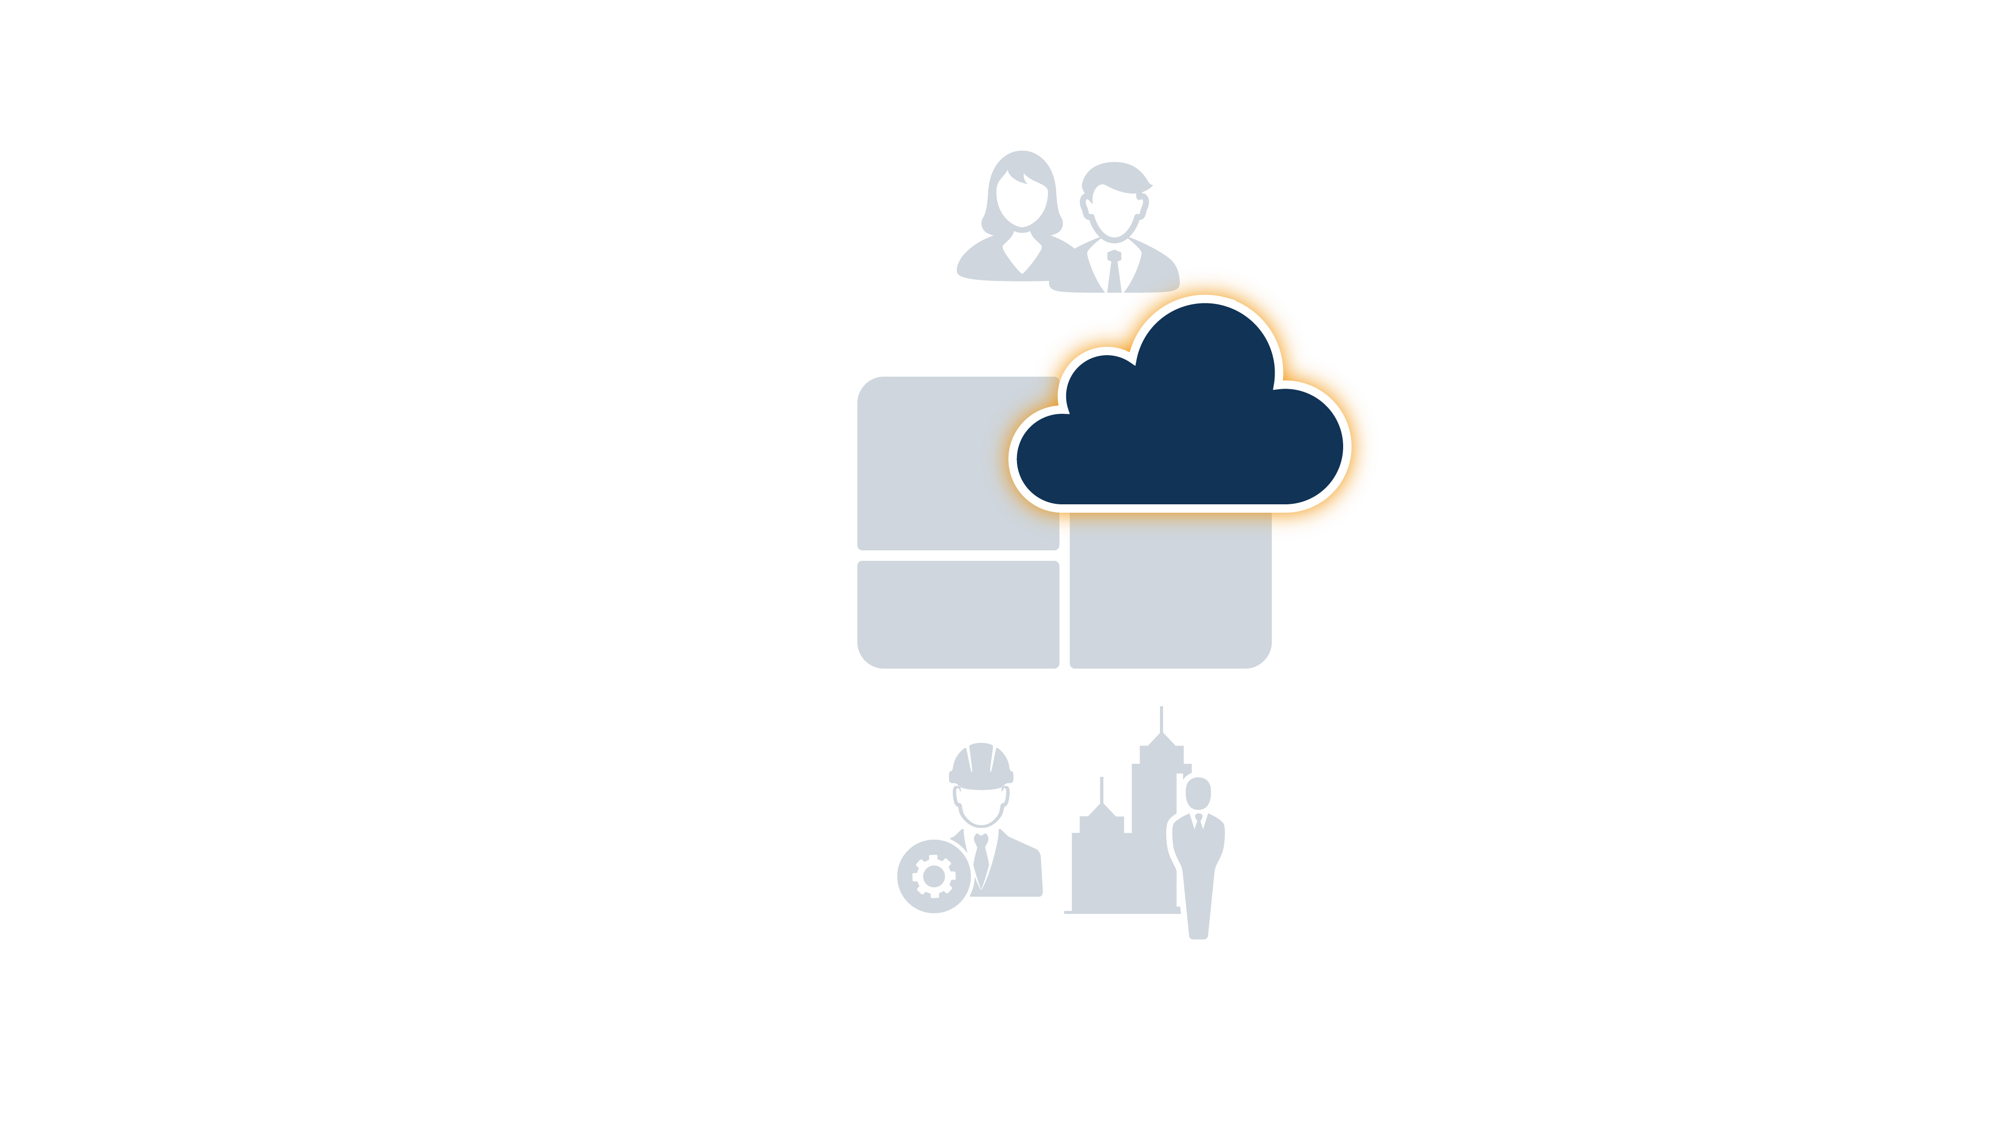
Entra ID
Identity and access management
?

Slide 80
More certainty
Starting points
Best practices
Hardened baseline configurations
Tools
Microsoft Secure Score
Cloud security posture management (CSPM)
Breach and attack simulation (BAS)
Experts
Penetration testing
Purple teaming
Red teaming
More security
Prevention
Best practices
Hardened baseline configurations
Detection
Scope of visibility
Scope of threats that are detectable
Response
First responders
Containment procedures
Backup and restore capabilities
More security
More certainty

Slide 81
More security
More certainty

Slide 82
Example case study: Entra ID
Microsoft Enterprise Access Model
Entra ID Protection
Entra PIM
Strong authentication
Regular incident response exercises
🧱
🧱
🔎
🚨
Security
Certainty
Purple teaming
🧑‍🎓
Threat modeling
🧑‍🎓
Microsoft Secure Score
🛠️
Microsoft best practices
✅

Slide 83
Example case study: Managed laptops
EDR
24/7 SOC
Vulnerability management
No BYOD
No local admins
Rapid contain and eradicate procedures
🧱
🔎
🧱
🚨
Security
Certainty
Purple teaming
🧑‍🎓
Breach and attack simulation (BAS)
🛠️
Microsoft Secure Score
🛠️
CIS Benchmark
✅

Slide 84
Example case study: Azure IaaS
Defender for Endpoint
Defender for Cloud,
24/7 SOC
Least privilege access control
Immutable backups,
Recovery procedures
🧱
🧱
🔎
🚨
Security
Certainty
Penetration tests, Security audits
🧑‍🎓
Threat intelligence,
Threat modeling
🧑‍🎓
Cloud security posture management (CSPM)
🛠️
Team security training and expertise
✅

Slide 85
Photo by Jason Leung on Unsplash

Slide 86
More acceptable risk
Risk management considerations:
Dependence of business on tech
Avoid, reduce, transfer, accept
🚀
More security
More acceptable risk
More certainty

Slide 87
Dissect cybersecurity into segments
For each, define how to determine (estimate!) security status
Based on the results, decide where to increase certainty and where to increase security
Iterate! Start small Build confidence
More security
More certainty

Slide 88
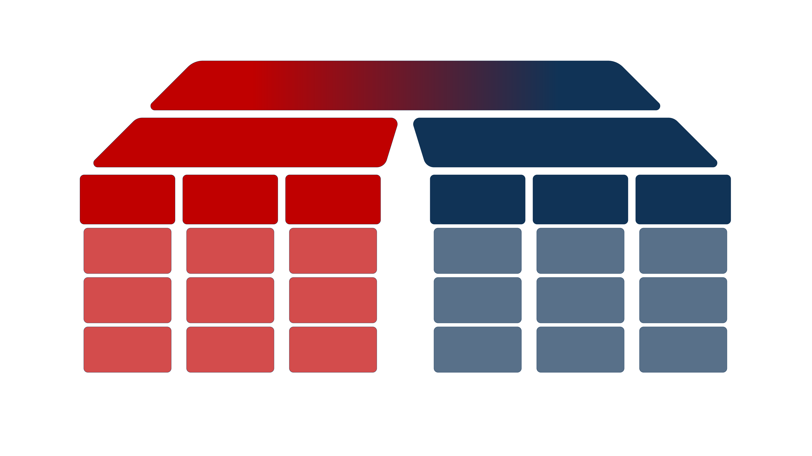
Cybersecurity complexity
How to think about threats
How to think about security
Strategic threats
Tactical threats
Trends
Decomposition
Cybersecurity risk
Examples
Cloud
Common segments
Cybersecurity and risk management
Entra ID
BYAD
Certainty and security
Managed laptops
Perimeter devices
Common estimation aids
Azure IaaS

Slide 89
Christo Butcher ◂ Executive Consultant ◂ Fox-IT (NCC Group)
①
A brief dive into general cyber security awareness
When: Thu November 7, 2024, 13:30
Where: Silent Presentation Area (track C)
②
Lessons from the trenches on managing cybersecurity, gaining control by breaking it down
When: Thu November 7, 2024, 16:00
Where: Frederick's (track D)

