Slide 1
The landscape of eduroam is changing, what to do?
Louis Twomey
HEAnet CLG
Nov 2024

Slide 2
Overview
Look at a typical eduroam architecture
How is the landscape changing?
Look at geteduroam architecture
How does geteduroam address the coming changes?
Q & A

Slide 3
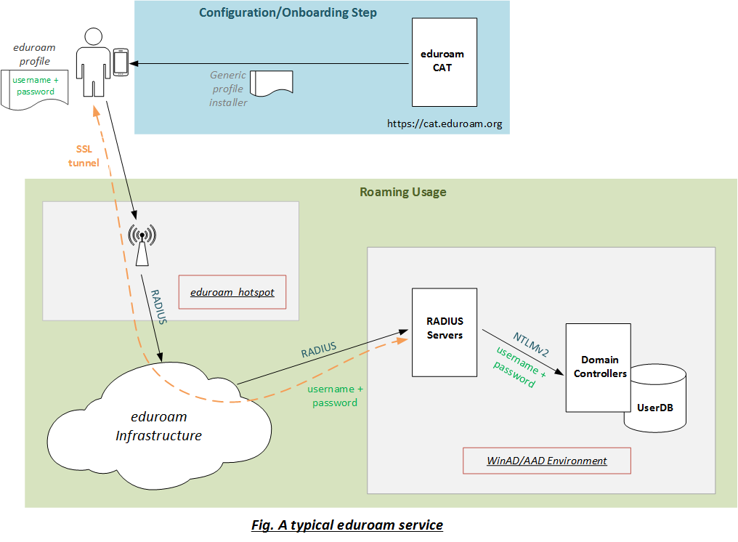

Slide 4
Typical eduroam architecture
eduroam CAT is not needed, but is strongly recommended
The user’s username/password are stored on the mobile device
A poorly configured mobile device exposes these valuable credentials
A new eduroam profile is needed if password expires or is changed
Tightly integrated with the back-end environment
Change back-end = change architecture e.g. migrate from WinAD to AAD
Blocking user from eduroam is tricky
Disable user account in DB is the simplest and most brutal option

Slide 5
How is the landsape changing?
Microsoft are eliminating support for NTLM in Windows Server
https://learn.microsoft.com/en-us/windows/whats-new/deprecated-features
“All versions of NTLM, including LANMAN, NTLMv1, and NTLMv2, are no longer under active feature development and are deprecated. Use of NTLM will continue to work in the next release of Windows Server and the next annual release of Windows.”
Will Negotiate work instead? Will AAD DS be affected?
Microsoft are moving away from passwords on Windows clients
https://learn.microsoft.com/en-us/windows/security/identity-protection/credential-guard/considerations-known-issues
“Microsoft recommends that in addition to deploying Credential Guard, organizations move away from passwords to other authentication methods, such as Windows Hello for Business, FIDO 2 security keys, or smart cards.”

Slide 6
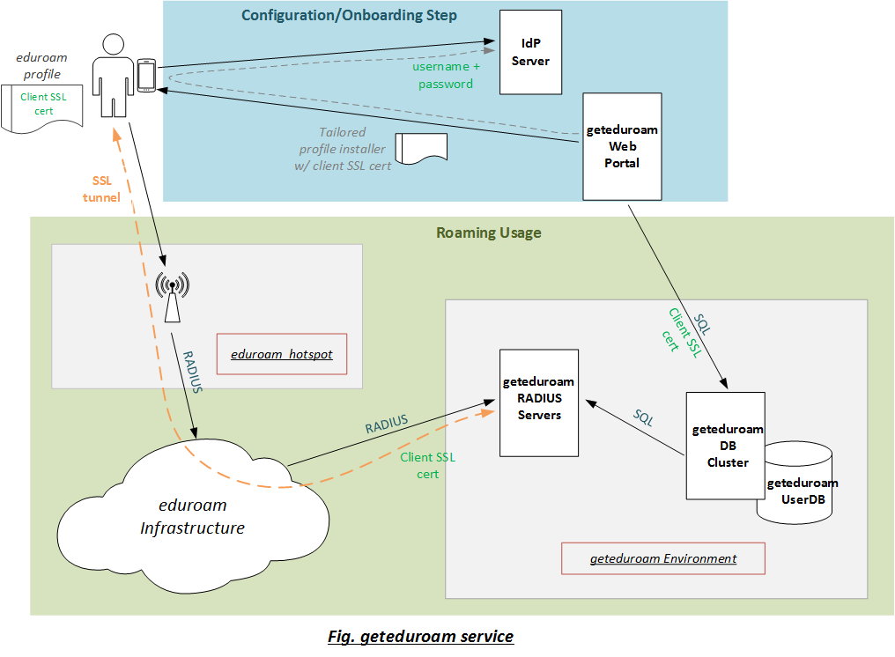

Slide 7
geteduroam architecture
geteduroam app, for consistency across platforms
Client SSL cert stored on mobile device, not username/password
Addresses concerns about credentials being exposed
New profile needed only when the client SSL cert expires (1yr)
Completely insulated from back-end environments
Leverages your existing IdP service
Blocking user from eduroam is easy
Revoke client SSL cert in DB (per mobile device or per user)

Slide 8
Q & A
Huh?

