Slide 1
IRLDAT: from Pilot to a Service Definition
- Niall Wilson, Irish Centre for High-End Computing
Notes:
1

Slide 2
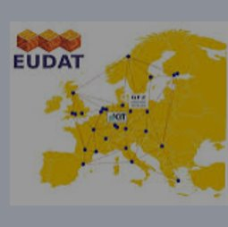
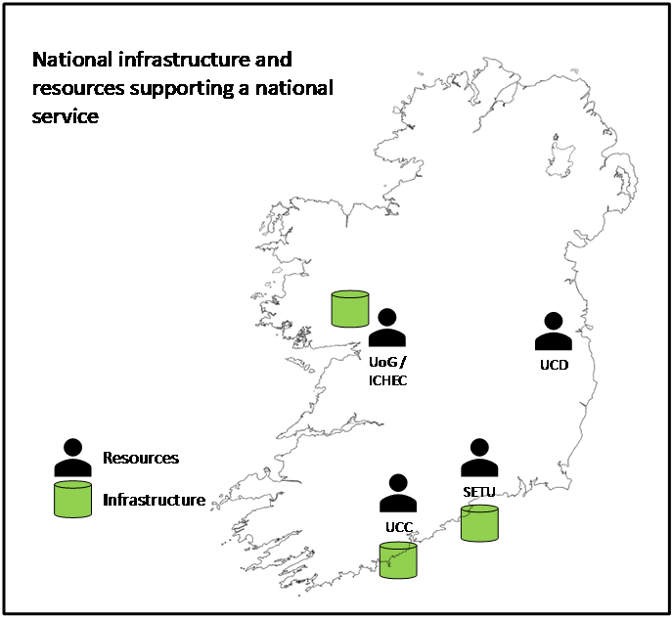
Project History (2022-2024)
Partners:
HEAnet: co-ordinator
EUDAT: expertise and technology provider
ICHEC, SETU, UCC, UCD: expertise and infrastructure providers
14 Use case proposals with 7 active use cases in the final pilot:
GeoData
IoT for smart roads
Life Sciences
Social Sciences
Humanities
Wider sector engagement through Stakeholder Advisory Forums (SAFs)
Develop and run a pilot. Leverage findings to develop the specification of a national production-quality and sustainable service.
Phase 1
Verify services on EUDAT European infrastructure with 2 use cases.
Phase 2
Onboard pilot users on
national infrastructure
Phase 3
Develop specification for a national production quality and sustainable service
Design and implement national pilot infrastructure

Slide 3
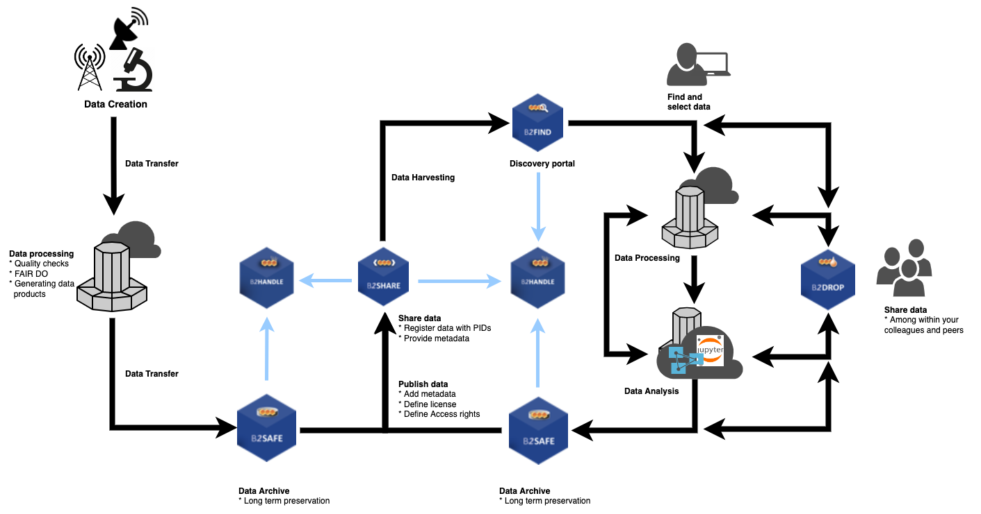
Note the B2* components in diagram are software components managed by EUDAT as part of a wider service catalogue. IRLDAT used B2ACCESS and B2DROP for the IRLDAT pilot project.
Research Data Life Cycle
Active data phase and IRLDAT service focus.
Notes:
3

Slide 4
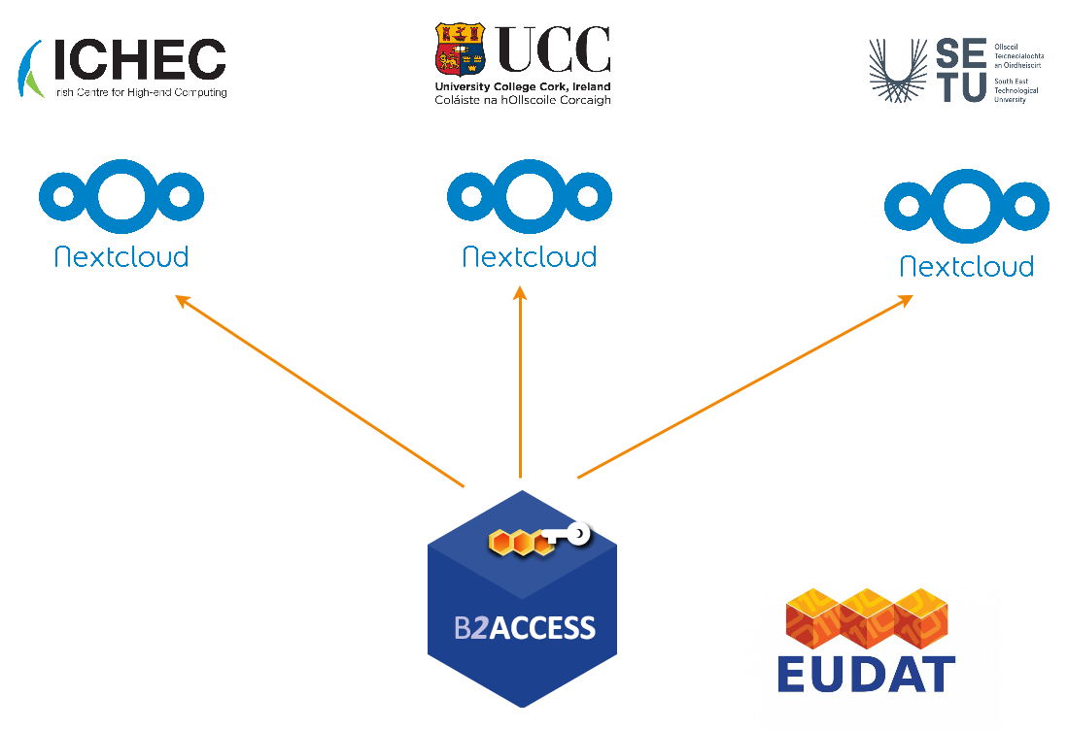
Pilot infrastructure & service
Technical team
ICHEC
SETU Walton Institute
UCC
UCD
Advisory
HEAnet
EUDAT
Jülich Supercomputing Centre
Surf
Notes:
4

Slide 5
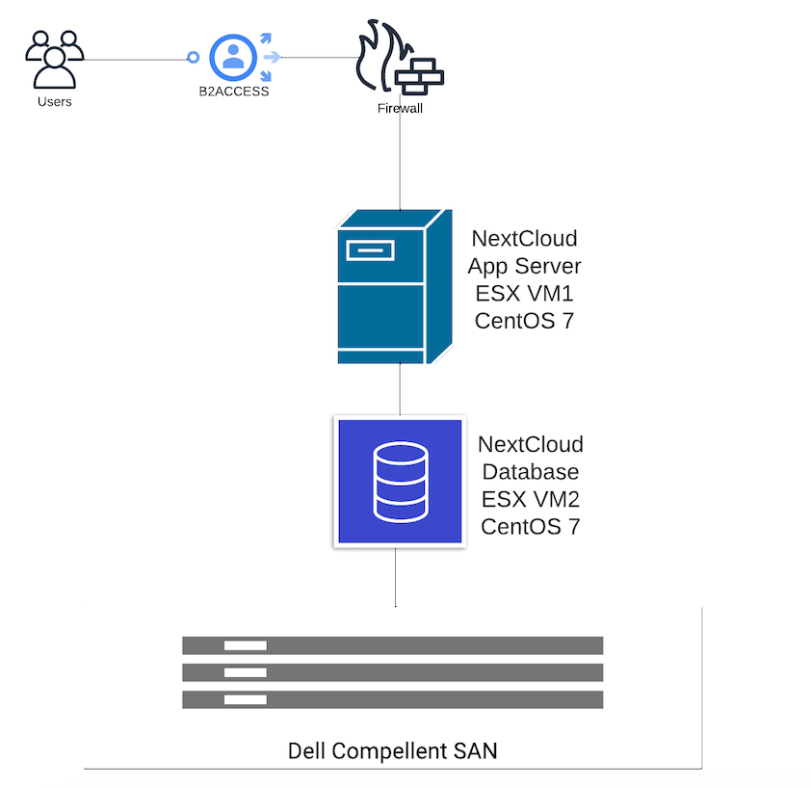
IRLDAT National Pilot Infrastructure Architecture: UCC instance
On-premise Nextcloud instance
Local Firewalls
Centos Linux OS VM running a Nextcloud application server and separate VM running a DB server
Nextcloud application server and DB server backed by a Dell SAN
Users from UCC, Tyndall, and Limerick onboarded via B2ACCESS

Slide 6
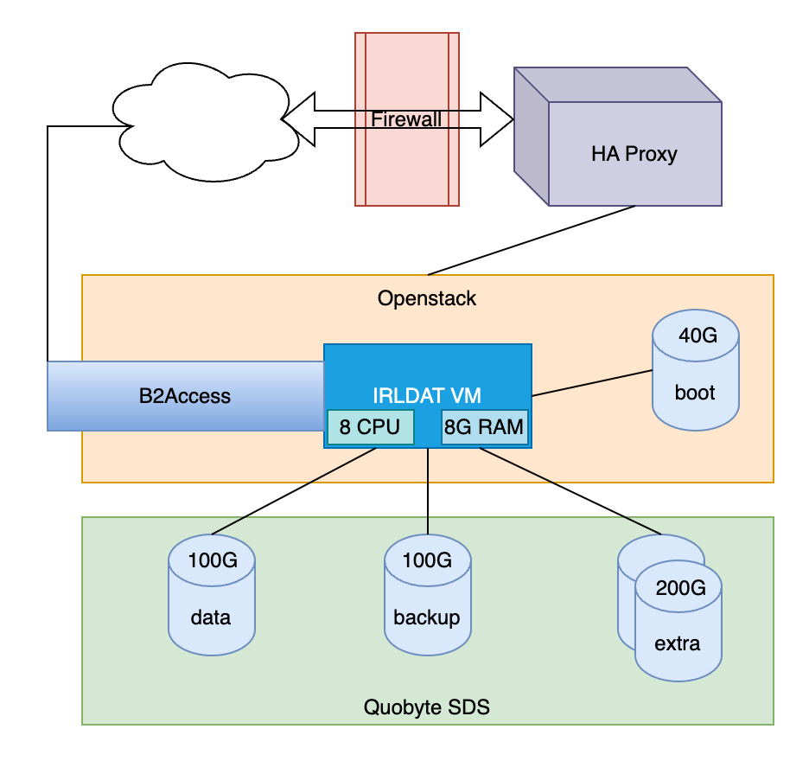
IRLDAT National Pilot Infrastructure Architecture: SETU instance
On-premise Nextcloud instance
Local Firewalls
Linux OS VM running a Nextcloud application server and DB server on OpenStack
Nextcloud application server and DB server backed by Quobyte Software Defined Storage system
Users from UCD, SETU onboarded via B2ACCESS

Slide 7
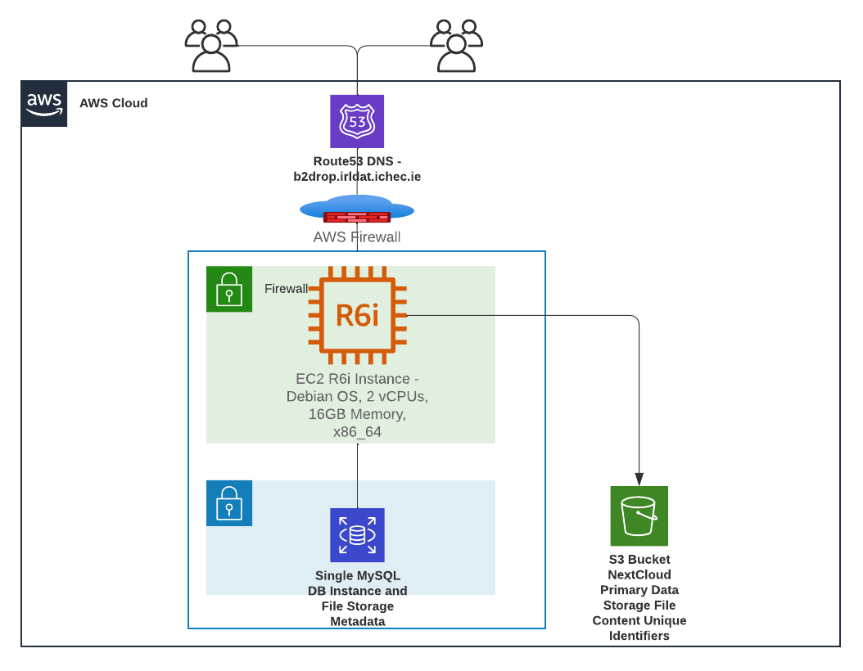
IRLDAT National Pilot Infrastructure Architecture: ICHEC instance
AWS Cloud Nextcloud instance
Firewalls at AWS VPC and VM instance layer
Debian Linux OS single VM running both the Nextcloud application server and MySQL DB server
Nextcloud data files are stored in an S3 bucket as the primary storage container
Users from UCD, ICHEC, Galway, and Yale onboarded via B2ACCESS

Slide 8
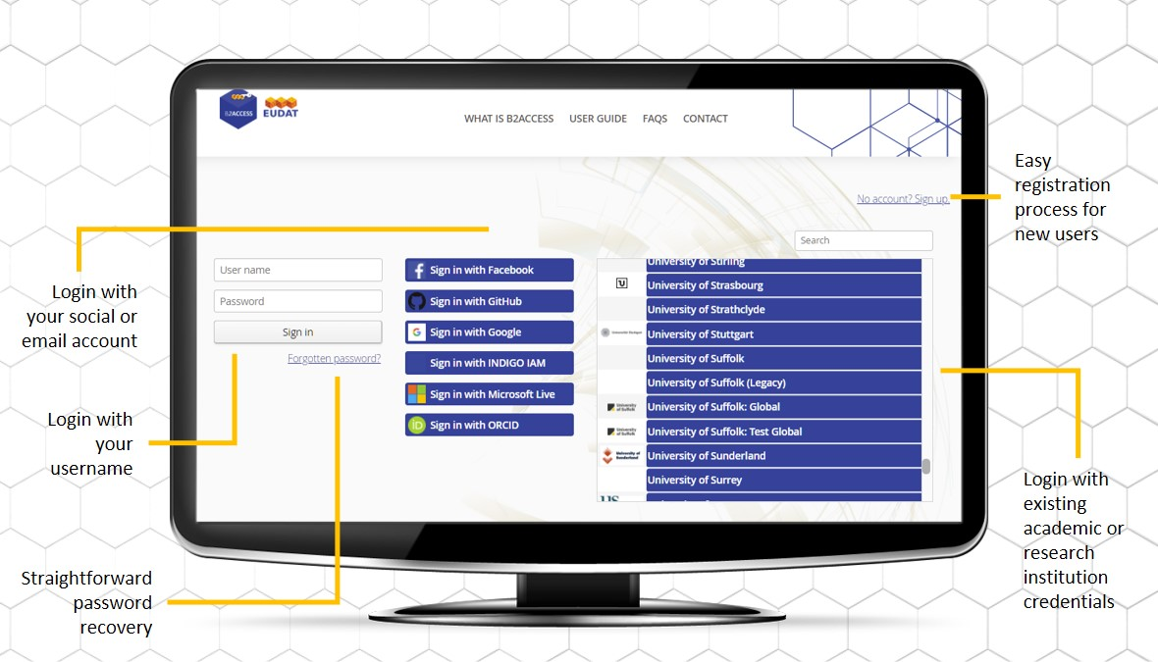
IRLDAT Infrastructure Architecture : B2ACCESS
Key service component on the IRLDAT pilot for onboarding users and facilitating Authentication using their HEI credentials and bypassing need to create additional local accounts (in most cases) on the Nextcloud instance
This was used as a central user management system for users and groups on the national IRLDAT pilot and provided Authorization
Users from commercial partners had option of using Social Identity Login (Google, Microsoft Live, or GitHub) or we could create local accounts for them
Notes:
8

Slide 9
Example Use Case: AISHT
Nextcloud UI with project folders for AISHT use case and share options on the folders.
Notes:
9

Slide 10
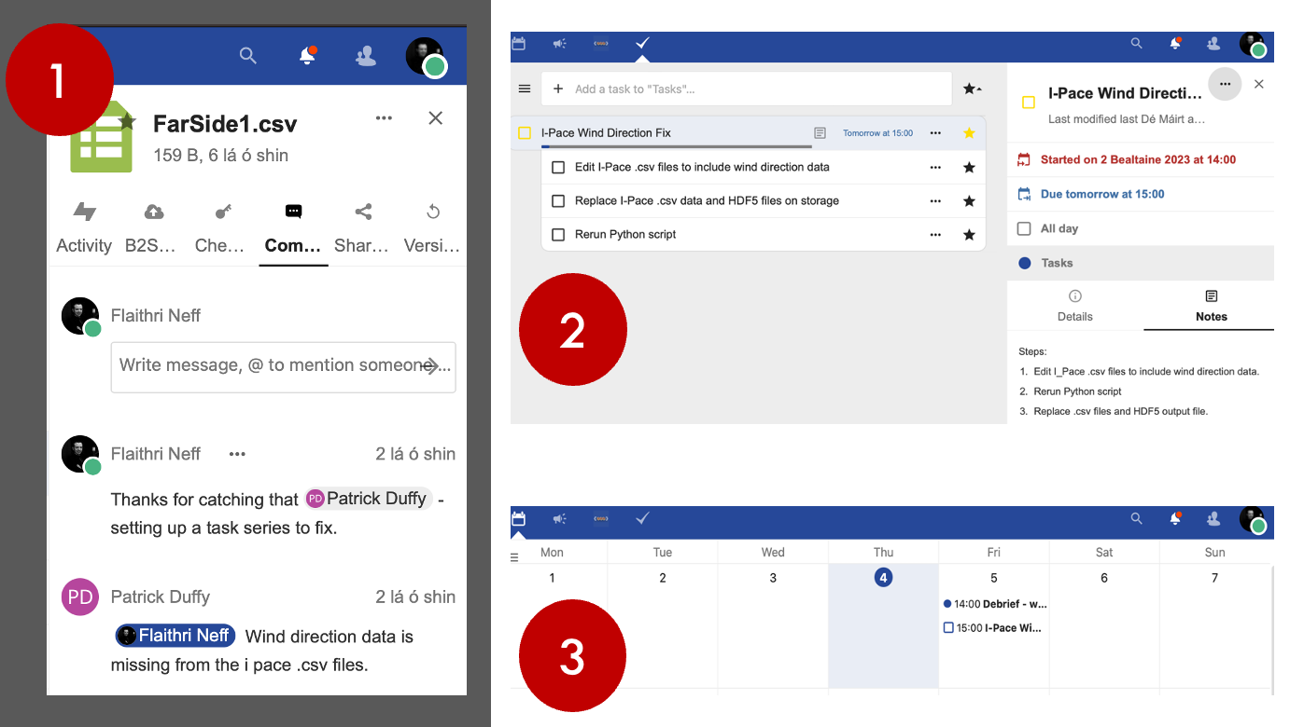
Example Use Case: AISHT
AISHT researchers demonstrating active data collaboration using Nextcloud UI with Comment directly on dataset within a single platform.
Notes:
10

Slide 11
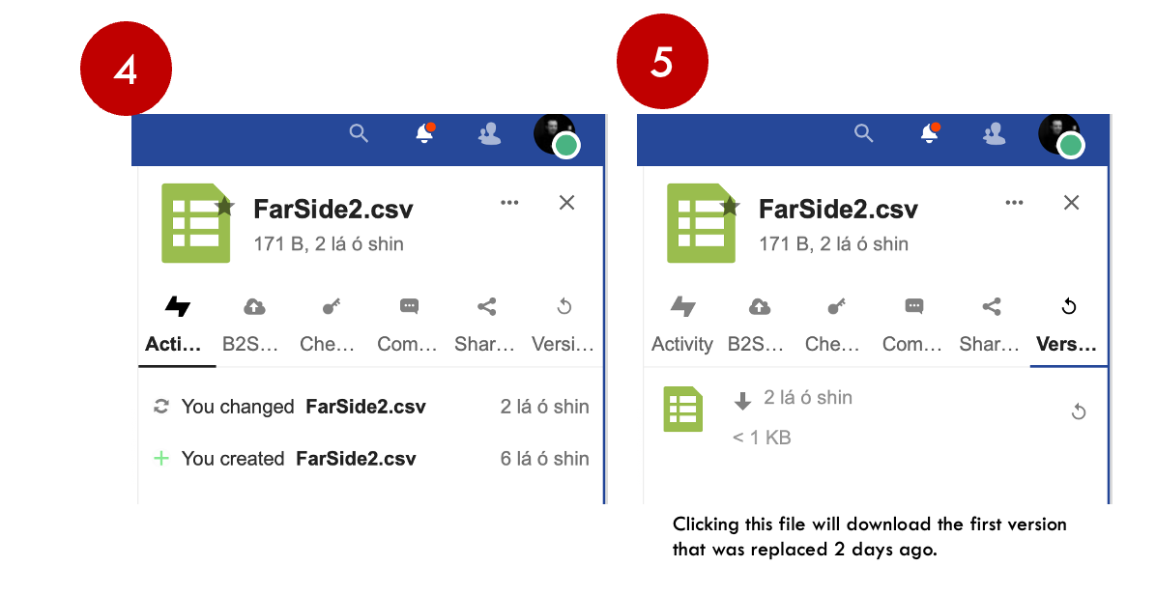
Example Use Case: AISHT
AISHT researchers demonstrating Nextcloud version management where they can fetch earlier file versions for a dataset file.
Notes:
11

Slide 12
Operations Duties
User Lifecycle Management
User Invitations for university users onboarding to IRLDAT national shared service
User Group Management in B2ACCESS Authorization and Authentication (AAI) service
User Shared Folder setup for PIs and Group assignment to root shared folder
User Storage Quota Management
User registration, onboarding technical support if any user registration or sign-in issues
Data syncing technical support for users
User account cleanup in B2ACCESS if user leaves IRLDAT national shared service project
System Management
Software Patching Maintenance, Software Release Version Upgrades (Nextcloud)
System Data Storage Management – File system, Database, Backups
System Security Management – Firewalls, OS Security Patches, Software Security Patches
Identity Provider (IDP) integration with B2ACCESS for user single-sign-on (Edugain)
Notes:
12

Slide 13
Similar services across Europe
Common theme that once the service is stable, limited resources needed to manage central service
On top of managing underlying infrastructure
Universities need a local contact / admin for first-level support
NREN | Capacity | N. Users | Central Staffing | Underlying infrastructure | Funding model
CARnet (Croatia) | 200TB | 600 | <1 FTE | On-prem cloud | Fully funded centrally
SWITCH (Swiss) | 600TB | >35K | ~1 FTE | On-prem cloud | Unis pay based on size
SUNET (Sweden) | 450TB | ~2000 (19 unis) | < 2 FTE | Safespring | Fixed unit charge
Notes:
13

Slide 14
IRLDAT Project Next Steps: 3 scenarios
Buy from EUDAT: a dedicated instance hosted and managed by EUDAT in Germany
Build on–prem leveraging existing infrastructure resources, starting small and growing to meet demand
Build on an IaaS provider, who provide the storage capacity and VMs required for the service
Notes:
14

Slide 15
Build or Buy
To scale up to a national productive service, the build option would require a step-up in following areas:
No. of users/researchers
Data storage and server infrastructure
Medium-to-long-term service duration (users expect 3 years minimum)
Resilience to data loss
Service availability and SLAs for end users who are accustomed to commercial sync and share tools like OneDrive and Google Drive
Security and Compliance – possible ISO27001 certification requirement
If we buy e.g. from EUDAT, then you get most of the above items immediately with a reputable organization already delivering to EU researchers and it would not prevent us migrating to our own national build solution longer term
Notes:
15

Slide 16
Next …
Project completed end Oct 2024. Recommendations report submitted to NORF:
Start with procuring dedicated service from EUDAT
Coordination and Level 1 technical support provided at National level
Mix of central funding for core services with HEIs paying annual subscription for units of storage + users
Based on uptake and growth:
Assess optimal path to sustainable hosting of service locally
Develop governance model and stakeholder involvement
Notes:
16

Slide 17
Questions?
Notes:
17

